Slide 1
The Renal System

Slide 2
Anatomy
Retroperitoneal , T12–L3 level and are 11–14 cm long.
The right kidney lies 1.5 cm lower → liver.
The kidneys move downwards during inspiration as the lungs expand.
kidneys receive ~25% of cardiac output.
Each kidney contains about one million nephrons.

Slide 3
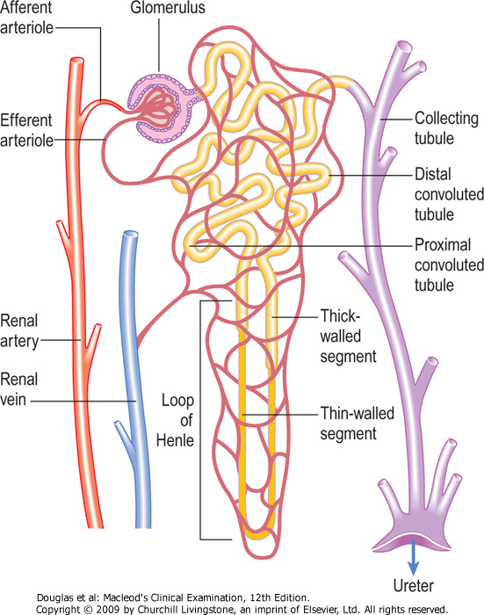

Slide 5
Function
excretion of waste products of metabolism
maintaining salt, water and electrolyte homeostasis
regulating blood pressure via the renin–angiotensin system
endocrine functions related to erythropoiesis and vitamin D metabolism.

Slide 6
The bladder → reservoir. As it fills, it rises out of the pelvis in the midline towards the umbilicus.
The bladder wall contracts under parasympathetic control, allowing urine to pass through the urethra (micturition).
The conscious desire to micturate occurs when the bladder holds ~ 250–350 ml of urine.
Renal capsule and ureter are innervated by t8- l2 nerve root

Slide 7
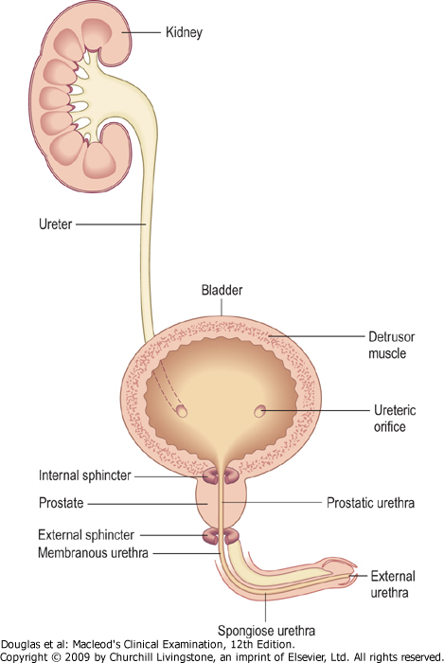

Slide 8
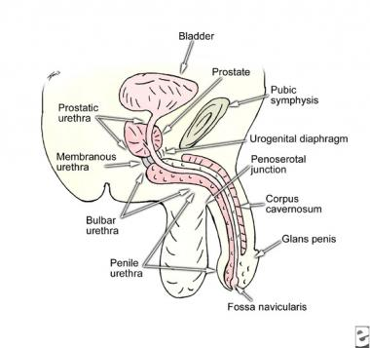
Anatomy
The male urethra runs from the bladder to the tip of the penis:
Prostatic urethra
Membranous
Bulbar
penile
The female urethra is much shorter.
Two muscular rings acting as valves (sphincters) control micturition:
• The internal sphincter is at the bladder neck and is involuntary.
• The external sphincter surrounds the membranous s2-4

Slide 9
Symptoms and Definitions
Severe renal disease may be asymptomatic, or have nonspecific symptoms, such as tiredness or breathlessness from renal failure or associated anemia. poor appetite, sleep disturbance, etc...
Growth retardation is common with CKD in childhood.
Detection often follows incidental testing of blood and urine.

Slide 10
Dysuria: (voiding pain) is pain during or immediately after passing urine, often described as a ‘burning’ sensation felt at the urethral meatus.
Ask about : associated symptoms(cystitis) /systemic symptoms( pyelonephritis )/ urine outflow obstruction symptoms/ sexual contacts
Prostatitis may cause perineal and rectal pain at the same time.

Slide 11
Ureteric colic (‘renal colic’)
• Site – unilateral, in the renal angle and flank area
• Onset – sudden
• Character – usually very severe and sustained, may vary cyclically in intensity
• Radiation – may radiate to the iliac fossa, the groin and the genitalia/ testes
• Associated features – patient is usually restless and nauseated, and often vomits
• Timing – may last for several hours.
• Exacerbating/relieving factors – analgesia
• Severity –often very severe .
• Similar – distinguish from intestinal colic or biliary pain, appendicitis, torsion of an ovarian cyst, ruptured ectopic pregnancy.

Slide 12
Loin Pain
Renal angle or loin pain is due to stretching of the renal capsule or renal pelvis → infection, inflammation or mechanical obstruction.
Constant loin pain, with systemic upset, fever, rigors and pain on voiding, suggests upper UTI (acute pyelonephritis).
Chronic dull, loin discomfort may occur with chronic renal infection and scarring from vesicoureteric reflux, adult polycystic kidney disease (APKD) or chronic urinary tract obstruction.

Slide 13
Voiding symptoms
Lower urinary tract symptoms may be:
• during the storage phase of micturition
• during the voiding phase of micturition
• incontinence

Slide 14
Storage symptoms
Frequency is a desire to pass urine more often than usual >6times/day
• Urgency – a sudden strong need to pass urine.
Urgency is due to either overactivity in the detrusor muscle or abnormal stretch receptor activity from the bladder (sensory urgency).
• Nocturia – waking one or more at night to void.
Storage symptoms are usually associated with bladder, prostate or urethral problems, e.g. lower urinary tract infection, tumour, urinary stones or obstruction from prostatic enlargement, or are a consequence of neurological disease.

Slide 15
Voiding phase symptoms
Hesitancy is difficulty or delay in initiating urine flow.
Dribbling and incomplete emptying are caused by bladder neck obstruction, but if they are associated with storage symptoms, may indicate abnormal detrusor function.
Poor stream
In men over 40 this is commonly due to bladder outlet obstruction by prostatic enlargement.
In women these symptoms suggest urethral obstruction from stenosis or in association with genital prolapse.

Slide 17
Incontinence
urge incontinence : Involuntary release of urine may occur with a need to void , occurs when the detrusor is overactive.
stress incontinence : result from an increase in intra-abdominal pressure, occurs in women due to weakness of the pelvic floor, usually following childbirth.
mixed incontinence: combination of both
Enuresis is incontinence during sleep, and common in childhood. In adults it suggests bladder outlet obstruction or abnormalities of the wakening mechanism.

Slide 20
Abnormalities in urine volume and composition
Healthy adults produce 2–3 litres of urine per day, equivalent to their fluid intake minus insensible fluid losses through the skin and respiratory tract (500– 800 ml/day).

Slide 21
Polyuria
Polyuria is an abnormally large volume of urine, and is most commonly due to excessive fluid intake.
>3 L /day
psychogenic polydipsia
Polyuria also occurs when the kidneys cannot concentrate urine:
extrarenal, e.g. diuretic drugs; DM, DI, Addison’s disease.
Renal causes : nephrogenic diabetes insipidus

Slide 22
Oliguria
<500 ml/day. It may be appropriate with a very low fluid intake or mechanical obstruction , but may also indicate loss of kidney function.
The minimum urine volume needed to excrete the daily solute load varies with diet, physical activity and metabolic rate, but is at least 500 ml/day.
Acute renal failure is usually associated with oliguria .

Slide 23
Anuria
Anuria is the total absence of urine production. < 50 per day
Exclude urinary tract obstruction, which may be lower (bladder neck or urethral obstruction causing acute urinary retention) or upper, e.g. a ureteric stone in a patient with a single functioning kidney.

Slide 24
Pneumaturia
passing gas bubbles in the urine, is rare.
It may be associated with faecuria, when faeces are voided. It suggests a fistula between the bladder and the colon, from a diverticular abscess, cancer or Crohn’s disease.

Slide 25
Haematuria
Non-visible haematuria occurs in renal or urinary tract disease, especially if associated with proteinuria, hypertension, raised serum creatinine or reduced estimated glomerular filtration rate.
Visible haematuria may be due to urinary tract infection with its associated symptoms but should be investigated, if painless→ cancer of the kidney, bladder or prostate.
Investigate all patients >40 years with haematuria (visible or non-visible).
contamination of the urine by blood from the female genital tract during menstruation.
Free haemoglobin in the urine due to haemolysis, myoglobin in rhabdomyolysis and other abnormalities of urine colour may mimic haematuria
Ask about : loin pain ,lower urinary symptoms, family hx

Slide 28
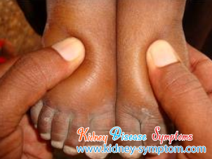
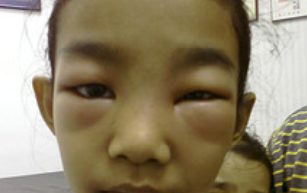

Slide 29
Proteinuria
Proteinuria is excess protein in urine and indicates kidney disease.
It is usually asymptomatic and detected by urinalysis
most commonly glomerulonephritis or diabetic nephropathy.
>3.5 g/ day in adults or 1g/ m2/day in children → nephrotic syndrome
More than 150 mg/day (Except children and pregnancy; 300 mg/d)
Proteinuria may occur in normal patients with febrile illness. Orthostatic proteinuria is proteinuria <1 g/l which disappears when lying down
Severe proteinuria may produce frothy urine. May reduce the plasma oncotic pressure, the patient develops generalised oedema
Ask about : wt loss , ankle swelling , sob , abdominal swelling

Slide 31
ACUTE KIDNEY INJURY
Abrupt elevation in serum cr conc. Or a decrease in urine output
It may have prerenal , renal and postrenal causes
PRERENAL
RENAL
POSTRENAL

Slide 32
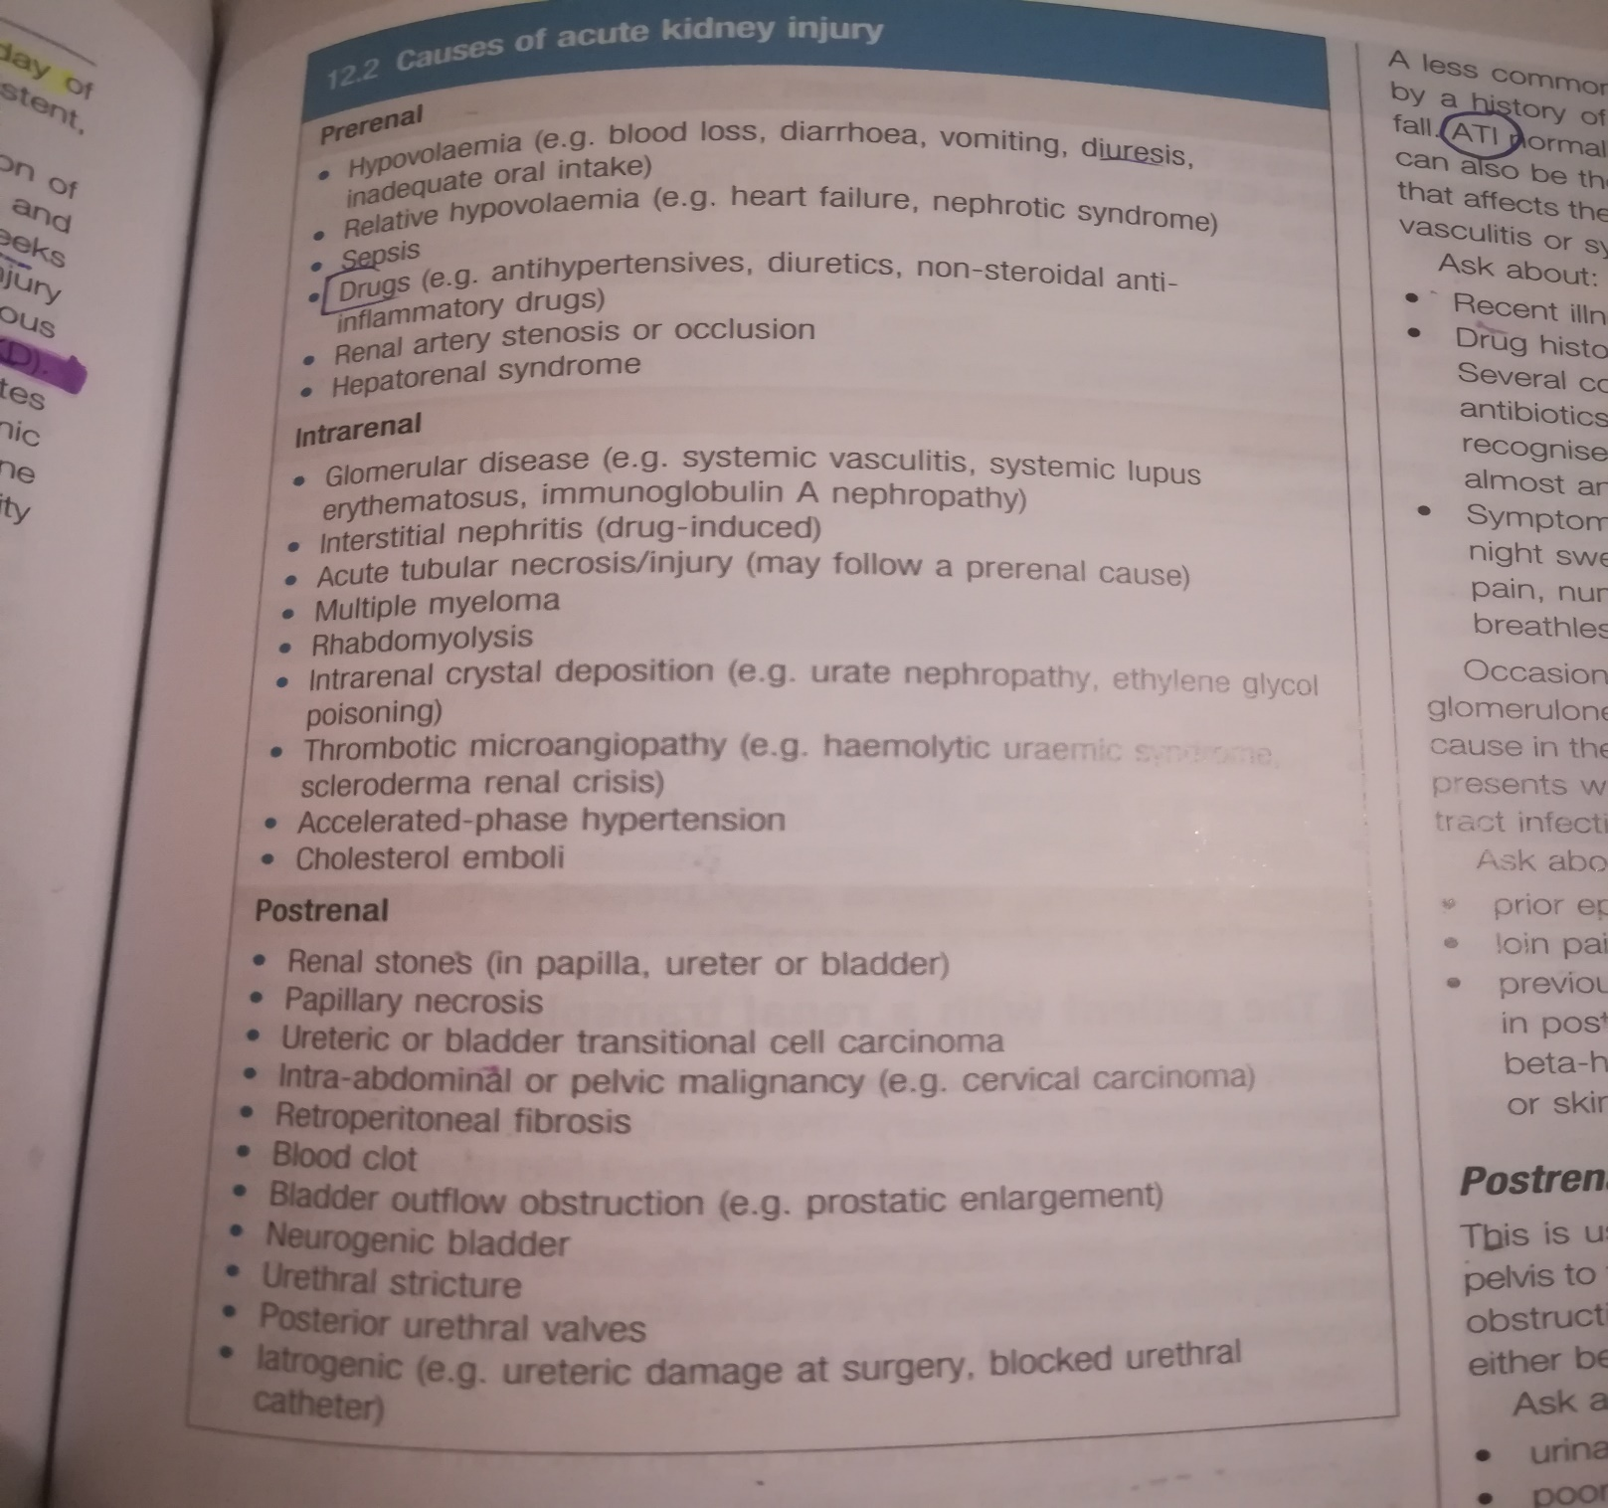

Slide 33
CHRONIC KIDNEY DISEASE
Alteration in kidney function or structure for more than 3 months
Look for underlying conditions that may explain the etiology of CKD:
HTN , DM , VASCULAR D. ( MI /PAD /STROKE) , HYPERLIPIDEMIA , EPISODES OF ACUTE GN , NEPHROTIC SYNDROME
PROTEINUREA OR HAEMATUREA MAY SUGGEST A GLOMERULAR D,
DETAILED FHX IS REQUIRED AS A NUMBER OF GENETIC DISEASES MAY PRESENT WITH CKD

Slide 34
END STAGE RENAL DISEASE AND URAEMIA
Most commonly when the estimated GFR less than 10ml/min/1.73m2
Poor conc , lethargy, anorexia ,n ,v pruritus , sob, pirephral edema
Less commonly pericarditis and periphral neuropathy

Slide 35
DIALYSIS PATIENTS
HAEMODIALYSIS : via arteriovenous fistula
The fistula has an obvious thrill
The most common problem here is infection
PERITONEAL DIALYSIS :via a tunnelled catheter
Infection is also common here

Slide 36
Past history
Ask about any previous history of renal system disease.
• hypertension (which may cause or result from renal disease)
• diabetes mellitus (associated with diabetic nephropathy and renovascular disease)
• vascular disease at other sites (which makes renovascular disease more likely)
• past history of urinary tract stones or surgery
renal disease
• recurrent infections (particularly urinary infection which may be associated with renal scarring, and upper respiratory infections which may be associated with glomerulonephritis and/or vasculitis)
• anaemia (which may be due to CKD).

Slide 37
Drug history
Drugs which accumulate in renal failure, such as digoxin, lithium, aminoglycosides, opioids and water soluble beta-blockers, e.g. atenolol.
Drugs which may affect renal function include angiotensin-converting enzyme inhibitors, angiotensin receptor antagonists and NSAIDs.
Aminoglycosides, amphotericin, lithium, ciclosporin, tacrolimus and, in overdose, paracetamol are toxic to normal kidneys.

Slide 38
Family history
The most common inherited conditions are APKD (autosomal dominant) and Alport’s syndrome (X-linked dominant) .
APKD is associated with subarachnoid haemorrhage from intracranial berry aneurysms;
Alport’s syndrome is associated with high-tone sensorineural deafness.

Slide 40
Social history
End-stage renal disease requiring dialysis and/or transplantation has major implications for lifestyle, employment and relationships. Similarly
incontinence has major implications for daily living.
Smoking.
Take a dietary history in patients with renal stones and patients with CKD.

Slide 41
Occupational history
Exposure to organic solvents may cause glomerulonephritis.
Aniline dye and rubber workers have an increased incidence of urothelial cancer.
Long term exposure to lead and cadmium may cause renal damage.

Slide 42
THE PHYSICAL EXAMINATION
Physical examination may be normal, even with significant kidney disease

Slide 44
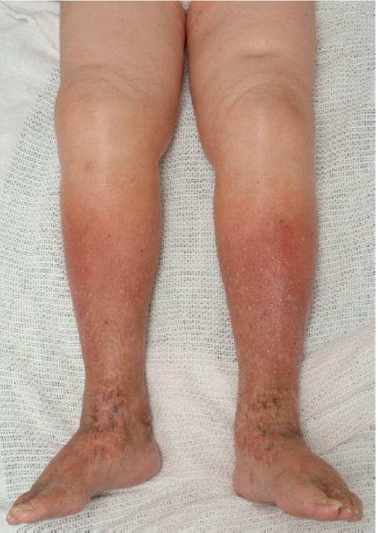

Slide 45
Examination sequence
Assess the patient’s general appearance and conscious level.
■ Look for fatigue, pallor, breathlessness, uraemic complexion, cushingoid appearance and hirsutism.
■ Measure the temperature + vs ( bp( + postural ) , hr
■ Look at the eyes for anaemia.fundoscopy
■ Note any bruising or excoriation.
■ Examine the hands for nail changes, vasculitic rash
■ Look for a coarse flapping tremor
■ Smell the patient’s breath for uraemic fetor.
■ Assess hydration by checking skin turgor, eyeball tone, JVP and presence of oedema , dry mucus membrane , weight assessment , fluid balance chart

Slide 46
Abdominal examination
Inspection
■ Look for distension (from the enlarged kidneys of APKD,ascites ,and suprapubically from bladder distension.
■ Look in the loins for scars of renal tract surgery and in the iliac
fossa for those of transplant surgery.
You may see a catheter for peritoneal dialysis or small scars left by one in the midline and hypochondrium.

Slide 47
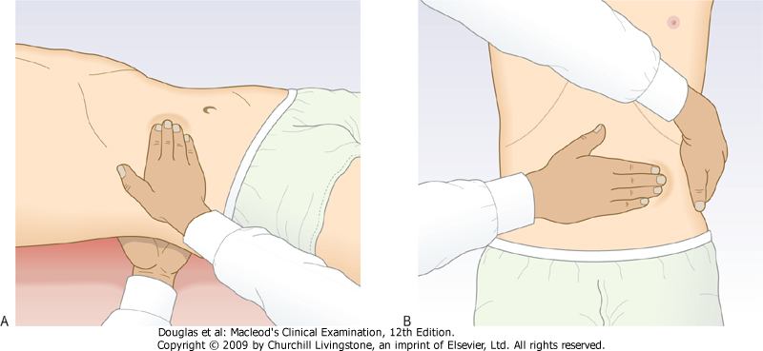
Palpation
■ palpate the kidneys.
■ If the kidney is palpable, assess its size, surface and consistency.
■ Ask the patient to sit up. Palpate the renal angle

Slide 48
Use the fingers of your right hand. Start in the right lower quadrant and palpate each area systematically A distended bladder is felt as a smooth firm mass arising from the pelvis which disappears after urethral catheterization. Polycystic kidneys have a distinctive nodular surface.
To detect lesser degrees of kidney enlargement, place your left hand behind the patient's back below the lower ribs and your right index finger against the 12th rib . Firmly, but gently, push your hands together as the patient breathes out. Ask the patient to breathe in deeply; feel for the lower pole of the kidney moving down between your hands. If this happens, gently push the kidney back and forwards between your two hands to demonstrate its mobility. This is ballotting, and confirms that this structure is the kidney.
Ask the patient to sit up. Palpate the renal angle firmly but gently. If this does not cause the patient discomfort, firmly (but with moderate force only!) strike the renal angle once with the ulnar aspect of your closed fist after warning the patient what to expect

Slide 49
Percussion
Percussion of the kidneys is unhelpful.
Enlarged kidney >> resonant
■ Percuss for the bladder over a resonant area in the upper abdomen in the midline and then down towards the symphysis pubis.
■ Test for ascites, which may be found in nephrotic syndrome or in patients having peritoneal dialysis.

Slide 50
Auscultation and...
■ Auscultate for bruits arising from the renal arteries.
■ Test for ascites, which may be found in nephrotic syndrome or in patients having peritoneal dialysis.
■ In men examine the external genitalia and perform a rectal examination to assess the prostate for benign or malignant change.

Slide 51
Cardiovascular examination
Examination sequence
■ Measure the pulse and blood pressure
■ Assess the JVP
■ Palpate the apex beat.
Auscultate for:
Quiet heart sound
■ a mid-systolic ‘flow’ murmur
■ third or fourth heart sounds
■ pericardial friction rub.
Look for pitting oedema in the ankles, the sacrum, and the
back of the thighs in recumbent patients

Slide 52
Respiratory examination
Measure the respiratory rate
• Percuss the chest to detect pleural effusions.
• Auscultate for bilateral basal lung crackles indicating fluid overload or heart failure.

Slide 53
Nervous system
Assess level of consciousness .
• Test sensation and the tendon reflexes .
• Examine the optic fundi .
Peripheral neuropathy ( dm )

