Slide 1
Peripheral Vascular System

Slide 2
*How common?
- around 20% of population >60 YO
- only 1/4th are symptomatic.
- legs 8X more commonly affected than arms
* General cause?
>> atherosclerosis of large & medium-sized vessels.
.

Slide 3
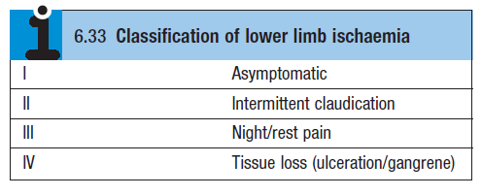
LLI

Slide 4
Asymptomatic Ischemia
Significant LLI = ABPI <0.9 at rest.
Mostly asymptomatic
choose not to walk very far, or
exercise tolerance is limited by other co-morbidity.
Even if the patient is symptomatic, they should be treated as if grade II (IC)

Slide 5
Intermittent Claudication
Most common symptom of PAD
* Def.: Pain in a group of muscles on walking due to arterial insufficiency.
- typically; Calf (femoro-popliteal disease).
- also; Thigh &/or buttock (aorto-iliac obstruction).
Tightness or ‘cramp-like’ pain.
Develops after relatively constant distance (claudication distance) ; often shorter if walking uphill, in the cold & after meals.
Disappears completely within a few minutes of rest but recurs on walking.
Notes:
total waking distance is the distance the patient can walk before the pain gets so severe the should stoal common p
Male pts who have bilateral common iliac or intrna iliac artery occlusion may develop lerich sy drome (butto claudication and erectile dysfunction )
Claudication by itself is not limb threatening,

Slide 6
>> Two other types of claudication:
• Neurogenic: due to neurological & musculo-skeletal disorders of lumbar spine.
• Venous: due to venous outflow obstruction from the leg, following extensive DVT.
>> Both are much less common than arterial claudication, & can be distinguished on Hx. & P/E.

Slide 7
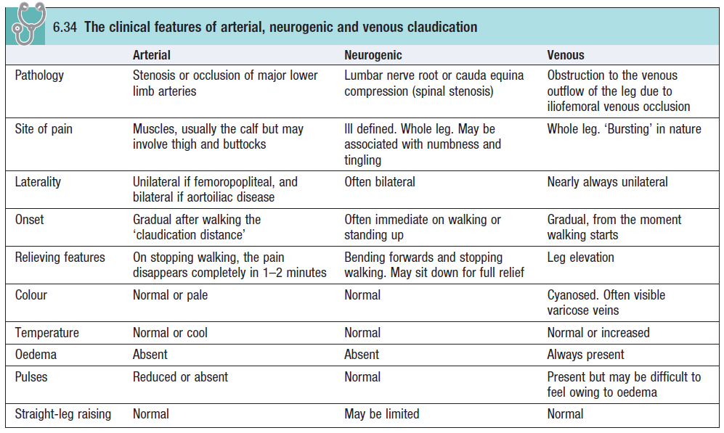

Slide 8
Night/Rest Pain
‘ Pt. goes to bed, falls asleep, but is then woken 1–2 hrs later with severe pain in the foot, usually in the instep ’
 Lying down >> No gravity effects >> poor perfusion.
 Dec. HR, BP & CO >> occurs when sleeping.
Relieved by hanging legs out of bed or by getting up & walking around. However, on return to bed, pain recurs & pts often choose to sleep in a chair.
Further reduction in tissue perfusion & ultimately a worsening of pain.
Dependent edema, ⬆ interstitial tissue pressure.

Slide 9
Critical limb ischemia
Rest pain persisting for more than 2 weeks requiring opiate analgesia
Tissue loss associated with ankle pressure of <50mmhg or toe pressure < 30 mmhg , , ABI <0.4 & a +ve Buerger’s test

Slide 10
A ‘red flag’ symptom
* Indicates severe, multilevel LL PAD.
* Mandates urgent referral to a vascular surgeon
>> As failure to re-vascularise >> critical LLI with tissue loss
(gangrene, ulceration) & amputation.
Rest Pain vs. Diabetic Neuropathy
* Both may be worse at night.
* Neuropathic pain: - usually not confined to the foot,
- burning, tingling or numbness (dysaesthesia),
- Not relieved by dependency,
- Many pts cannot even bear bedclothes pressure on their feet.

Slide 11
Tissue loss
(ulceration &/or gangrene)
In severe LL PAD, even trivial injuries to feet fail to heal.
This allows bacteria to enter, leading to gangrene &/or ulceration.
Without re-vascularisation; leads quickly to amputation &/or death
* critical limb ischaemia (rest pain, tissue loss) typically have an ankle BP <50 mmHg, ABI <0.4 & a +ve Buerger’s test.

Slide 12
Signs of lower limb PAD
Absence of hair.
Thin skin.
Brittle nails.
Notes:
* Muscle tenderness is a grave sign indicating impending muscle infarction.

Slide 13
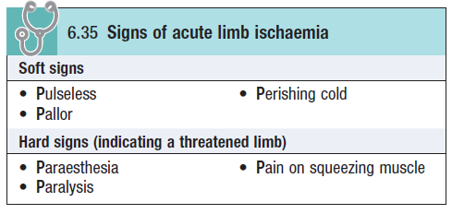
Acute LLI
Irreversible damage unless circulation is restored within a few hours.

Slide 14
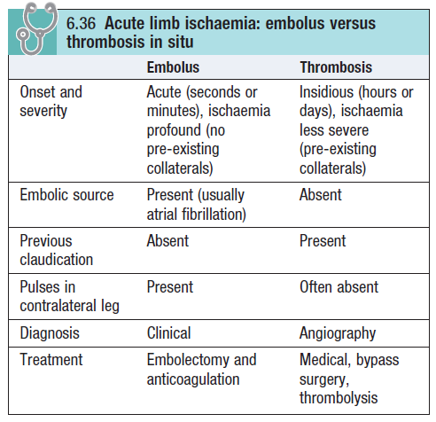

Slide 15
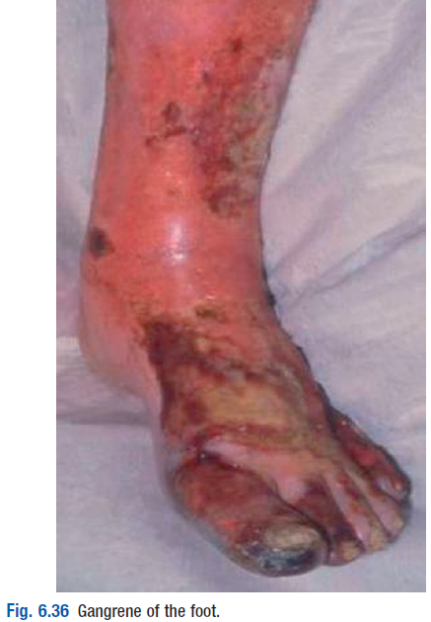

Slide 16
Compartment Syndrome
* Def. >> increased pressure within the fascial compartments of the limb, most commonly the calf, which compromises
perfusion & viability of muscle & nerves.
* Causes: commonest >> 1. lower trauma, (e.g. fractured tibia),
2. reperfusion following tt of acute LLI.
* Failure to recognize & treat >> may require limb amputation!
* The key symptom >> severe pain often unrelieved by opioids & exacerbated by active or passive movement. Peripheral pulses are usually present.

Slide 17
Mesenteric ischemia
The three major visceral arteries
(celiac trunk, SMA & IMA).
Chronic mesenteric arterial insufficiency:
2/3 must be critically stenosed or occluded as there is Rich collateral circulation.
Severe central abdominal pain typically develops 10–15 min post-prandial. “scared of eating” + significant wt. loss.
Diarrhea may occur.
Confirmed by Angiography.

Slide 18
Acute mesenteric ischemia:
“surgical emergency”
Severe abdominal pain,
Shock,
Bloody diarrhea,
Profound metabolic acidosis.
Rarely, renal angle pain occurs from renal infarction or ischaemia, & is associated with microscopic or macroscopic hematurea.

Slide 19
Abdominal Aortic Aneurysm
Def. >> Abnormal focal dilatation of aorta.150%
How common? 5% of men aged >65 yrs (3X more in men)
Risk factors >> smoking, HTN, familial/genetic element.
Mostly asymptomatic until rupture and usually Dx incidentally on CT scan or alternative imaging done for other reasons
symptoms &/or back pain or awareness of abdominal pulsation, observation of ripples in the water when they are in the bath (wave sign)
Confirm Dx. >> US.
* Now, In UK, US-based AAA screening program for men as they reach their 65

Slide 20
Ruptured AAA
Difficult to diagnose!
>> many pts do not have the classical features which are: abdominal &/or back pain, pulsatile abdominal mass , syncope & shock (hypotension).
If any suspicion >> call a vascular surgeon straight away >> immediate contrast-enhanced CT abdomen (if pt is stable).
You should lways have low threshold of suspicion
‘blue toe syndrome’: purple discoloration of toes & forefoot of both feet. Due to athero-embolism from an AAA,poplitial aneurysm, atherosclerotic plaque . Usually full set of pedal pulses.risk of major emboli
Herald the risk of a major embolus eading to acute limb ischemia and even limb loss

Slide 21
Vasospastic Symptoms
Reynaud's phenomenon
Digital ischaemia induced by cold.
Three phases:
• Pallor: due to digital art. spasm &/or obstruction.
• Cyanosis: due to deoxygenation of static venous blood
(this phase may be absent).
• Redness: due to reactive hyperemia.
Pts >40YO with unilateral Raynaud’s phenomenon have underlying PAD unless proven otherwise, especially if they have risk factors (smoking, diabetes).

Slide 22
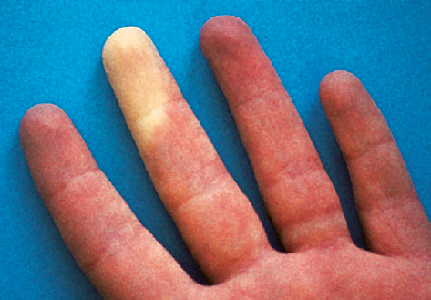
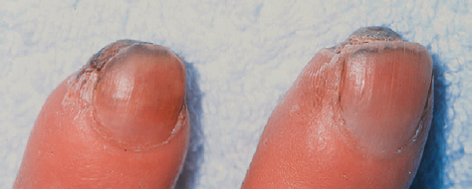
Notes:
ادخال النية في كل شيء / د.معلى

Slide 23
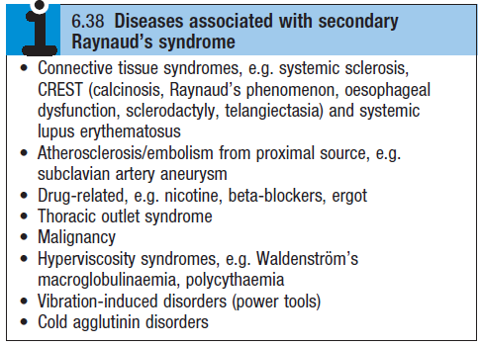
Primary
(Raynaud’s disease)
>> idiopathic digital
artery vasospasm.
Secondary
(Raynaud’s syndrome).
Self limiting.. Tissue loss in minority

Slide 24
History

Slide 25
Risk factors for atheroma (smoking, hypercholesterolaemia, HTN, DM)?
Family Hx. premature arterial disease? Other vascular disease (AAA), CVA
Previous investigation , operation
Impact of IC relates to pt’s age & lifestyle, daily living .
Drugs : antiplatlet, lipid lowering …..

Slide 26
Physical Examination

Slide 27
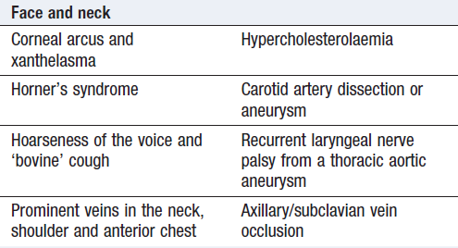
* + signs of anemia & cyanosis.
* Abnormally prominent pulsation in neck of elderly significant >> normally caused by tortuous arteries rather than a carotid aneurysm or carotid body tumor.

Slide 28
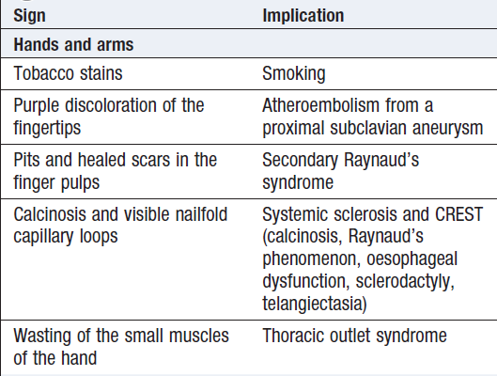
 Examine radial & brachial pulses.
 Measure BP in both arms.

Slide 29
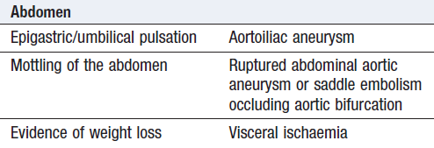
* Aortic bifurcation >> at level of umbilicus.
 Palpate over abdominal aorta – for pulsatile mass (Below or above umbilicus = AAA vs. Iliac aneurysm).
 Listen over abdominal aorta.
Notes:
In thin pts a tortuous but normal-diameter aorta can feel aneurysmal.

Slide 30
LL EXAMINATION

Slide 31
 Inspection:
Position of pt.
>> Flat , elevate 45 degree, dependant position.
Color changes / muscle wasting / hair distribution / scars form previous surgery / varicose vein / shiny skin / onycholysis /Venous guttering/ Fungal infection in between toes/ Swelling …
Look specifically between toes for ulcers [position, margin, depth & color] & at heels for ischemic changes (commonest site of ‘pressure sores’).

Slide 32
 Palpation:
Muscle tenderness.
Difference in temperature.
Lower limb pulses.
Capillary Refill.
Special Tests (Burger’s Test, ABPI).

Slide 33
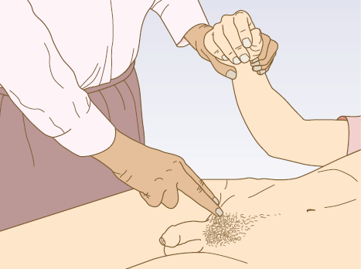
Femoral pulse:
Against head of femur.
Use 2 fingers pads (index & middle).
2.5*2.5 cm inferior & lateral to pubic tubercle.
Difficult to feel in obese ppl.
Check for radio- femora delay.
Bilateral auscultation (for bruit) using the diaphragm.

Slide 34
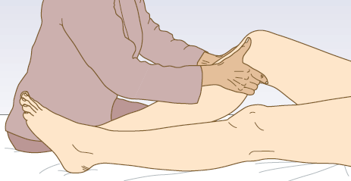
Popliteal pulse:
Lying flat – knee flexion 30 degrees. Both thumbs in front of the knee, other fingers behind & press firmly.
Notes:
slide your fingers 2–3 cm below the knee crease & try to compress the artery against back of tibia as it passes under soleal arch.

Slide 35
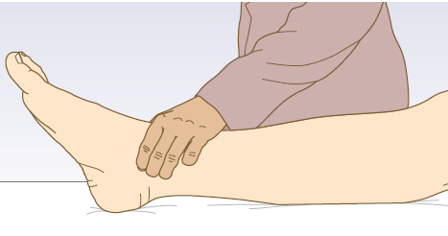
Posterior tibial pulse:
2 cm below &
2 cm behind
medial malleolus.
Pads of middle three
fingers.

Slide 36
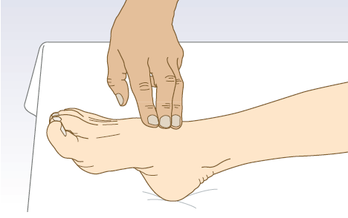
Dorsalis pedis pulse:
Pads of three middle
fingers.
Middle of the dorsum
of the foot Lateral to
extensor hallucis
longus tendon.

Slide 37
ABPI
Routinely whenever difficulty palpating lower pulses
PAD is suspected
Ratio of highest pedal artery pressure to highest brachial artery pressure

Slide 38
ABPI> 1 in supine
<0.9 intermittent claudication
<0.4 critical limb ischemia
ABPI in diabetic patient falsly reassuring due to ncompressibality and calcified vessels

Slide 39
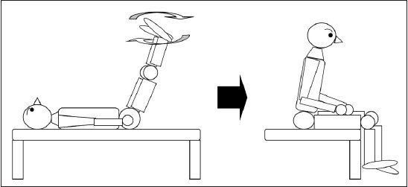
Burger’s Test
Pt lying supine.
Raise pt’s feet & support legs at 45° for 2–3 minutes.
Watch for pallor with emptying or ‘guttering’ of superficial veins.
Ask pt to sit up & hang legs over bed’s edge.
Watch for reactive hyperemia on dependency.
Loss of pallor & spreading redness is a positive test.

Slide 40
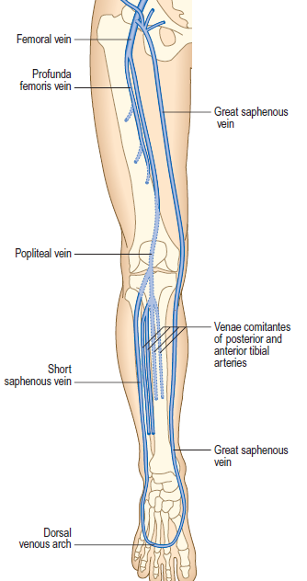
Peripheral Venous System
* Anatomy *

Slide 41
Venous Return
Passive from head & neck Active from lower limb
( pressure on the sole of the foot + contraction of muscle ( calf , andto a lesser extent in the thighs ., buttock)
90% through deep venous system
10% through superficial system
valves --- prevent backward flow (reflux)
The usual ambulatory venous pressure is <20 mmHg

Slide 42
Venous Diseases
Muscle pump failure
Failure of valves function
Primary or post thrombotic
Venous HTN

Slide 43
Clinically the patient usually present with following
Varicose vein
Superficial thrombophlebitis
DVT
Chronic venous insufficiency & ulceration

Slide 44
Pain
Swelling
Skin changes
varicoes eczema, hemosedrine deposition secondary to venous HTN, lipodrematosclerosis

Slide 45
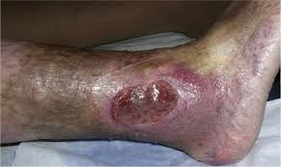
Chronic venous ulcer
70-80% of lower limb ulceration
other causes of LL ulceration: syphilis ,TB, pyoderma gangrenosum , leprosy (Hansen’s dis), sickle cell and tropical conditions
Medial aspect of the leg , shallow , pink(granulation tissue) or yellow/green (slough) in color ,irregular margin with surrounding skin changes of eczema and lipodermatosclerosis

Slide 46
superficial thrombophlebitis
10% of sever varicoes vein , common during pregnancy
Recurrent , different area is usually associated with underlying malignancy
Risk of DVT, PE (propagation)

Slide 47
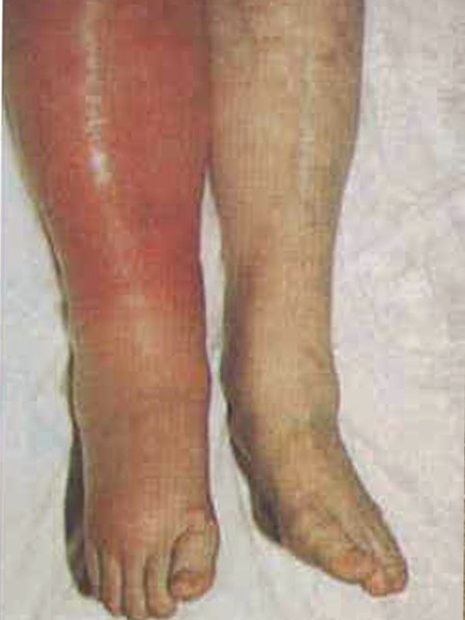
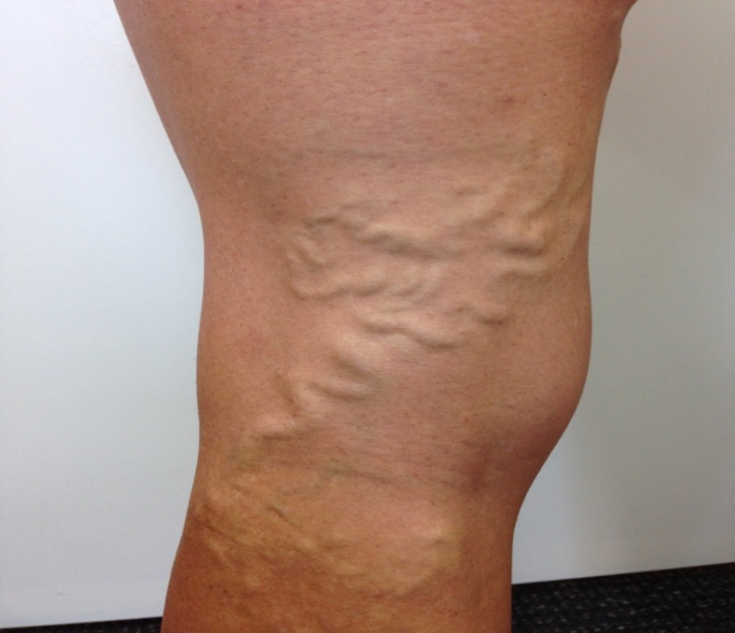

Slide 48
DVT
Upper limb
Axillary , subclavian vein
repetitive trauma , indwelling venous catheter , repetitive trauma at the thoracic outlet.
pain / swelling exacerbated with exercise , skin is cyanosed and mottled
lower limb
Risk factor .

Slide 49
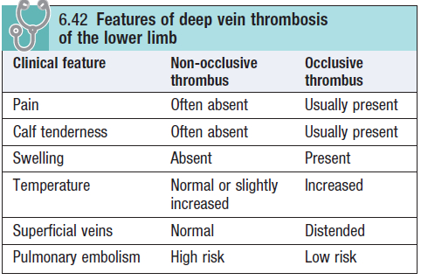

Slide 50
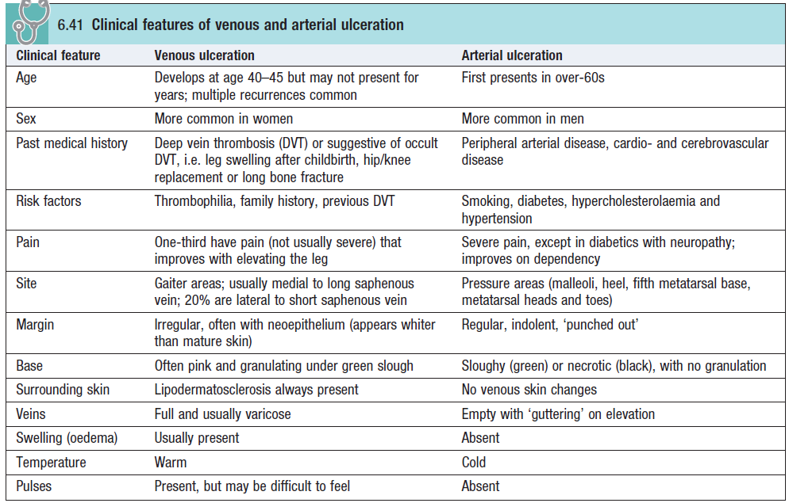

Slide 51
examination
General inspection for patient condition + risk factor
While the patient standing , lying supine
Leg inspection
For skin color changes / swelling / dialed vein
Palpation : temperature / tenderness/ pitting edema/ leg circumference ( 10 cm below tibial tuberosity ).
Edema → check the JVP( bilateral edema with raised JVP suggest cardiac disease or pulmonary HTN)

