Slide 1
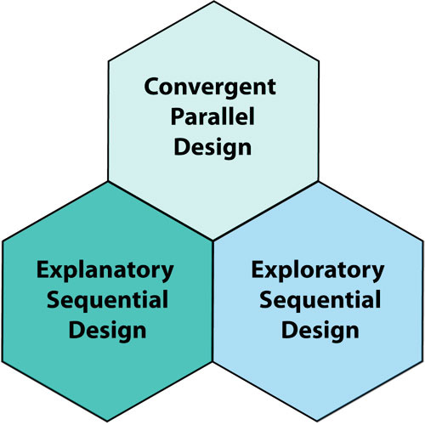
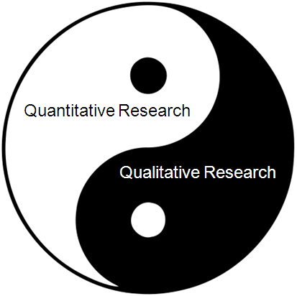
Mixed methods research-1

Slide 2
Intended learning outcomes
After this lecture, you will be able to :
1. Define mixed methods research
2. Identify the types of mixed methods designs.
3. Identify key characteristics of mixed methods research.
4. Describe steps in conducting a mixed methods study

Slide 4
Mixed Methods Research (MMR)
Frequently referred to as the ‘third methodological orientation’ (Teddlie & Tashakkori, 2009).

Slide 5
What is Mixed Methods Research (MMR)?
A Mixed methods research design is a research approach whereby researchers collect and analyse both quantitative and qualitative data within the same study to understand a research problem (Bowers et al., 2013).

Slide 6
What is Mixed Methods Research (MMR)?
Johnson et al. (2007, p. 123) defined “mixed method research” as: “… the type of research in which a researcher or team of researchers combines elements of qualitative and quantitative research approaches (e.g., use of qualitative and quantitative viewpoints, data collection, analysis, inference techniques) for the broad purposes of breadth and depth of understanding and corroboration.”

Slide 7
What is mixed methods research (Continued)
The key word is ‘mixed’, as an essential step in the mixed methods approach is data linkage or integration (Ivankova, Creswell, & Stick, 2006).
The researcher Mixes qualitative and quantitative data at the same time (concurrently) or one after the other (sequentially).
The concept of mixing methods was first introduced by Jick (1979), as a means for seeking convergence across qualitative and quantitative methods within social science research (Creswell, 2003).
This is beyond simply the inclusion of open‐ended questions in a survey tool or the collection of demographic data from interview participants, but rather involves the explicit integration of qualitative and quantitative elements in a single study (Halcomb, 2018).

Slide 10
Multi versus Mixed Methods
.
Multi Methods
Uses more than one method
Can be two qualitative or two quantitative
Mixed Methods
Uses both qualitative and quantitative
Involves mixing and integration of the data so that one type of data informs another

Slide 11
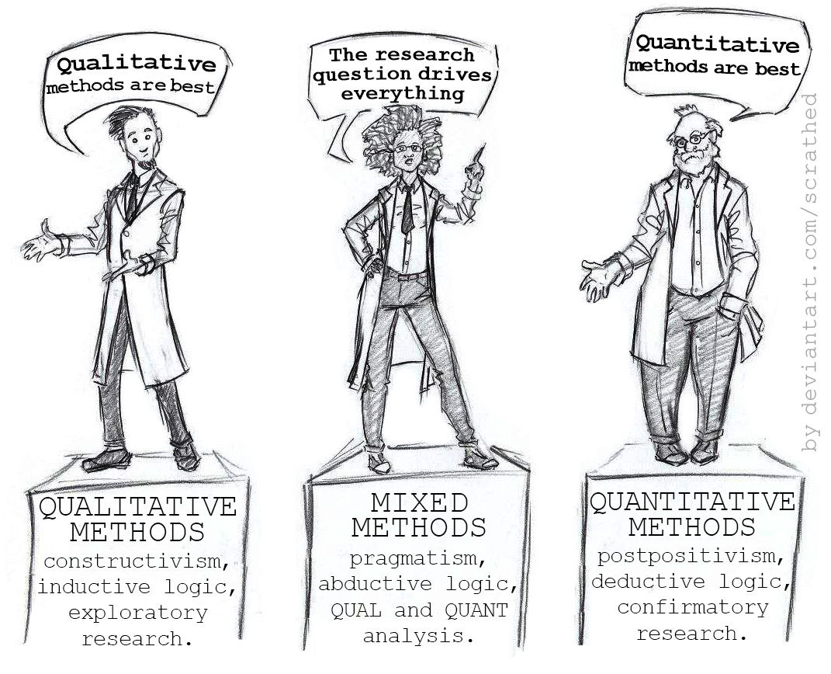
The Rise of MMR
Mixed method research has a short history as an identifiable methodological movement which can be traced to the early 1980s and has been described as a ‘quiet’ revolution due to its focus of resolving tensions between the qualitative and quantitative methodological movements (Teddlie & Tashakkori, 2003)

Slide 12
Philosophy in mixed methods research
Mixed methods research represents an opportunity to transform these tensions into new knowledge through a dialectical discovery.
Dialectical pluralism is a process theory for dialoging across differences and producing dynamic integration of divergent perspectives and methods to produce a more complex and meaningful whole.
A pragmatic perspective draws on employing “what works,” using diverse approaches, giving primacy to the importance of the research problem and question, and valuing both objective and subjective knowledge

Slide 13
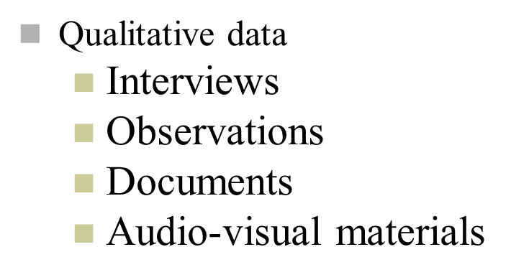
MMR involves collecting both quantitative and qualitative data

Slide 14
Why Mixed Methods?
Quantitative data can reveal generalizable information for a large group of people
These data often fail to provide specific answers, reasons, explanations or examples
Qualitative research provides data about meaning and context regarding the people and environments of study
Findings are often not generalizable because of the small numbers & narrow range of participants
Both methods have strengths and weaknesses
When used together, these methods can be complimentary

Slide 15
Why?
Provides a more complete picture of the research problem
“Reaching the parts other methods cannot reach”
Pope C, and Mays N. (1995)

Slide 16
Qualitative versus quantitative research
Criteria | Qualitative research | Quantitative research
Purpose | To understand and interpret social interactions | To test hypotheses, look at cause and effect and make predictions.
Group studied | Smaller | Larger
Variables | Study of the whole (not variables). | Specific variables studied.
Form of data collected | Qualitative data, such as open ended responses, interviews, participant observation, and field notes. | Quantitative data based on precise measurement using structured and validated data collection instruments.

Slide 17
Qualitative versus quantitative research (Continued)
Criteria | Qualitative research | Quantitative research
Type of data analysis | Identify patterns, features and themes | Identify statistical relationships
Results | Particular or specialised findings that are less generalizable. | Generalised findings that can be applied to other populations.
Scientific method | Bottom- up- the researcher generates a new theory from the collected data. | Top- down- the researcher tests the theory with the data.

Slide 18
When do you use mixed methods research?
You have a sense that scores are not telling you the entire story. If you just asked a few people about the concept you might obtain a better understanding…mixed methods research provides a more complete understanding of the research problem than either quantitative or qualitative alone.
Interpretation of data from one design only might be misleading, for example, a structured questionnaire about teachers’ emotions regarding teaching practices may only show negative or positive emotion without adequately explain the event that triggered the emotions (Scott & Sutton, 2009).

Slide 19
Rationales for mixed methods research adopted from (Doyle, Brady, & Byrne, 2016)
Rationale | Explanation
Triangulation (convergence) | Using quantitative and qualitative methods so that findings may be mutually corroborated (Quantitative analyses employ descriptive and inferential statistics, whereas qualitative analyses produce expressive data that provide descriptive details (often in narrative form) to examine the study’s research objectives)
Explanation | The first phase has findings that require explanation qualitatively (to explain results or how mechanisms work) in causation models. Unexpected findings that need to be explained
Exploration | An initial phase is required to develop an instrument, identify variables to study or develop a hypothesis that requires testing (Explore qualitatively then develop an instrument)
Complementarity | Using different methods to address different parts of the phenomenon. to integrate two different but connected answers to a research question: one reached via a quantitative approach and the other by means of a qualitative one.
Offset weaknesses (compensation) | Ensures that weaknesses of each method are minimised.

Slide 20
Planning of MMR
Four questions must be addressed by the researcher during the planning stage of mixed methods research:
1. In what sequence will the qualitative and quantitative data collection
be implemented?
2. What relative priority will be given to the qualitative and quantitative data collection and analysis?
3. At what stage of the project will the qualitative and quantitative
data be integrated?
4. Will an overall theoretical perspective be used to guide the study?

Slide 21
Planning of MMR (Continued)
Priority in mixed methods design is the relative weight assigned to the qualitative and quantitative research components.
Sometimes priority is referred to as dominance.

Slide 22
Notations of MMR
The use of upper case refers to emphasis (i.e. the primary or dominant method), whereas the use of lower case refers to lower emphasis, priority or dominance (Morse, 1991).
QUAN or quan refers to quantitative data.
QUAL or qual refers to qualitative data.
MM refers to mixed-methods.
→ data collected sequentially.
+ data collected simultaneously.
= converged data collection.
( ) one method embedded in the other.

Slide 23
Mixed methods designs (According to the order or timing of implementation of the data collection)
Sequential Explanatory Design
Sequential Exploratory Design
Sequential Transformative Design
Concurrent Triangulation Design
Concurrent Embedded/Nested Design
Concurrent Transformative Design
(Creswell & Creswell, 2003)

Slide 25
Sequential explanatory design (‘QUAN → qual’)
Alternatively, we can refer to it as explanatory design.
The most frequently applied mixed methods design in both health and social sciences literature (Ivankova, Creswell, & Stick, 2006).
The reason for favouring sequential explanatory design is that quantitative design in the first stage will portray the objective statistical findings from the group in general. Afterwards, a qualitative approach can be used to discover subjective nuances from participants as individuals and explain the phenomenon behind the numbers that cannot be described merely by the quantitative data (Fries, 2009).
Viewing the study as a two-phase project.
It is denoted by ‘QUAN → qual’ which represents the quantitative study occurs first and has greater weight in addressing the study’s aims, and the qualitative study follows to explain quantitative results.

Slide 26
Sequential explanatory design
Used when you want to explain the initial quantitative results in more depth with qualitative data (e.g. statistical differences among groups).
The rationale for this approach is that the quantitative data and their subsequent analysis provide a general understanding of the research problem. The qualitative data and their analysis refine and explain those statistical results by exploring participants’ views in more depth.
This design can be especially useful when unexpected results arise from a quantitative study.

Slide 27
Sequential Explanatory Design
Data analysis is usually connected, and integration usually occurs at the data interpretation stage.
To reiterate, key characteristics:
Data collection priority (Quantitative data).
Sequence (First quantitative data then qual).
Use of data (to refine, elaborate).

Slide 28
Sequential Explanatory Design
Questions to consider when collecting the qualitative data:
What results need further explanation?
What qualitative questions arose from the quantitative results?
Interview schedule questions depend on and are developed based on the quantitative findings (Liem, 2018).
In explanatory research where qualitative research is mostly used to substantiate findings generated in a population-level survey, priority is mostly assigned to the quantitative component.

Slide 29
Example on Sequential Explanatory Study
Researchers may ask persons with hearing loss to rate their conversational abilities before and after an aural rehabilitation program (QUAN) and then have the same participants take part in one-on-one clinician-led follow-up interviews to discuss reasons for specific ratings (qual).

Slide 30
Another example on Sequential Explanatory Design
A study aimed to : 1) to identify the proportion of individuals with cerebral palsy, spinal cord injury, multiple sclerosis, or arthritis who report difficulties with accessing and/or utilising needed health care services; 2) to identify reasons for access or utilisation difficulties and the consequences that these may produce.
The quantitative component involved a survey that identified a group of ‘access-stressed’ individuals who reported substantial problems in accessing and/or using health care services.
The qualitative study component focused on this group to examine what specific barriers made access problematic and what consequences resulted from not receiving care when needed (Neri & Kroll, 2003).

Slide 31
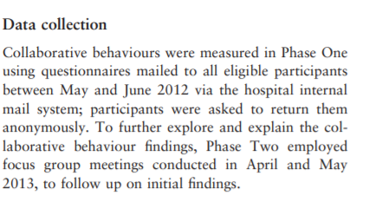
Collaboration amongst clinical nursing leadership teams: a mixed-methods sequential explanatory study

Slide 32
Collaboration amongst clinical nursing leadership teams: a mixed-methods sequential explanatory study

Slide 33
Collaboration amongst clinical nursing leadership teams: a mixed-methods sequential explanatory study

Slide 34
Example of Sequential Explanatory mixed methods design protocol

Slide 35
Drawbacks of Sequential Explanatory Design
It is more time-consuming when compared to concurrent designs (Ivankova, Creswell, & Stick, 2006).
Potential for loss of participants.
Can be difficult to fully plan the qualitative arm since it will be dependent on the results of the quantitative results.

