Slide 1
Introduction to Radiology
Jafar S. Sadaqah Radiology department
Jordan University Hospital

Slide 2
It’s always exciting when a class starts out with a surprise quiz.

Slide 3
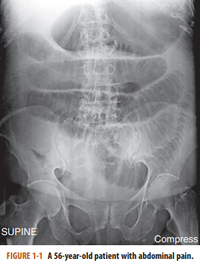

Slide 4
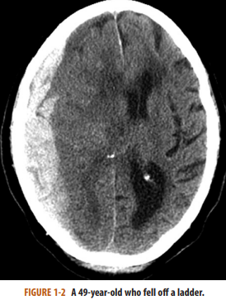

Slide 5
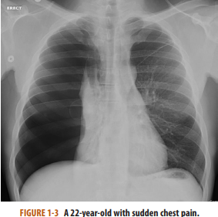

Slide 6
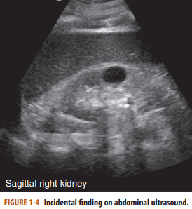

Slide 7
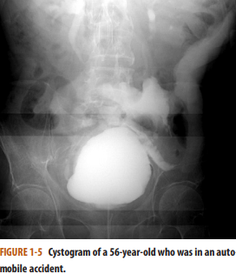

Slide 8
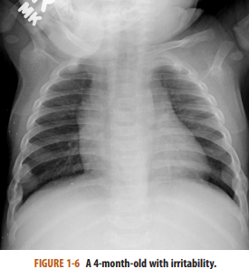

Slide 9
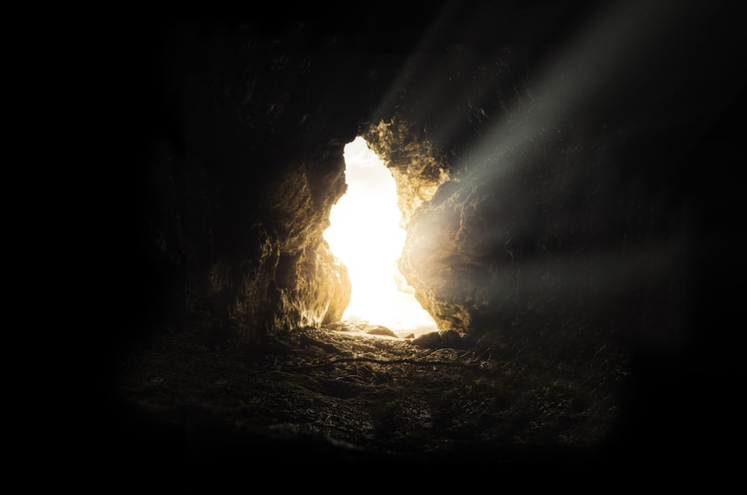
FROM DARKNESS … LIGHT
From darkenss…. to light

Slide 10
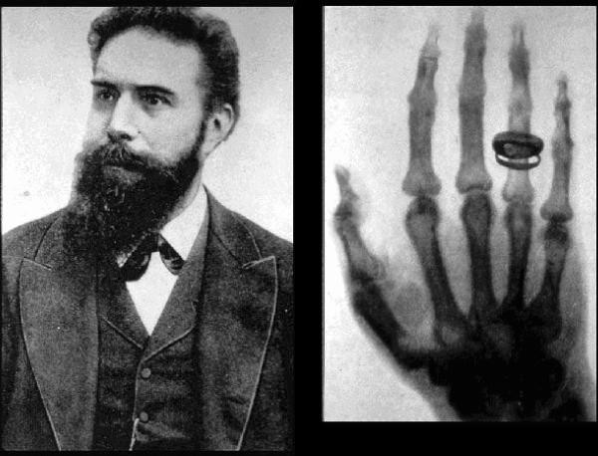
First Image.
In 1895, Wilihelm Röntgen (or Roentgen), working in a darkened laboratory in Würzburg, Germany, noticed that a screen painted with a fluorescent material in the same room, but a few feet from a cathode ray tube he had energized and made lightproof, started to glow (fluoresce).
Notes:
Sensing something important had happened, he recognized that the screen was responding to the nearby production of an unknown ray transmitted invisibly through the room. He named the new rays “x-rays,” using the mathematical symbol “x” for something unknown. It didn’t take long before almost everyone was taking x-rays of almost everything imaginable.

Slide 11
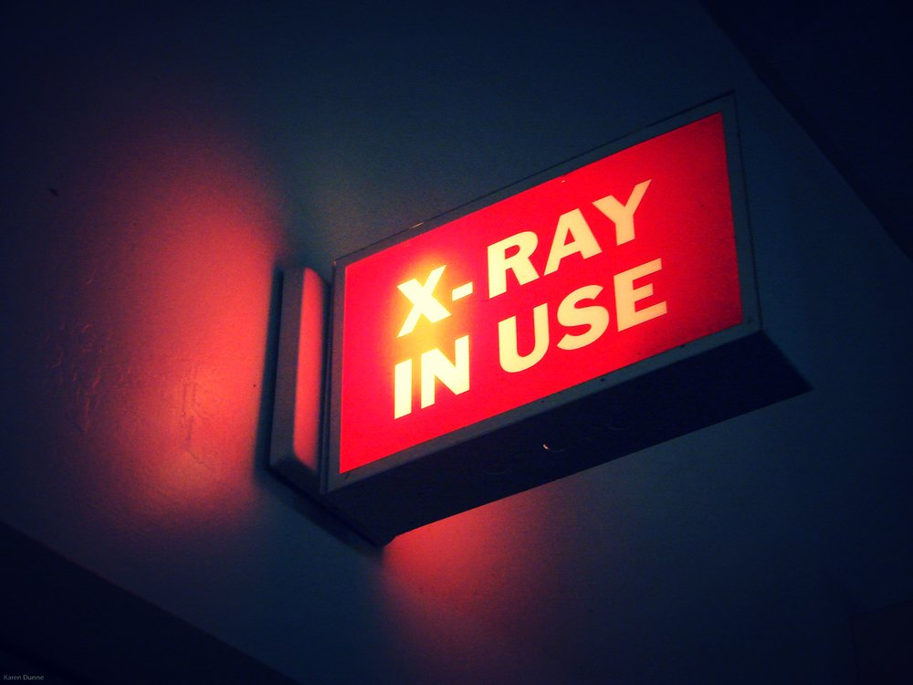
For about 100 years after that, radiographic images survived their brief birth as a burst of ionizing radiation nestled comfortably on a piece of film. In some places, film is the medium still used, but it’s much less common.

Slide 12
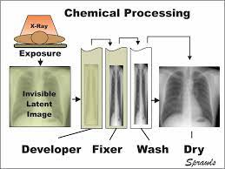
Today, like in 1895, conventional radiographic images (usually shortened to x-rays) are produced by a combination of ionizing radiation and light striking a photosensitive surface, which, in turn, produces a latent image that is subsequently processed. At first, the processing of film was carried out in a darkroom containing trays with various chemicals; the films were then, literally, hung out and then up to dry

Slide 13
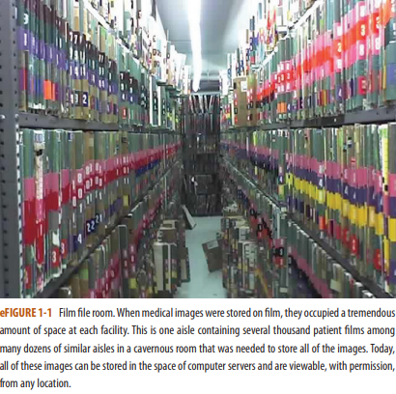

Slide 14
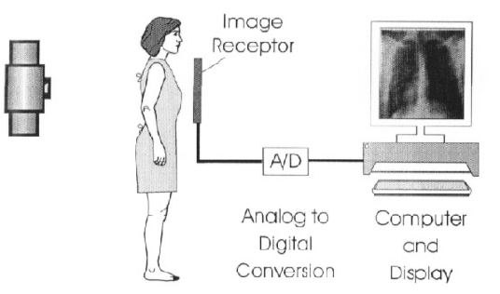
Digital radiography came into being
Notes:
, in which the photographic film was replaced by a photosensitive cassette or plate that could be processed by an electronic reader and the resulting image could be stored in a digital format. This electronic processing no longer required a darkroom to develop the film or a large room to store the films. Countless images could be stored in the space of one spinning hard disk on a computer server. Even more important, the images could be viewed by anyone with the right to do so, anywhere in the world, at any time

Slide 15
PACS
The images were maintained on computer servers, where they could be stored and archived for posterity and from which they could be communicated to others. This system is referred to as PACS, which stands for picture archiving, communications, and storage.

Slide 16
Using PACS systems, images created using all modalities can be stored and retrieved. Conventional radiography, computed tomography (CT), ultrasonography, magnetic resonance imaging (MRI), fluoroscopy, and nuclear medicine are examples of images that can be stored in this way.

Slide 17
Radiology is medical specialty using medical imaging technologies to diagnose and treat the patient.
Medical imaging: Is non-invasive visualization of internal organs.
Requires recognition of NORMAL anatomy.
It’s primary purpose is to identify pathologic conditions.

Slide 18
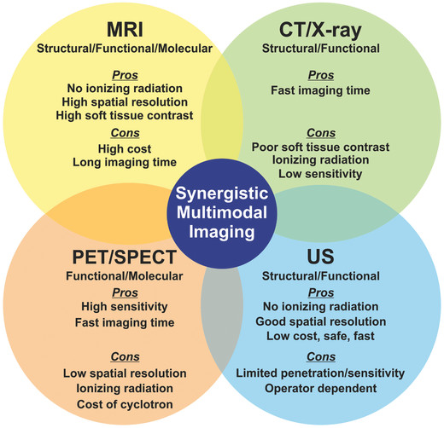

Slide 19
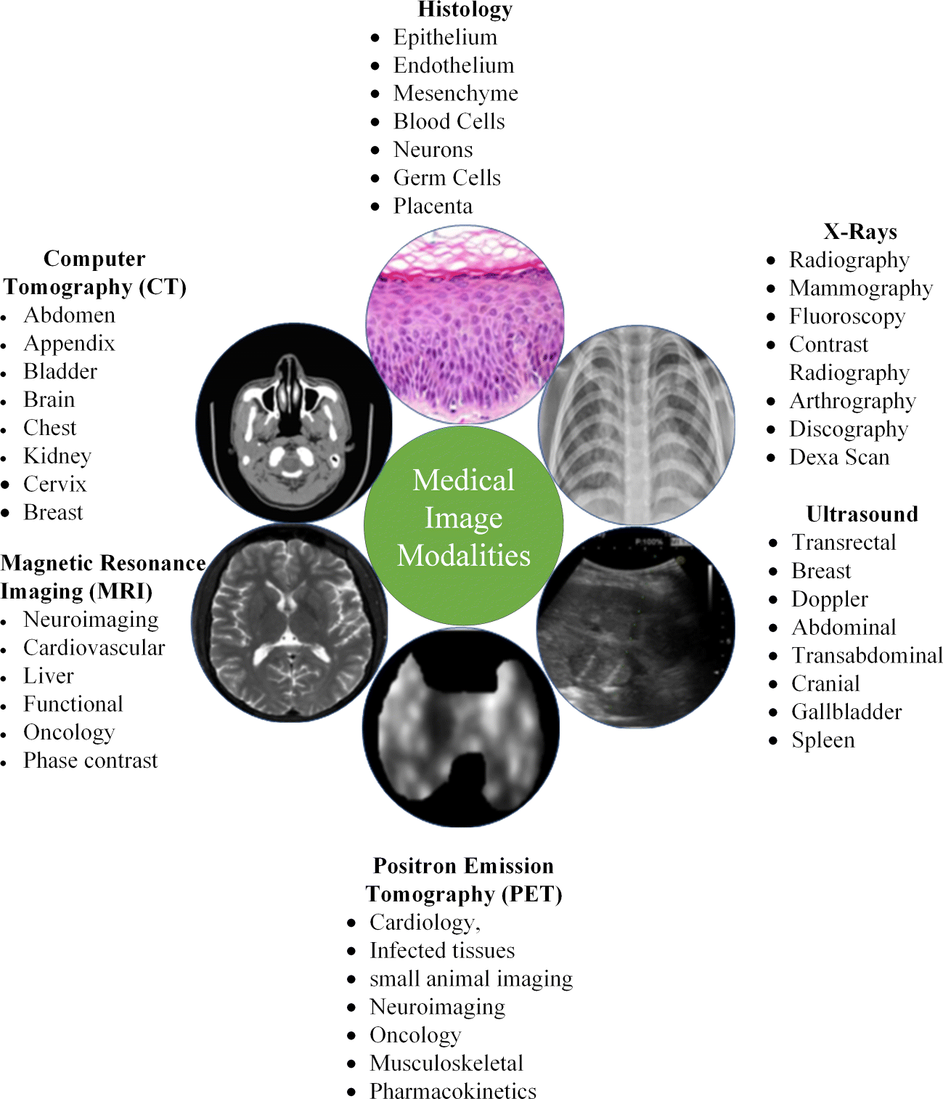

Slide 20
CONVENTIONAL RADIOGRAPHY
Images produced through the use of ionizing radiation.
Advantage: Relatively inexpensive, can be obtained almost anywhere by using portable or mobile machines, and are still the most widely obtained imaging studies.
They require a source to produce the x-rays (the “x-ray machine”), a method to record the image (a film, cassette, or photosensitive plate), and a way to process the recorded image (using either chemicals or a digital reader).
Notes:
Images produced through the use of ionizing radiation (i.e., the production of x-rays, but without added contrast material such as barium or iodine) are called conventional radiographs or, more often, plain films. ■ The major advantage of conventional radiographs is that the images are relatively inexpensive to produce, can be obtained almost anywhere by using portable or mobile machines, and are still the most widely obtained imaging studies. ■ They require a source to produce the x-rays (the “x-ray machine”), a method to record the image (a film, cassette, or photosensitive plate), and a way to process the recorded image (using either chemicals or a digital reader). ■ Common uses for conventional radiography include the ubiquitous chest x-ray, plain films of the abdomen, and virtually every initial image of the skeletal system to evaluate for fractures or arthritis. ■ The major disadvantages of conventional radiography are the limited range of densities it can demonstrate and that it uses ionizing radiation.

Slide 21
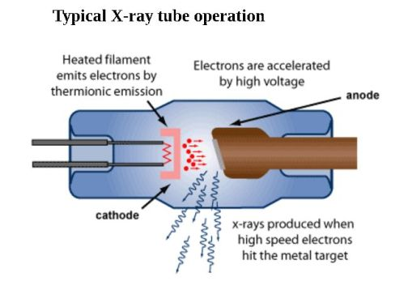

Slide 22
Common uses for conventional radiography include the ubiquitous chest x-ray, plain films of the abdomen, and virtually every initial image of the skeletal system to evaluate for fractures or arthritis.
The major disadvantages of conventional radiography are the limited range of densities it can demonstrate and that it uses ionizing radiation.

Slide 23
The five basic densities

Slide 25
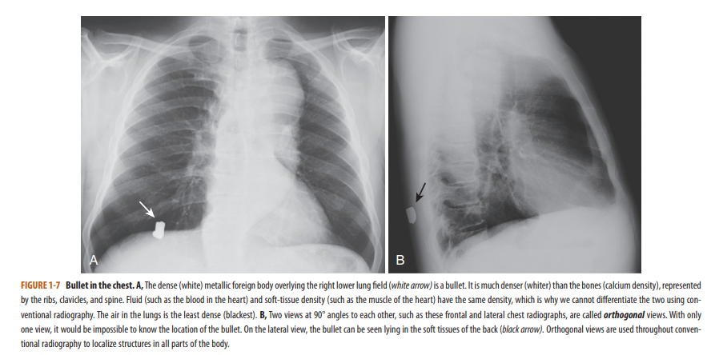

Slide 26
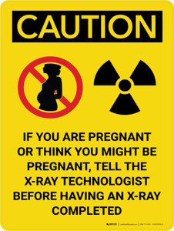
Radiation has the potential to produce cell mutations, which could lead to many forms of cancer or anomalies.
Only medically necessary diagnostic examinations should be performed.
Imaging using x-rays should be avoided during potentially teratogenic times, such as pregnancy.

Slide 27
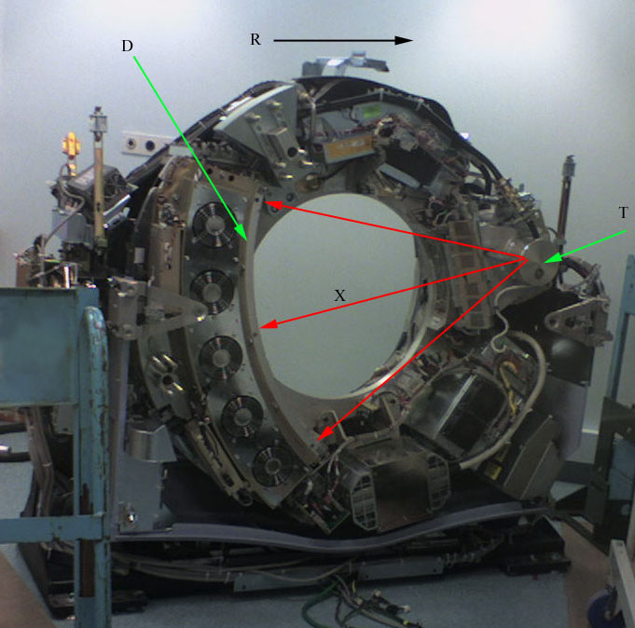
Computerized Tomography
CT (or “CAT”) scanners, first introduced in the 1970s.
Using a gantry with a rotating x-ray beam.
Notes:
beam and multiple detectors in various arrays (which themselves rotate continuously around the patient), along with sophisticated computer algorithms to process the data, a large number of two-dimensional, slicelike images (each of which is millimeters in size) can be formatted in multiple imaging planes

Slide 28
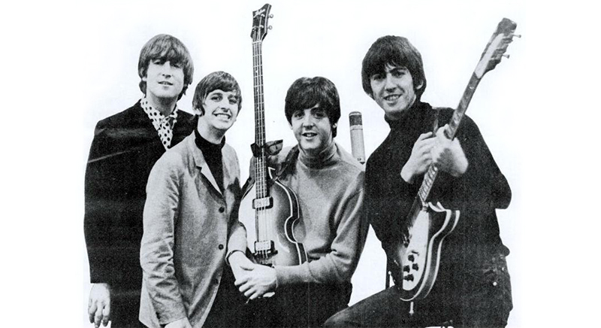

Slide 30
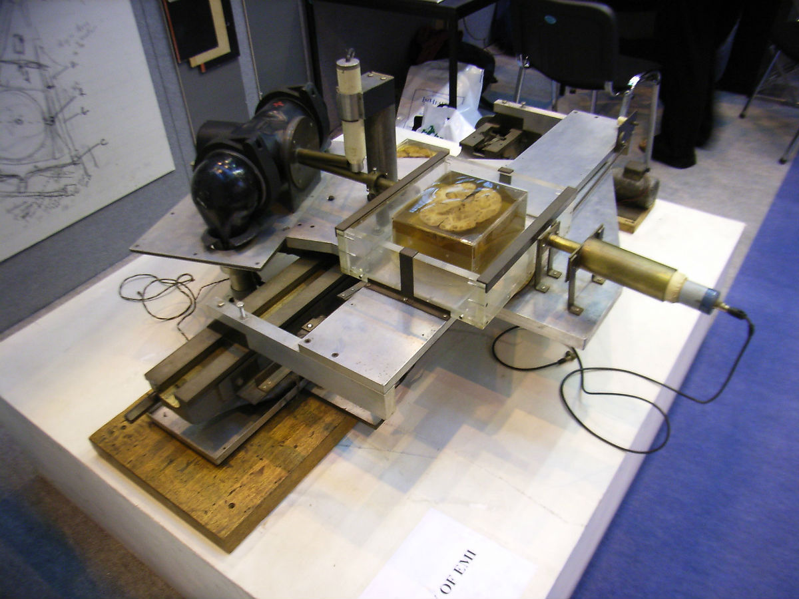

Slide 31
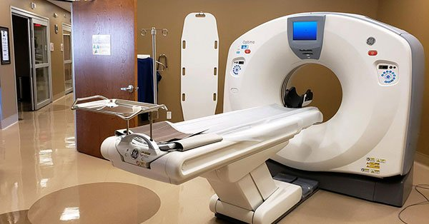

Slide 32
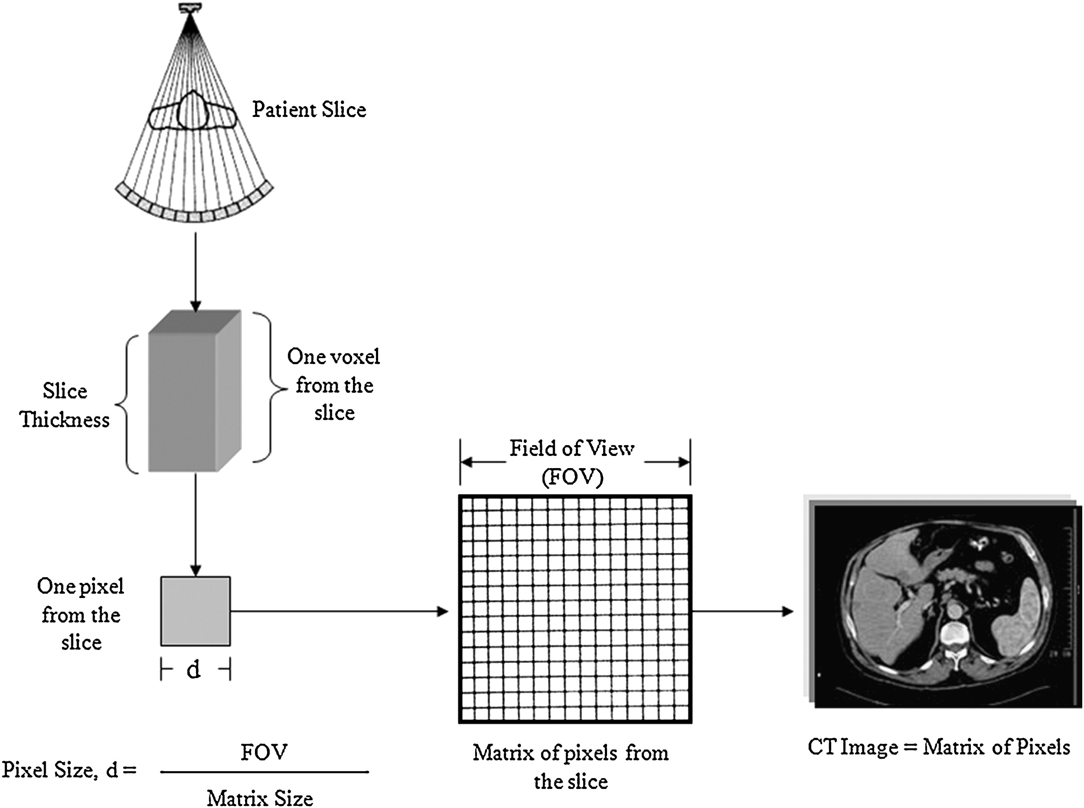
A CT image is composed of a matrix of thousands of tiny squares called pixels, each of which is computer-assigned a CT number from −1000 to +1000 measured in Hounsfield units (HUs).
Notes:
named after Sir Godfrey Hounsfield, the man credited with developing the first CT scanner (for which he won the Nobel Prize in Medicine in 1979 with Allan Cormack).

Slide 33
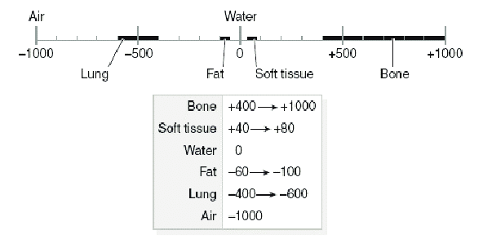
The CT number will vary according to the density of the tissue scanned.
Notes:
The CT number will vary according to the density of the tissue scanned and is a measure of how much of the x-ray beam is absorbed by the tissues at each point in the scan. By convention, air is assigned a Hounsfield number of −1000 HU and bone about 400 HU to 600 HU. Fat is −40 to −100 HU, water is 0, and soft tissue is 20 HU to 100 HU

Slide 34
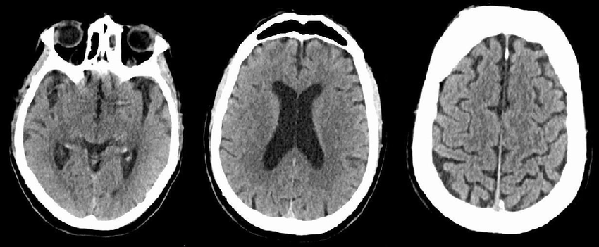
Denser substances that absorb more x-rays have high CT numbers, are said to demonstrate increased attenuation, and are displayed as whiter densities on CT scans.

Slide 35
Less dense substances that absorb fewer x-rays have low CT numbers, are said to demonstrate decreased attenuation, and are displayed as blacker densities on CT scans.

Slide 36
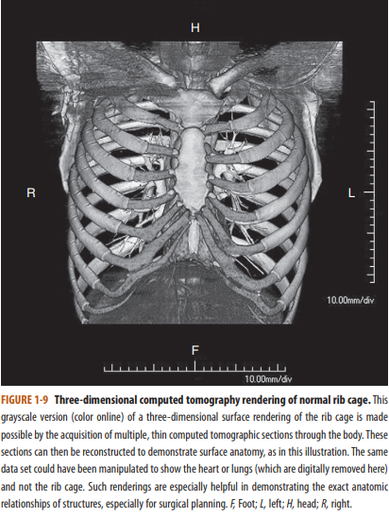
Postprocessing allows for additional manipulation of the raw data to best demonstrate the abnormality without repeating a study and without reexposing the patient to radiation

Slide 37
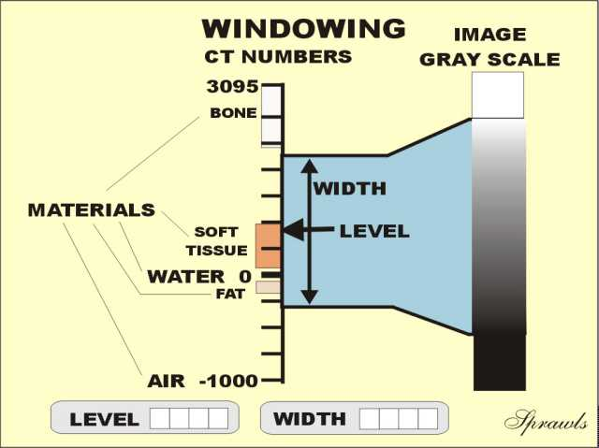
CT images are displayed or viewed using a range of Hounsfield numbers preselected to best demonstrate the tissues being studied (e.g., from −100 to +300).
Anything within that range of CT numbers is displayed over the levels of density in the available gray scale.

Slide 39
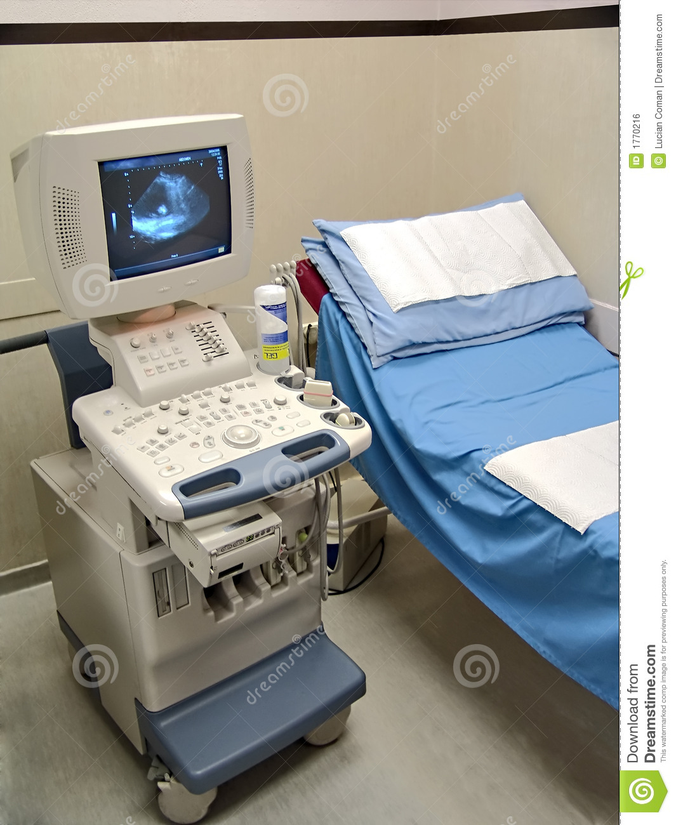
Ultrasonography
Ultrasound probes utilize acoustic energy above the audible frequency of humans to produce images.
An ultrasound probe or transducer both produces the ultrasonic signal and records it.
The signal is processed for its characteristics by an onboard computer.

Slide 40
Ultrasound images are recorded digitally and are easily stored in a PACS system.
Images are displayed either as static images or in the form of a movie (or “cine”).
Ultrasound scanners are relatively inexpensive compared with CT and MRI scanners.
They are widely available and can be made portable to the point of being handheld.

Slide 41
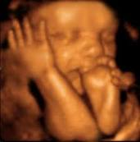
Because ultrasonography utilizes no ionizing radiation, it is particularly useful in obtaining images of children and women of childbearing age and during pregnancy.

Slide 42
Applications
First choice in imaging the female pelvis and in pediatric patients.
In differentiating cystic versus solid lesions in patients of all ages.
In noninvasive vascular imaging.
In imaging of the fetus and placenta during pregnancy, and in real-time, image-guided fluid aspiration and biopsy.
Other common uses are evaluation of cystic versus solid breast masses, thyroid nodules, and tendons and in assessment of the brain, hips, and spine in newborns.

Slide 43
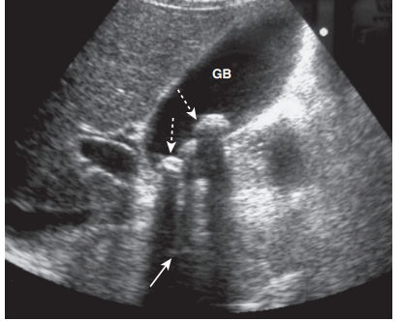
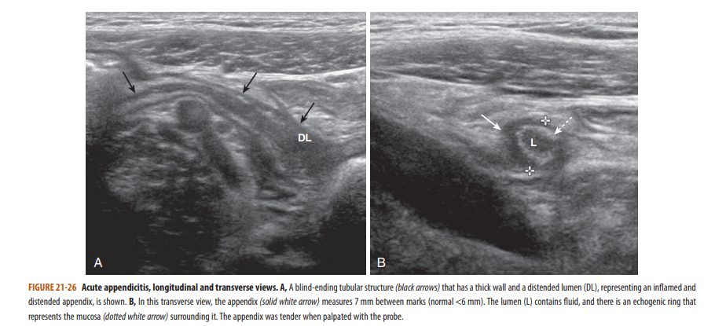
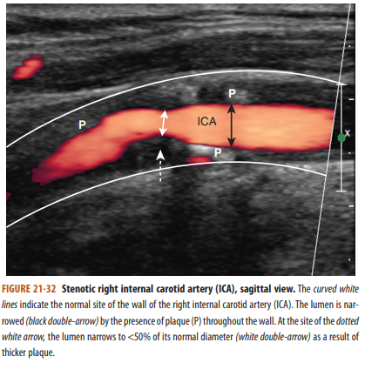

Slide 44
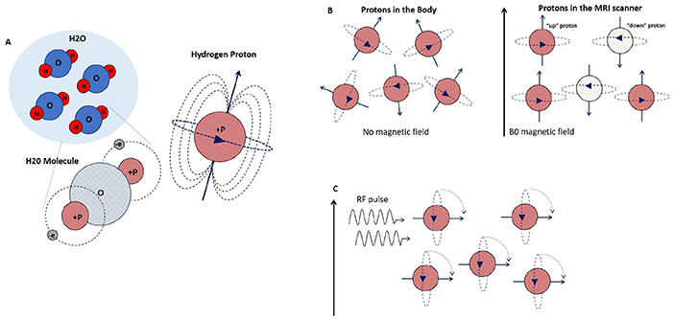
Magnetic Resonance Imaging
MRI utilizes the potential energy stored in the body’s hydrogen atoms.
The atoms are manipulated by very strong magnetic fields and radiofrequency pulses to produce enough localizing and tissue-specific energy to allow highly sophisticated computer programs to generate two- and threedimensional images

Slide 45
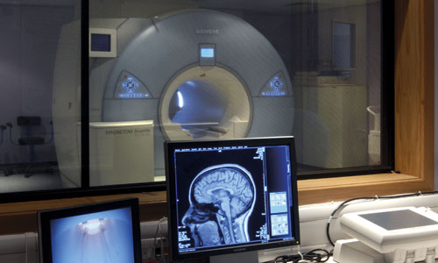
MRI scanners are not as widely available as CT scanners. They are expensive to acquire and require careful site construction to operate properly. In general, they also have a relatively high ongoing operating cost.

Slide 46
No ionizing radiation and produce much higher contrast between different types of soft tissues than is possible with CT.
MRI is widely used in neurologic imaging and is particularly sensitive in imaging soft tissues such as the muscles, tendons, and ligaments.
There are safety issues (e.g., cardiac pacemakers) and for ferromagnetic projectiles in the MRI scanner environment (e.g., metal oxygen tanks in the room).

Slide 47
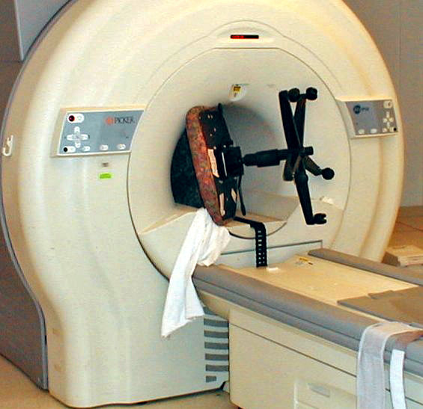

Slide 48
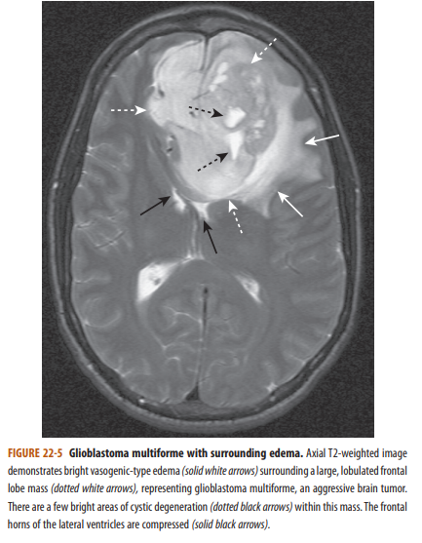
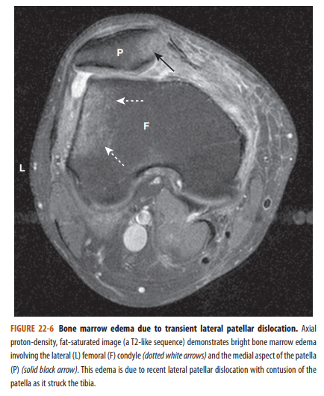
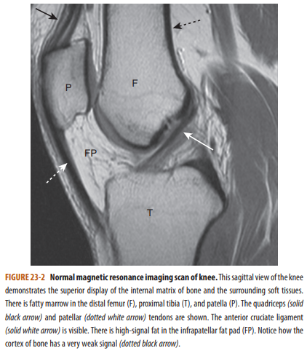

Slide 49
Flouroscopy
Fluoroscopy (or “fluoro”) is a modality in which ionizing radiation (x-rays) is used in performing real-time visualization of the body in a way that allows for evaluation of the motion of body parts, real-time positioning changes of bones and joints, and the location and path of externally administered barium or iodine contrast agents through the gastrointestinal and genitourinary tracts and blood vessels. Images can be viewed as they are acquired on video screens and captured as either a series of static images or moving (video) images.

Slide 50
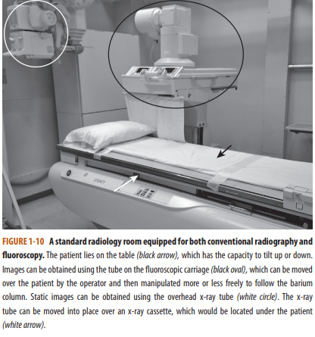

Slide 51
In interventional radiology, iodinated contrast is selectively injected into blood vessels or other ducts that can be imaged fluoroscopically to demonstrate normal anatomy, pathology, or the position of catheters or other devices

Slide 52
Radiation doses in fluoroscopy can be substantially higher than those used in conventional radiography because so many images are acquired for every minute of fluoroscopy time. Therefore the dose is reduced by using the shortest possible fluoroscopy time to obtain diagnostic images

Slide 53
Patient Encounter
History
Clinical examination
Labs
Differential diagnosis and plan
Indication to perform imaging study
Choice of imaging modality
i.e ILD, Temporal bones → HRCT
Looking for urinary tract stones → Urinary tract CT
Looking for causes of acute abdomen → Abdomen and Pelvis CT
With / without contrast??

Slide 54
Contrast
Contrast can be administered IV, IA, Oral or Rectal
IV contrast administration ?
Valid clinical indication for contrast medium administration
Justification ( Benefit VS Side effects allergic like and physiologic )
Imaging alternatives that would provide the same or better diagnostic information

Slide 55
Contrast (Cont’d)
Before administration IV contrast
Patient consent form
Check Serum Cr levels / eGFR
Check Contraindications and the need for premedication.
Contraindication: Prior allergic like reactions to contrast medium
Premedication i.e Allergy to medications, Asthma…etc.

Slide 56
IV iodinated contrast media
Contrast side effects
Physiologic reactions ( reactions related directly to contrast chemical composition and osmolarity or molecular binding to certain activators) which include:
Nausea
Vomiting
Feeling of warmth

Slide 57
IV iodinated contrast media ( Cont’d )
Cardiovascular effects (cardiac arrythmias, depressed myocardial contractility, cardiogenic pulmonary edema→ (more common and significant in patients with underlying cardiac disease) and seizures. These phenomena are likely related to either contrast media-related hyperosmolality and/or calcium binding leading to functional hypocalcemia.
Hypertension

Slide 58
Vasovagal reactions ( Hypotension and bradycardia ) exact pathogenesis still unknown. Related to anxiety during obtaining informed consent or during placement of needle / catheter, or during IV administration of contrast media.

Slide 59
IV iodinated contrast media (Cont’d)
Allergic like reactions
Hives (Urticaria)
Diffuse erythema
Bronchospasm
Laryngeal edema
Anaphylactic shock

Slide 60
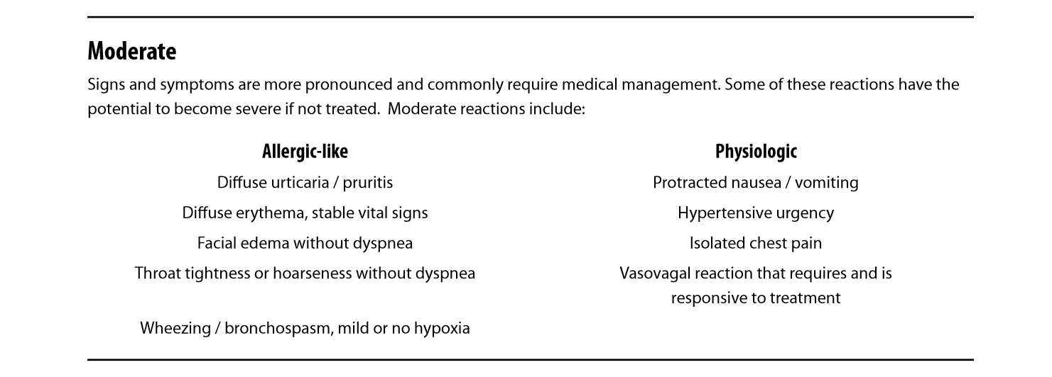
Contrast media physiologic and Allergic like reactions

Slide 61
SEVERE

Slide 62
GENERAL RULES for contrast administration
Allergy to previous IV contrast examination is absolute contraindication for contrast re-administration.
Pre-medication is required for patients with history of allergy using 13 or 12 hour regimen ( Allergy to food, medications, medical conditions like Asthma, seasonal allergy…..etc)
Corticosteroids
Chlorpheniramine ( Mandatory 13 hr regimen / optional 12 hr regimen )

Slide 63
Postcontrast acute kidney injury & CIN
PC-AKI: sudden deterioration in renal function that occurs within 48 hours following the intravascular administration of iodinated contrast medium.
The exact pathophysiology of CIN is not understood. Etiologic factors that have been suggested include renal hemodynamic changes (vasoconstriction) and direct tubular toxicity.
One of the most commonly used criteria has been an absolute increase of 0.5 mg/dL over a baseline serum creatinine.

Slide 64
Postcontrast acute kidney injury & CIN (Cont’d)
According to Acute Kidney Injury Network (AKIN)-definition of acute kidney injury: “If one of the following occurs within 48 hours after a nephrotoxic event (e.g., intravascular iodinated contrast medium exposure) “
1) Absolute serum creatinine increase ≥0.3 mg/dL (>26.4 µmol/L).
2) A percentage increase in serum creatinine ≥50% (≥1.5-fold above baseline).
3) Urine output reduced to ≤0.5 mL/kg/hour for at least 6 hours.

Slide 65
Postcontrast acute kidney injury & CIN (Cont’d)
Risk factors:
The most important risk factor is pre-existing severe renal insufficiency.
Multiple iodinated contrast medium doses in a short time interval (<24 hours)
Other risk factors include diabetes mellitus, dehydration, cardiovascular disease, diuretic use, advanced age, multiple myeloma, hypertension, hyperuricemia

Slide 66
Postcontrast acute kidney injury & CIN (Cont’d)
Prevention:
Avoidance of iodinated contrast medium administration.
Volume expansion.
Use Isotonic fluids (Lactated Ringer’s or 0.9% normal saline). Normal saline ( 0.9% ) at rate 100 mL/hr 6-12 hours before and continued 4 to 12 after contrast administration.
Oral hydration has also been utilized.

Slide 67
Gadolinium based contrast media
Most adverse reactions are physiologic and mild , however allergic like reactions are uncommon. Severe life threatening anaphylactic reactions are rare.
Mild physiologic adverse reactions associated with GBCM administration:
Include coldness, warmth, or pain at the injection site; nausea with or without vomiting; headache; paresthesias; and dizziness.
Safer

Slide 68
Gadolinium based contrast media ( Cont’d )
Important side effect →NSF (Nephrogenic Systemic Fibrosis)
Patients at risk are those with underlying kidney disease. (Patients with acute kidney injury or severe chronic kidney disease )
eGFR ( Normal => 60, not administrated if < 30 )
Thus its incidence was reduced significantly.

Slide 69
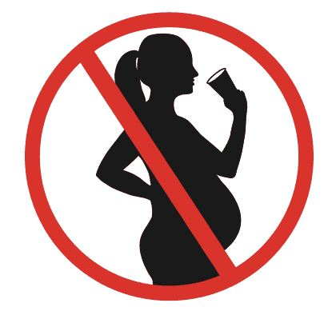
Administration of contrast to pregnant / potentially pregnant patients
All IV iodinated and gadolinium-based contrast media behave in a similar fashion and cross the blood-placental barrier and into the fetus.
Their administration to pregnant and potentially pregnant patients should be limited.

Slide 70
RADIATION DOSE AND SAFETY
All health care providers should understand the risks associated with radiation exposure and limit exposure when possible

Slide 71
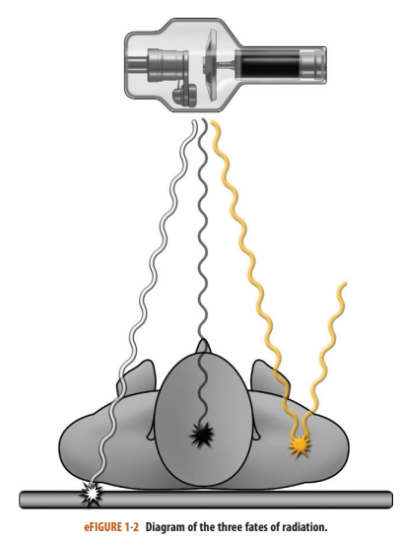
Three Fates of Radiation During an Imaging Procedure
Transmitted.
Absorbed radiation
Scatter radiation
Notes:
Transmitted radiation is the radiation that passes through the patient and interacts with the detector to create the image (wavy white line in eFig. 1-2). Unfortunately, only about 5% to 15% of the radiation produced by the source becomes transmitted radiation.
Absorbed radiation is the radiation that interacts with the tissues of the patient, depositing its energy in those tissue; it is the source of the patient radiation exposure
Scatter radiation is not transmitted or absorbed by the patient. As radiation passes through the patient, some of the radiation changes its original path, with the scatter leaving the patient along a different course. Scatter radiation can degrade the quality of the image and can be an exposure source to personnel

Slide 72
Measurements of Radiation
The absorbed radiation is measured by the absorbed dose. The unit for absorbed dose is the gray (Gy), which is the energy absorbed per unit of mass (kilogram).
Absorbed dose does not take into account the biological effect of that radiation.

Slide 73
The equivalent and effective doses attempt to correlate the absorbed dose with the potential biological effects on different types of tissues.
The unit for these doses is the Sievert (Sv) or rem, where 1 Sv = 100 rem.

Slide 74
Biological Effects of Radiation
Radiation causes biological effects on a cellular level either
(1) by directly damaging molecules
(2) by indirectly creating free radicals to disrupt cellular metabolism.

Slide 75
Types of Biological Effect
Deterministic effects (nonrandom), occurs when a threshold level is met
Stochastic effects (random), Damage that may occur at any level of exposure, without a threshold dose
Notes:
This is damage that occurs when a threshold level is met. Both the probability and the severity of the effect are proportional to increasing dose, where the dose is usually given in one exposure or several exposures over a very short period of time. These effects occur when the level of radiation-induced cell damage exceeds the cell’s ability to repair the damage. Some examples of deterministic effects and threshold doses.
Stochastic effects (random): Damage that may occur at any level of exposure, without a threshold dose. These effects occur by chance, and while their probability increases with an increasing dose, their severity is independent of the dose. These effects are due to damage of cellular components, usually DNA, by free radicals, leading to abnormal cell function if repair is incomplete or incorrect. Stochastic effects are “invisible damage” and may not manifest until many years after exposure

Slide 76
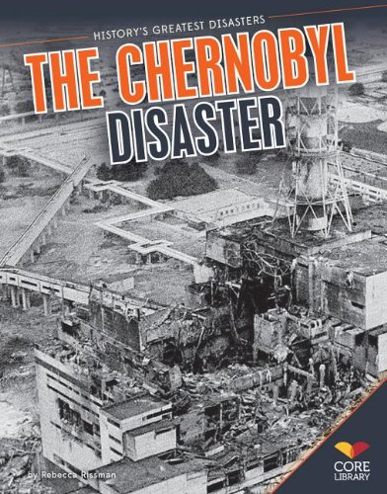

Slide 77
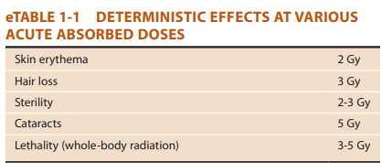

Slide 78
In general, slowly dividing mature cells, such as bone cells, have a low sensitivity to radiation damage, whereas undifferentiated, rapidly dividing cells, such as intestinal epithelial cells, have a higher sensitivity. The most radiosensitive organs are bone marrow, colon, lung, female breast, stomach, and childhood thyroid.

Slide 79
Sources of Radiation for Humans
Cosmic radiation, naturally occurring radioactive materials in soil, and radon gas.
This background radiation dose does not include additional radiation exposure from diagnostic imaging procedures.
The average yearly background radiation dose for a person living in the United States is about 3 mSv

Slide 80
Practices for Radiation Safety
ALARA principle.
High-quality images should be obtained by using the lowest possible dose to limit the exposure of patients and health care workers. The goal is to prevent deterministic effects and limit stochastic effects.
There are three major radiation safety practices: time, distance, and shielding.

Slide 81
Special Circumstances
Children: Children have a three to five times higher risk of mortality due to radiation-induced cancer than adults. Ultrasonography and MRI should be employed when possible.
Pregnant women.

Slide 83
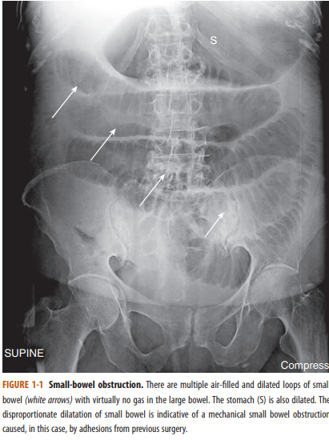

Slide 85
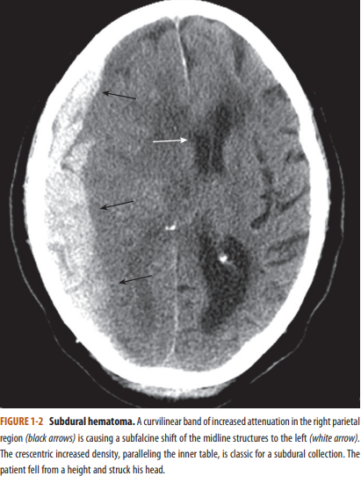

Slide 87
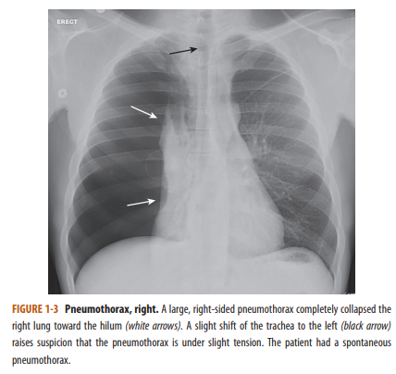

Slide 89
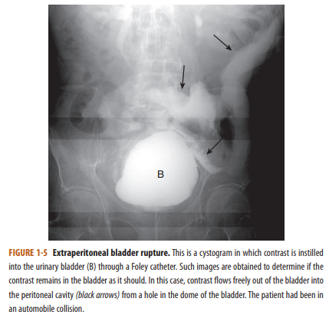

Slide 91
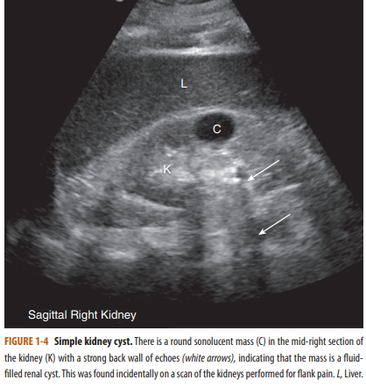

Slide 93
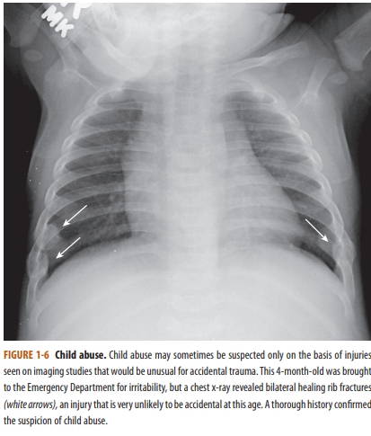

Slide 94
ANY QUESTIONS?

Slide 95
Thank you

