Slide 1
viral Hepatitis
References: Harrisons infectious disease 2nd Ed., Oxford handbook of microbiology and ID

Slide 2
Acute hepatitis
An acute inflammation of the liver characterized by hepatocyte damage and elevations in serum AST and AST.
May be caused by a variety of infectious and non-infectious agents.

Slide 3
Causes
Viral hepatitis
Hepatitis viruses (HAV,HBC,HCV, HDV, HEV)
Other viruses (EBV, CMV, HSV.,VZV, Measles, Rubella, Adenovirus, Coxsackie, yellow fever)
Non viral infectious diseases
-Leptospirosis, Q fever (coxiella burnetti), sepsis, legionella, TB, Brucellosis, plague (Yersinia pestis)
-Drug induced, toxins, alcohol, ischemia, autoimmune, HELLP (hemolysis, elevated liver, low platelet syndrome)

Slide 4
Hepatitis A virus
Hepatitis A virus (HAV) is an enterically transmitted picornavirus.
Outbreaks of infectious hepatitis have been recognized for centuries, but it was first demonstrated in the stool of infected volunteers in 1973.
HAV is a 27–28nm spherical, non-enveloped virus, upon purification three distinct types are demonstrated:
Mature virions, Empty capsids or partial genome particles less stable particles with a more open structure.
The HAV genome is a ssRNA of 7474 nucleotides.
As with other picornaviruses, the coding region is divided into three parts: P1 (encoding the four capsid proteins VP1–4), P2, and P3 (encoding seven non-structural proteins).
Four genotypes have been identified; all belong to the same serotype.
Viral infection of hepatocytes is not cytopathic, but the cytotoxic T-cell response results in cell death.

Slide 5
Epidemiology
HAV has a worldwide distribution and is associated with overcrowding and poor sanitation, and is endemic in the developing world where it is an infection of childhood.
Improved hygiene caused reduction in the incidence in children but causes greater susceptibility in adults.
Main risk groups: occur among homosexuals, IV abusers, and homeless people.
Other risk groups : children and staff in childcare facilities, patients and staff in mental health institutions, and travelers to endemic areas (Indian subcontinent, Far East, Eastern Europe)
Transmission is faeco–oral, →community outbreaks have occurred as a result of water or food contamination.

Slide 6
Clinical features
Incubation period of 4 weeks • Subclinical infection—common in children (>90% if <5 years of age).
Acute hepatitis—this occurs more frequently with increasing age.
An abrupt prodrome of fever, headache, malaise, anorexia, vomiting, and right upper quadrant pain is followed <7 days after by dark urine, pruritus, and pale stools. Occasionally, diarrhoea, cough, coryzal symptoms, or arthralgia may occur (commoner in children).
Physical findings: jaundice, hepatomegaly, splenomegaly (5–15%). People feel better once jaundice appears, which peaks within 14 days.
Complications—include prolonged cholestasis, relapsing disease, fulminant hepatitis (rare, commoner in older patients), extrahepatic disease, and triggering of autoimmune chronic active hepatitis.

Slide 7
Diagnosis
Can be inactivated by boiling for 1 minute, UV light, chlorine, formaldehyde
One serotype (for diagnostic purposes)
Replication limited to liver, but its present in liver, bile, STOOL, BLOOD during preicteric phase and incubation period
Once jaundice is apparent infectivity in stool and blood is diminished
Anti HAV (IgM) antibodies can be detected during acute illness while stool shedding is still present and ALT is high
These ABs can persist for several months, after convalescence IgG becomes predominant (thus diagnosis is during acute illness)
IgG Abs provide lifelong immunity

Slide 8
Diagnosis
LFTs are elevated, with very high aspartate transaminase (AST) and ALT levels.
Bilirubin and ALP are usually only mildly elevated.
Serology—detection of anti-HAV IgM confirms the diagnosis and remains positive for 3–6 months.
It is present at the onset of symptoms.
Anti-HAV IgG becomes positive at 2–3 months and persists for life.

Slide 10
Treatment
Acute hepatitis—symptomatic (avoid paracetamol and alcohol); 85% have full clinical/biochemical recovery by 3 months, and nearly all by 6 months.
Fulminant hepatitis—patients should be treated with supportive therapy and referred for consideration of liver transplantation.
Fatalities are commoner with advancing age and in those with hepatitis C co-infection.

Slide 11
Prevention
Pre-exposure prophylaxis → vaccination (Several inactivated HAV vaccines exist) and these have largely superseded the use of immunoglobulin.
Two doses of HAV vaccine are given, at 0 and 6–12 months, and provide protection for at least 10 years.
Indications for immunization include: people at risk; travelers to endemic areas, homosexuals, IV drug users, chronic liver disease, regular recipients of blood products, people that work in high risk institutions (childcare, mental health and military personnel).

Slide 12
HBV
HBV; a DNA virus causes acute and chronic viral hepatitis in humans.
It has a diameter of 42nm, the outer envelope that contains HBsAg proteins, glycoproteins, and cellular lipid.
Three morphologic forms, nuclear and capsid antigens form antibodies
Replicate in liver but exists extrahepatically
Have dsDNA and partial ssDNA

Slide 13
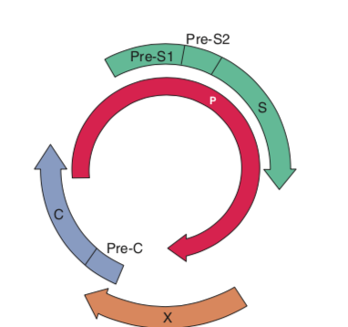
Hepatitis B virus
HBsAg proteins may be released from infected cells as small spherical or filamentous particles.
Beneath the envelope is the internal core or nucleocapsid, which contains hepatitis B core antigen (HBcAg).
The third antigen HBeAg is a truncated form of the major core polypeptide. It is released from infected liver cells in which HBV is replicating.
HBV has small compact circular DNA genome with eight genotypes (A–H) and four long (ORFs):
• C (core/nucleocapsid) gene, encodes HBcAg and HBeAg. Mutations in the pre-core region result in HBV mutants that lack HBeAg;
S (surface/envelope) gene, which includes the pre-S1, pre-S2, and s regions; encodes HBsAg;
P (polymerase) gene, encompasses 3/4 of the viral genome, encodes a polypeptide (DNA polymerase with ribonuclease H activity)
X gene, encodes a polypeptide, with several functions.

Slide 14
Epidemiology
HBV is a global public health problem ~400 million chronically infected and ~1 million deaths per year.
Prevalence ranges from 0.1–2% in low-prevalence countries (USA, West EU),10–20% in parts of China and sub-Saharan Africa.
Variation reflects differences of age which infection occurs (risk of chronicity is greatest in the very young) (90% for perinatal infections), compared to adults (5% become chronic).
HBV may be transmitted vertically/perinatally ( ^ high-prevalence areas), sexually, blood, by IV drug use, by needlestick injury, and horizontally (especially between children in intermediate-prevalence areas).
Perinatal transmission rates reach 90% in HBeAg-positive mothers the majority occur at or after birth (neonatal vaccination is 95% protective).

Slide 15
Clinical features
Acute hepatitis—incubation 1–4 months.
70% asymptomatic; 30% develop acute hepatitis.
Symptoms include malaise, nausea, abdominal pain, and jaundice.
Symptoms subside over 1–3 months, but fatigue may persist.
Fulminant hepatic failure occurs in 0.1–0.5% of acute infections and is thought to be immunologically mediated, rather than directly due to the virus.
Severe cases of acute disease should be considered for antiviral therapy.

Slide 16
Chronic hepatitis
5–10% of adult acute infections.
May be asymptomatic for many years.
Exacerbations of infection may occur, mimicking acute hepatitis or presenting as liver failure.
Extrahepatic manifestations (immune complex-mediated?) → serum sickness, polyarteritis nodosa, and membranous glomerulonephritis, with most cases seen in children (presents as nephrotic syndrome).

Slide 17
Chronic features,Three phases:
Replicative immune-tolerant phase (perinatal infections only)—high levels of virus (HBeAg-positive) but no hepatitis, normal ALT, and a largely normal liver;
Replicative immune clearance—HBeAg seroconversion may occur, often associated with biochemical exacerbations (due to an increase in immune lysis of infected hepatocytes) which may be misinterpreted as acute hepatitis B.
Inactive carrier state (most) in which liver disease is in remission and patients are HBeAg-negative, anti-HBe-positive, ALT usually normal, although some cases may still have histologically active liver disease.
Several normal ALTs and HBV viral loads over 12 months are required to confirm someone is inactive due to the fluctuating nature of disease.
Some patients have moderate HBV replication and active liver disease but remain HBeAg-negative, some variants cannot produce HBeAg due to pre-core or core promoter mutations. Such patients tend to be older with more advanced liver disease and fluctuations in HBV DNA and ALT.

Slide 18
A few patients with chronic HBV infection may show delayed clearance of HBsAg (around 0.5–2% patients per year). Some remain HBV DNA-positive.
Complications of chronic HBV:
End-stage liver disease (15-40 % of cases), hepatocellular carcinoma (HCC).
Disease progression is associated with HBeAg positivity, high DNA levels, those with prolonged replicative phase, alcohol, and co-infection with HCV or hepatitis D virus (HDV).

Slide 19
Diagnosis = serology
• HBsAg
appears 1–10 weeks after acute infection, prior to symptoms.
Those who clear infection become negative after 4–6 months.
Positivity beyond this time indicates chronic HBV.
Its disappearance is followed by the development of anti-HBs antibody.
A few patients may be positive for HBsAg and anti-HBs, suggesting that the antibody cannot neutralize the virus and patients are therefore carriers.

Slide 20
HBcAg
an intracellular antigen and not detectable in serum.
Anti-HBc is predominantly IgM in early infection and may be the only indicator of infection in the window between HBsAg loss and anti-HBs production.
It may remain for a couple of years, and titers can rise during flares, which may lead to the mistaken diagnosis of acute infection.
Isolated anti-HBc may be seen in two other situations: many years after recovery from acute HBV (anti-HBs fallen to undetectable levels), many years after chronic HBV (HBsAg fallen to undetectable levels).
HBV DNA may be detected in the liver of these patients.

Slide 21
HBeAg
A secretory protein and marker of HBV replication and infectivity.
Associated with high levels of HBV DNA.
HBeAg seroconversion to anti-HBe may be delayed for years in patients with chronic HBV.
When it occurs, it is usually associated with a decrease in DNA and reduction in liver inflammation.
Pre-core mutants however, may have active liver disease in the absence of HBeAg.

Slide 22
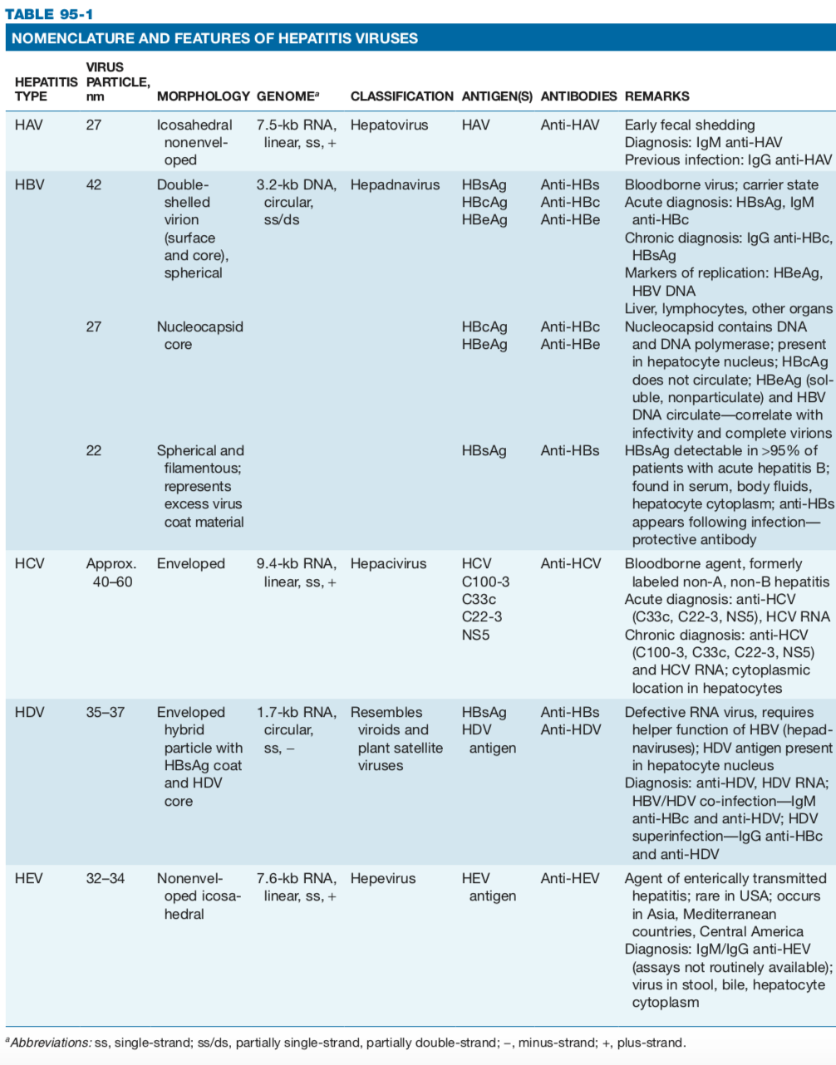
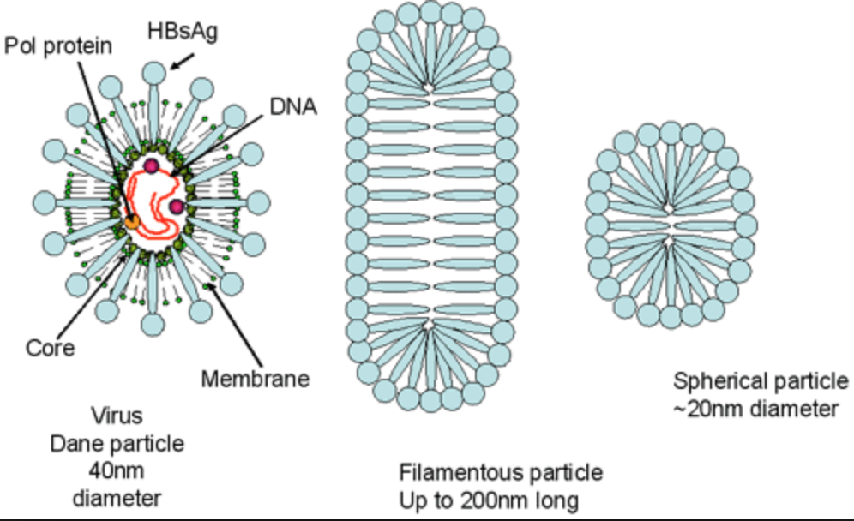

Slide 23
The outer surface HBsAg , is the envelope protein on of the virion, eight genotypes are identified according to this antigen (genotypes B and C are dominant in Asia, A and D in the US)
Subtype does not correlate to clinical picture, however genotype B is associated with less rapid progressive liver disease and lower chance or HCC than genotype C
Genotype A in patients is likely to be cleared (viremia) and patients achieve HBsAg seroconversion (with or without therapy)

Slide 24
Nucleocapsid core genes forms HBcAg (no signal added, not secreted) or HBeAg (with a signal protein added, secreted) this there are no naked core particles in serum HBcAg (only inside hepatocytes), however the secreted part HBeAg gives a good prediction on replication activity.
In serum → HBsAg +ve, and HBeAg +ve is highly infectious, thus detectable DNA is expected in this form rather than HBeAg –ve or with HBeABs
So a mother with HBsAg +ve and HBeAg +ve will >90% transmit HBV to child, HBeAg-ve mothers have 10-15% chance only
Resolution of HBeAg predict resolution of disease, having it +ve for more than 3 months → chronic state
Anti-HBs are deemed the protective antibody, as it seems to protect from reinfection, thus susceptiple people are given Anti-HBs for protection

Slide 25
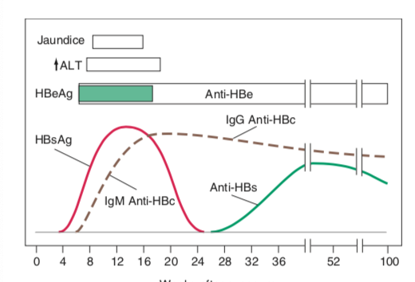
HBcAg is intracellular, thus not found in serum. AntiHBc within 1-2 weeks after HBsAg, and B4 Anti HBs. THUS window of
No HBsAg and AB, we can only detect Anti HBc (this gap can be weeks,errors of blood transfusion).
AntiHBc might be+ve in SOME HBsAg patients
ALT ^ following
HBsAG
HBeAg appears
With HBsAg,
refers to high
replication and
DNA.
HBsAg as early as 1-2 weeks, detected b4 ALT and symptoms by as much as 2-6 weeks, undetectable after 1-2 mths,
rare after 6, after HBsAg disappears → antiHBs are seen, remain forever.

Slide 27
Chronic HBV → HBsAg remains detectable after 6 months
→ Anti HBc is primarily IgG
→ no or very low Anti HBs
Non (low) replicative phase, 10% per year, coincides
With another peak in ALT, unlike
replicative phase only spherical and tubular forms,
NO intact virions, liver injury is less (v low)
(INACTIVE HBV carrier)
early chronic; DNA found serum & hepatocyte

Slide 28
HBV DNA assays
Real-time PCR techniques allow quantification of HBV DNA.
This is useful in determining whether a patient will benefit from therapy, as high levels are associated with cirrhosis and its complications.
DNA may remain detectable in the serum after recovery from acute infection, suggesting ‘clearance’ is more about ‘control’ by the immune system.
This contrasts with patients who become HBeAg negative during nucleoside/nucleotide therapy who generally have undetectable DNA by PCR.
Rare cases of occult HBV (detectable DNA, but negative HBsAg, and even absent anti-HBc) have been described—this may be due to mutations leading to altered expression or structure of HBsAg.

Slide 29
Other investigations:
LFTs, gamma-glutamyl transferase (GGT), clotting, screening for other blood-borne viruses and haemochromatosis, liver biopsy (disease severity).
Liver biopsy is especially important in those who do not meet treatment criteria but have high HBV DNA, as they may benefit from treatment if the disease is histologically active.
A normal ALT does not predict mild findings in someone with active viral replication.

Slide 30
Treatment
General:
avoid alcohol, practice safe sex, hepatitis A vaccination (low-prevalence areas), avoid occupations with high risk of transmission such as surgery, dentistry; HBV immunization of household members, monitor for HCC and varices.
Treatment
Treatment to prevent hepatitis B infection after exposure
Exposure with no previous vaccination history → immunoglobulin (AntiHBs) within 12 hours + vaccine
Treatment for acute hepatitis B infection
Supportive care unless severe cases or patients with underlying illness → antiviral drugs or a hospital stay is needed to prevent complications.
Treatment for chronic hepatitis B infection
Chronic HBV may require lifelong treatment to reduce risk of complications (HCC, liver failure) also reduce risk of transmission

Slide 31
Antiviral medications. Several antivirals: including entecavir (Baraclude), tenofovir (Viread), lamivudine (Epivir), adefovir (Hepsera) and telbivudine (Tyzeka), all help reduce amount of virus and thus reduce liver damage.
Interferon injections. Interferon alfa-2b (Intron A) mainly used for younger patients hepatitis B who wish to avoid long-term treatment or women who might want to get pregnant (cant be used in pregnancy) within a few years, usually given after a course of antiviral therapy.
Liver transplant. In the event of severe liver damage

Slide 32
Prevention
Education
Screening of blood products
Immunization (e.g. HCWs, MSM, close family contacts of an infected individual, those regularly receiving blood products, haemodialysis recipients)
Post- exposure vaccination (sexual contacts, needlestick recipients, neonates born to infected mothers).
Hepatitis B immunoglobulin should be given to neonates born to HBsAg-positive mothers (unless anti-HBe positive) and unvaccinated needlestick recipients from HBsAg-positive dono

Slide 33
Hep C virus
HCV is a spherical, enveloped RNA flavivirus.
Its genome is a positive ssRNA moleculeCodes for a single gene of large polyprotein (3k aa), cleaved to yield 10 proteins.
4 structural proteins, a nucleocapsid protein (C), two envelope glycoproteins (E1, E2), membrane protein (P7).
Envelope proteins are coded in hypervariable regions, core is conserved.
At least seven major genotypes (genotypes 1–7) exist, and these may be further grouped into subtypes (e.g. 1a, 1b, 1c).
Different subtypes predominate in different geographical locations.
The high replication rate and absence of proofreading by NS5b polymerase result in the rapid accumulation of mutations (multiple quasi-species exist at any one time).

Slide 34
Epidemiology
HCV infects an estimated 170 million people worldwide.
In developed countries, HCV prevalence is low (0.5–2%), injecting drug users.
HCV is commoner in certain areas (Egypt, Japan, Italy) and may be related to reuse of needles for injection, acupuncture, or folk remedies.
Transmission routes: transfusion, injecting drug use, nosocomial (needle- sticks, dialysis, inadequate sterilization of colonoscopes).
Vertical or sexual transmission is rare

Slide 35
pathogenesis
15% of people with acute infection clear the virus in 3–24 months
85% develop chronic infection.
HCV-specific cytotoxic T- lymphocyte (cellular) responses play an important role in suppressing HCV RNA levels.
There is a broad humoral response to HCV epitopes, but these are not sufficient to clear the virus.
Infection results in hepatic inflammation, steatosis and hepatic fibrosis and HCC (estimated risk 5–25% after 10–20 years).
Factors associated with cirrhosis include alcohol, HBV or HIV co-infection, HLA B54, HCV genotype 1b, and high levels of HCV viraemia. (Quasi species –high variance in subtypes within same host)

Slide 36
Clinical features
Acute hepatitis C → 75% of infections are anicteric (non jaundice).
Symptomatic infection is similar to acute HAV and HBV, but with lower transaminases. Presents 7–8 weeks (range 2–26) after exposure. If diagnosed early, treatment is appropriate.
Fulminant hepatitis C → unusual in the Western countries. Commoner in HBV co-infection. And in 40–60% of cases in Japan.
Chronic hepatitis C → 85% of patients, associated with fatigue, malaise, and reduced quality of life indices. ALT levels fluctuate independently of symptoms, whereas HCV RNA levels remain fairly constant. Eventually progresses to cirrhosis, decompensated liver disease, and HCC.
Extrahepatic manifestations → essential mixed cryoglobulinaemia, membranoproliferative glomerulonephritis, sporadic porphyria cutaneatarda, Mooren’s corneal ulcers, Sjögren’s syndrome, lichen planus, pulmonary fibrosis, thyroid hormone abnormalities. (hallmark: autoimmune syndromes)

Slide 37
Diagnosis
Serology
Detection of antibody to recombinant HCV peptides.
Third- generation enzyme linked assays have a sensitivity of ~97% and can detect HCV antibody within 6–8 weeks. The positive predictive value is ~95%, but much lower in low-prevalence populations such as blood donors; thus, confirmatory testing by HCV RNA detection is essential. Immunocompromised patients (including HIV) may have false-negative serology.
HCV RNA
Detectable within days to 2 months after exposure (varies with inoculum size). Qualitative tests can detect <50 IU/mL HCV RNA and are used to confirm diagnosis and achievement of a sustained virological response (SVR). Quantitative tests report a viral titre and are used to assess response to treatment. New real-time PCR assays detect <10–15 IU/mL and may be sensitive enough for both purposes.

Slide 38
Genotype testing—essential before treatment. The line probe assay reports the genotype and subtype. Currently only the genotype is used in planning therapy.
Liver disease severity—assessed prior to therapy. Important to identify cirrhosis, as prognosis and treatment selection are altered. Fibrosis can be assessed non-invasively (elastography), with liver biopsy reserved for those cases in which there is uncertainty or
Acute hepatitis C—diagnosis is confirmed by newly positive HCV RNA PCR and conversion to HCV antibody-positive within 12 weeks.
In the absence of a documented initial negative test, distinguishing acute from chronic is problematic. Circumstantial evidence, clinical features, timing of aminotransferase changes, and presence of liver fibrosis may help.
Chronic hepatitis C—positive ELISAs should be confirmed with a HCV RNA test. High-risk patients with negative PCRs should be retested a few months later, in case of false-negative results.

Slide 39
most sensitive indicator of HCV infection is the presence of HCV RNA, by PCR or transcription-mediated ampli- fication (TMA)

Slide 41
Treatment
The aim is to achieve a ‘sustained virological response’ (SVR, the absence of HCV RNA by PCR at 6 months after finishing treatment). An SVR is associated with 98–100% chance of being RNA-negative in the longer term and reduces all-cause mortality.
Treatment has been revolutionized by direct-acting antivirals such as sofosbuvir.
Response is affected by the genotype, race, baseline viral load, and certain host genetics
Cirrhotic patients achieving an SVR should continue to be monitored, as they remain at risk of HCC.

Slide 42
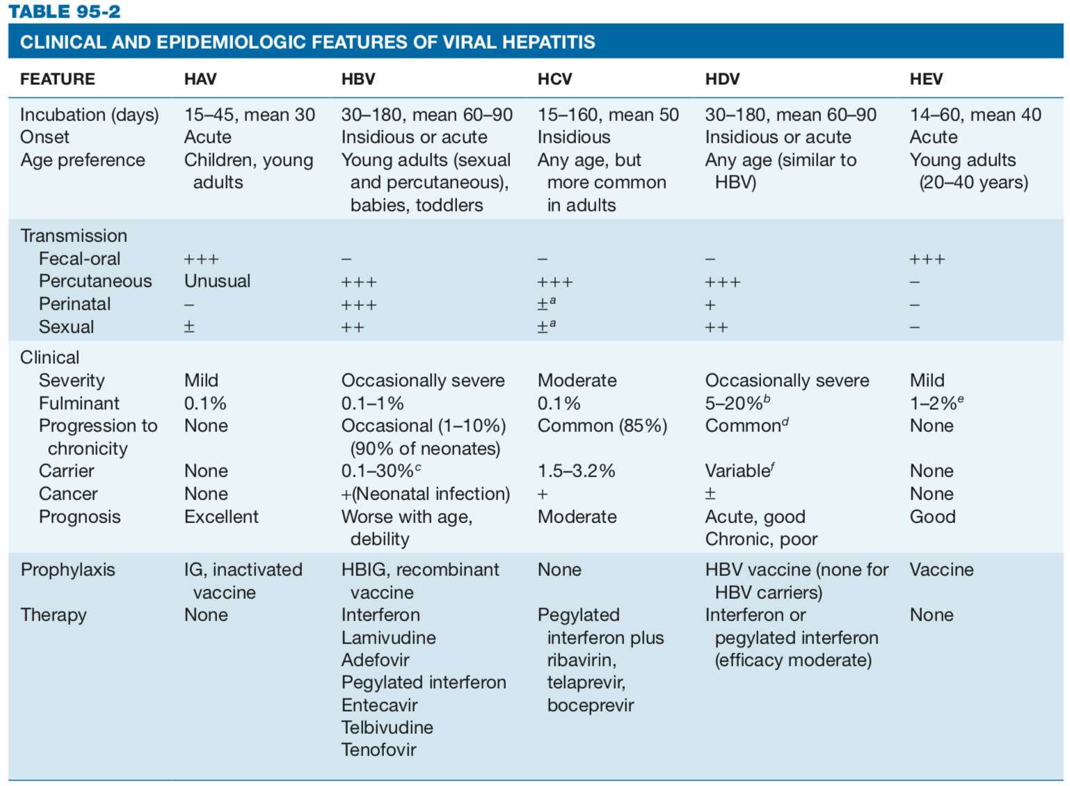

Slide 43
HDV
Hepatitis delta virus (HDV) is a defective virus whose replication requires HBV.
Hence those with HDV are always co-infected with HBV.
Virions of HDV consist of a core of delta antigen and single-stranded circular RNA enclosed in an envelope provided by HBV (with HBsAg).
8 genotypes.
Most patients with delta antigen in the liver have anti-delta antibodies in their serum.
HDV superinfection usually results in the suppression of HBV replication by mechanisms as yet unknown (HBsAg and HBV DNA levels drop).

Slide 44
Epidemiology
It is thought that 5% of chronic HBV carriers worldwide may be infected with HDV.
However, the prevalence of HDV in HBV carriers varies around the world—it is endemic in Mediterranean countries (around 10% in Italy) and the Far East (90% in the Pacific islands, 5% in Japan), but largely confined to at-risk groups in other Western countries.
There is a higher incidence of HDV infection in HBsAg-positive patients with acute and chronic hepatitis, compared with asymptomatic

Slide 45
Clinical features
• Symptoms range from asymptomatic to fulminant liver failure (rare, but still ten times commoner than in other viral hepatitis).
Clinical features seem to cluster in geographical areas that may relate to the prevailing genotype in that area, Western countries see higher rates of fulminant disease that may relate to genotype 1(which is dominat in these areas)
Simultaneous co-infection with HBV/HDV—causes acute hepatitis indistinguishable from classical acute hepatitis B (maybe with higher rates of liver failure, esp in IV drug abusers).
5% of people develop chronic HDV.
HDV superinfection of a carrier of HBV—may cause liver flare (may present as severe acute hepatitis if HBV is undiagnosed). up to 80% of people become chronically infected.
In the longer term, HDV seems to exacerbate the pre-existing liver disease due to HBV, with potentially rapid progression of cirrhosis (within 2 years).

Slide 46
HEV
Hepatitis E virus (HEV) is transmitted feco oral route
A member of the family Hepeviridae.
It is the commonest cause of acute hepatitis in certain parts of Asia (prevention for travelers).
Infection with hepatitis E may be asymptomatic or range in severity from mild to fulminant hepatitis
Fulminant disease is more common in pregnant women and elder men.

Slide 47
The virus
An icosahedral, non-enveloped ssRNA virus (30–32nm in diameter).
The genome is 7.2kb in length, encoding three ORFs—ORF1 encodes
non-structural proteins; ORF2 encodes the capsid; ORF3 encodes an
immunogenic protein of unknown function.
There are four genotypes—1 and 2 appear to be confined to humans;
3 and 4 infect humans and animals (pigs in the case of 3).
Genotype 3 may cause milder disease.

Slide 48
Epidemiology
Epidemiology similar to HAV
Highest incidence is in Africa, Asia, Central America, and the Middle East, and rising in the west.
HEV has a wide host range and has been shown experimentally to infect New and Old World monkeys, swine, rodents, and sheep
Transmission: Many epidemics of HEV have been waterborne(contaminated water), some food-borne (maybe undercooked meats), and infection may follow blood transfusion in endemic areas.
Transmission from animal (esp. swine) may occur (high seroprevalence amongst those with occupational exposure to animals). Person-to-person transmission (e.g. within a household) seems to be uncommon.
Perinatal transmission has been reported, and severe neonatal disease can occur.
Seroprevalence—the presence of anti-HEV antibodies is 15–60% in endemic countries, and higher than expected in non-endemic regions (overall uS rate reported at 21%, higher in those consuming organ meat).
In the US,UK most cases are due to genotype 3 (may not have clinical manifestations).
Peak incidence in 15–35 year olds (males>females) low in infants and children.

Slide 49
Clinical features
Maybe asymptomatic or range in severity from mild to fulminant hepatitis.
Acute cases of HEV are clinically indistinguishable from other viral hepatitis (more severe than HAV)
Symptoms: fever, nausea, vomiting, jaundice, and abdominal tenderness. Cholestasis may be prolonged; arthralgia and urticarial rash may occur.
Fulminant hepatitis is commoner in the third trimester of pregnancy and older men, and carries a high mortality (up to 20%) this accounts for the overall fatality rate of 0.5–3%
Outcome can be poor in those with chronic liver disease.
Chronic HEV infection occurs amongst organ transplant recipients

Slide 50
Diagnosis
Serology
Anti-HEV IgM can be detected in up to 90% of cases 1–4 weeks after acute infection, usually within the same period as symptoms occur.
By 3 months, anti-HEV IgM is only detectable in 50% of patients.
Anti-HEV IgG is detectable 2–4 weeks after onset of symptoms (one high titer or rising current titer suggest infection).
PCR
HEV is detectable by RT-PCR in blood and stool (viremia is short but may last upt o 4 months in some patients)
In stool, it appears around 1 week before illness onset, remaining until 2 weeks after.

Slide 51
Treatment
Supportive.
Transplant for liver failure
Reductions in immunosuppressive therapy can help chronically infected patients.

Slide 52
Diagnosis of viral hepatitis
First, diagnose HBV—HDV cannot exist without it. Consider HDV in those with acute HBV if they have HDV risk factors or experience particularly severe hepatitis, and in those with established HBV with severe liver flare.
HDV antibodies—appear late (4 weeks) and may vanish after resolution of acute infection.
Present in high titers in chronic infection.
HDV RNA—can be detected in serum by hybridization or RT-PCR assays.
Differentiating between HBV/HDV co-infection and HDV superinfection relies on the detection of high levels of IgM anti-HBc (in those co-infected).

Slide 53
Clinical features
There are no clinical features that distinguish the various causes.
Acute viral hepatitis can be divided into four clinical stages:
incubation period, pre-icteric phase, icteric phase, and convalescence.
Clinical features may range from
asymptomatic disease to anorexia, malaise, abdominal pain, and jaundice to fulminant hepatic failure.
hepatitis B and C may cause immune complex-mediated diseases, e.g. serum sickness, polyarteritis nodosa (hBV), glomerulonephritis, mixed cryoglobulinaemia.
Fulminant viral hepatitis, characterized by liver failure and hepatic encephalopathy, occurs within 8 weeks after onset of symptoms.

Slide 54
Diagnosis
routine blood tests—AST and ALT are usually very high, with bilirubin levels variably increased.
A prolonged PT is rare and suggests severe hepatic necrosis.
Serology—anti-hAV IgM, hBsAg and anti-hBc IgM, and anti-hCV should be performed initially (see next slide).
If these are negative, other diagnoses should be considered.
Liver ultrasound is usually normal in acute viral hepatitis.
Other abnormalities such as hepatic lesions, cirrhosis, portal hypertension, or ascites suggest alternative diagnoses.
Liver biopsy may be performed to establish the diagnosis in acute hepatitis with negative serology.

Slide 55
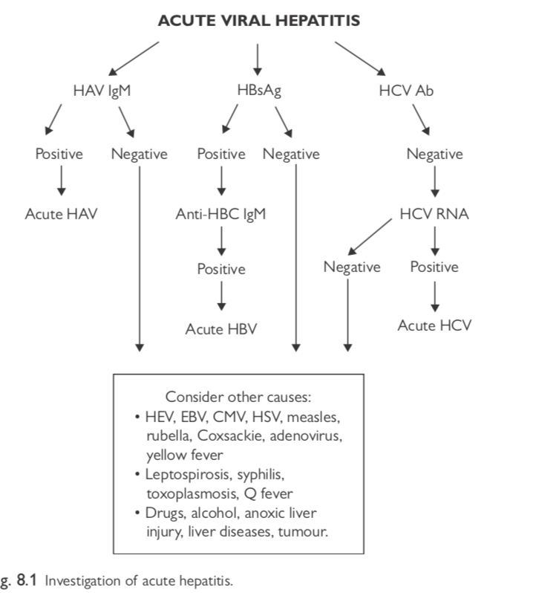

Slide 56
Chronic Hepatitis

Slide 57
Clinical features
There are no specific clinical features, and many patients remain asymptomatic, until they develop end-stage liver disease.
Non-specific features (e.g. fatigue and right upper quadrant discomfort) are common.
Symptoms, such as jaundice, weight loss, abdominal distension, or confusion, suggest decompensation.
Examination may show signs of chronic liver disease (e.g. palmar erythema, Dupuytren’s contractures, jaundice, spider naevi, hepatosplenomegaly, caput medusae, ascites).
Clinical features of hepatic encephalopathy include confusion, drowsiness, asterixis, ophthalmoplegia, and ataxia.

