Slide 1
The Gastrointestinal System

Slide 3
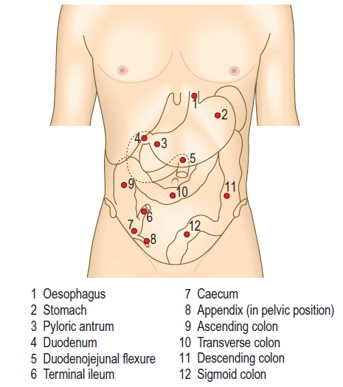

Slide 5
ANATOMY
Transpyloric L1
Transtubercular L5

Slide 6
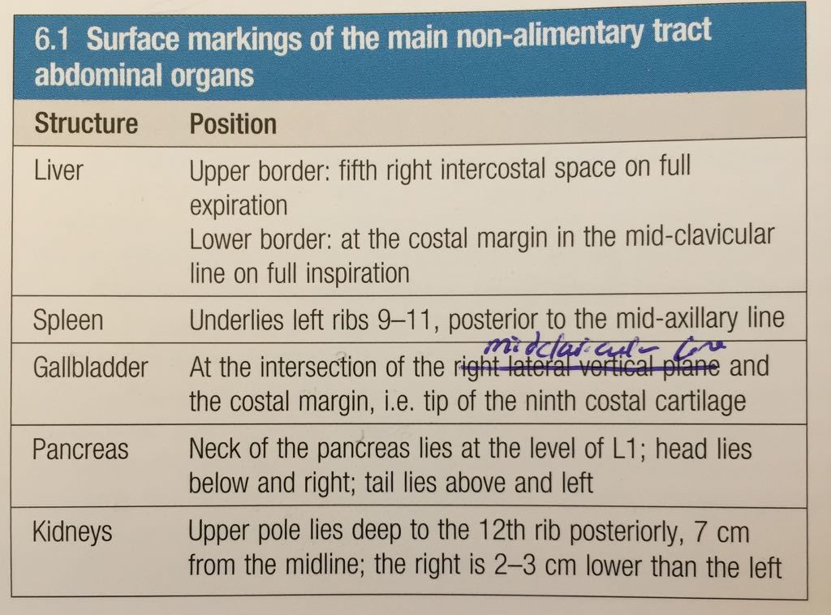

Slide 7
The history

Slide 9
Common presenting symptoms

Slide 10
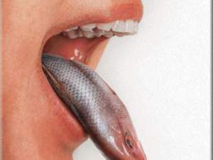
Mouth Symptoms
Halitosis
Xerostomia
Dysgeusia
Cacogeusia

Slide 11
Weight loss
SIGNIFICANT WEIGHT LOSS
2% IN ONE MONTH
5% in 3 months
10% IN 6 MONTHS

Slide 12
Causes of weight loss
Reduced energy intake
Dieting
Loss of appetite, e.g malignancy .
Malabsorption.
Malnutrition.

Slide 13
2. Increased energy expenditure
Hyperthyroidism.
Fever.
Adoption of a more energetic lifestyle.

Slide 14
A net calorie deficit of 1000 kcal/day produces a weight loss of approximately 1 kg/week .
Greater weight loss during the initial stages of energy restriction arises from salt and water loss and depletion of hepatic glycogen stores, and not from fat loss.
Rapid weight loss over days suggests loss of body fluid as a result of vomiting, diarrhea or diuretic therapy.

Slide 15
Ask how much weight has been lost
Over what time
Current and previous weight records to confirm apparent weight loss
Loose fitting clothes

Slide 16
Anorexia
Loss of appetite and/or lack of interest in food

Slide 17
Pain

Slide 18
Painful Mouth

Slide 19
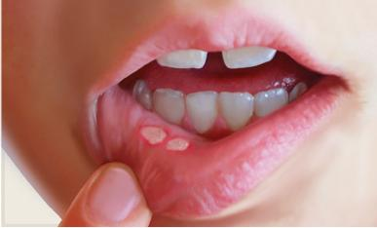
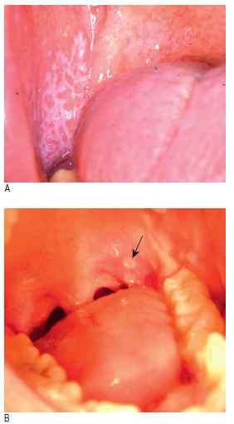

Slide 20
causes
Iron, Folate, Vitamin B12, Vitamin C deficiency
Dermatological (lichen planus)
Chemotherapy
Apthus ulcer
Infective stomatitis
Inflammatory bowel disease

Slide 21
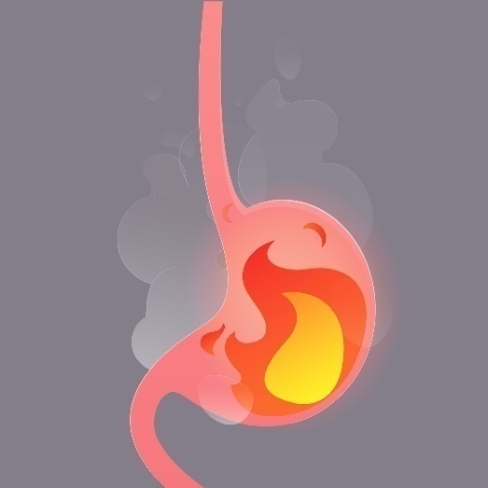
Heartburn and reflux
Heartburn is a hot, burning retrosternal discomfort which radiates upwards.
Reflux is a sour taste in the mouth from regurgitating gastric acid.
Waterbrash is the sudden appearance of fluid in the mouth due to reflex salivation as a result of GERD or, rarely, peptic ulcer disease.

Slide 22
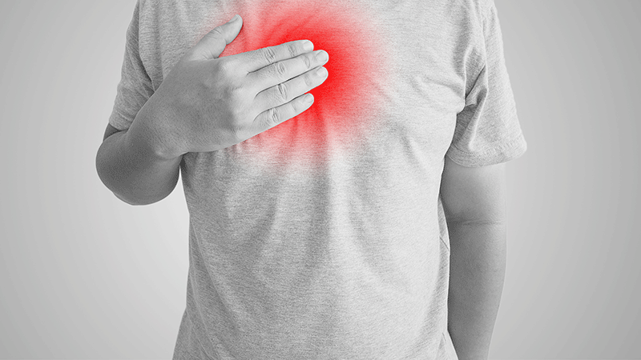
Heartburn VS. Cardiac pain
Character
Radiation
Precipitating factors
Associated symptoms

Slide 23
Dyspepsia
Reflux-like dyspepsia
(heartburn-predominant dyspepsia)
Ulcer-like dyspepsia
(epigastric pain relieved by food or antacids)
Dysmotility-like dyspepsia
(nausea, belching, bloating and premature satiety).

Slide 24
Odynophagia
Pain upon swallowing.
It can be present with or without dysphagia, and often precipitated by drinking hot liquids.
It indicates active oesophageal ulceration or oesophagitis from GERD or oesophageal candidiasis.

Slide 25
Abdominal pain

Slide 26
SITE
Visceral abdominal pain
Arises from visceral peritoneum , distension of hollow organs, mesenteric traction or excessive smooth-muscle contraction
It is deep and poorly localized in the midline.
It is conducted via sympathetic splanchnic nerves.

Slide 28
Somatic pain
Arises from the parietal peritoneum and abdominal wall.
It is lateralised and localised to the area of inflammation, and conducted via intercostal (spinal) nerves.
Examples ..cholecystitis , appendicitis, diverticulitis..

Slide 29
Onset
The sudden onset of severe abdominal pain, rapidly progressing to become generalized and constant, suggests a hollow viscus perforation, a ruptured abdominal aortic aneurysm or mesenteric infarction.
Cecal or sigmoid volvulus occur with sudden abdominal pain associated with intestinal obstruction

Slide 30
Character
Colicky pain lasts for a short time (seconds or minutes) eases off and then return. arises from hollow structures such Small and large bowel obstruction.
Dull constant vague and poorly localized pain is suggestive of inflammation, e.g.. salpingitis, appendicitis or diverticulitis.

Slide 31
Biliary colic is misnamed , as the pain is rarely colicky , pain rapidly increases to a peak and persists over period of time before gradually resolving

Slide 32
Radiation
Notes:
Pancreasitis , aneurysm , appendicitis , cholecytitis , renal

Slide 33
Associated symptoms
Non-specific symptoms : Anorexia, nausea and vomiting are common but may be absent even in advanced intra-abdominal disease.
altered bowel habits : IBS, CRC, Diverticular disease
Breathlessness and Palpitations – non alimentary causes
Tachycardia , hypotension – sepsis or bleeding

Slide 34
Timing
Frequency and duration
acute appendicitis: (periumbilical -right iliac fossa –generalized) -> changing with time to the somatic pain in the RIF )
Silent interval: 1-2 hours after perforation
Change of pattern : either wrong diagnosis or complications happened
Abdominal pain persisting for hours or days suggests an inflammatory disorder
( appendicitis,cholecystitis,diverticulitis)

Slide 35
Exacerbating and relieving factors
Pain due to inflammation is exacerbated by movement or coughing suggests.
Patients tend to lie still in order not to exacerbate the pain.
Patients with colic typically move around or draw their knees up towards the chest during painful spasms.

Slide 36
Severity
Excruciating pain, poorly relieved by opioid analgesia, suggests an ischemic vascular event, e.g. bowel infarction or ruptured abdominal aortic aneurysm.
Severe pain rapidly eased by potent analgesia is more typical of acute pancreatitis or peritonitis secondary to a ruptured viscus.

Slide 37
Notes:
< 6 HOURS COLIC , >24 HOURS CHOLECYTITIS, RENAL COLICK (COLICKY – INTERMITTANT ) , LEANING FORWARD

Slide 38
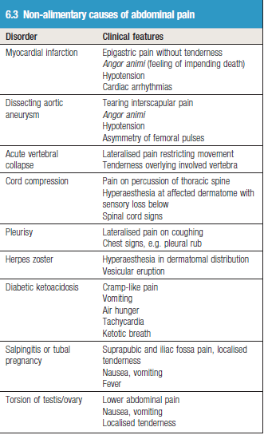

Slide 39
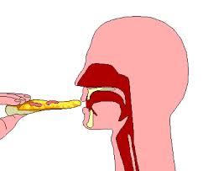
Dysphagia
Dysphagia is difficulty swallowing.
Oral vs esophageal
Not Early satiety
Not Globus

Slide 40
Onset: recent or longstanding
Progressive VS. intermittent.
Liquids VS. Solids.
Level of stucked food
Regurgitation of food or fluids
Associated symptoms ( wt loss, heartburn, odynophagia)

Slide 41
Neurological :
liquids > solids , choking , spluttering , regurge from nose
Neuromuscular :
worse for solids , improves with liquid and setting upright
Dysmotility :
central chest pain
Pharyngeal pouch :
halitosis , recurrent chest inf.
Mechanical :
benign vs malignant , ask about associated symptoms

Slide 42
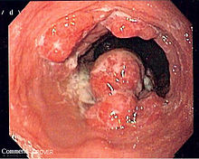
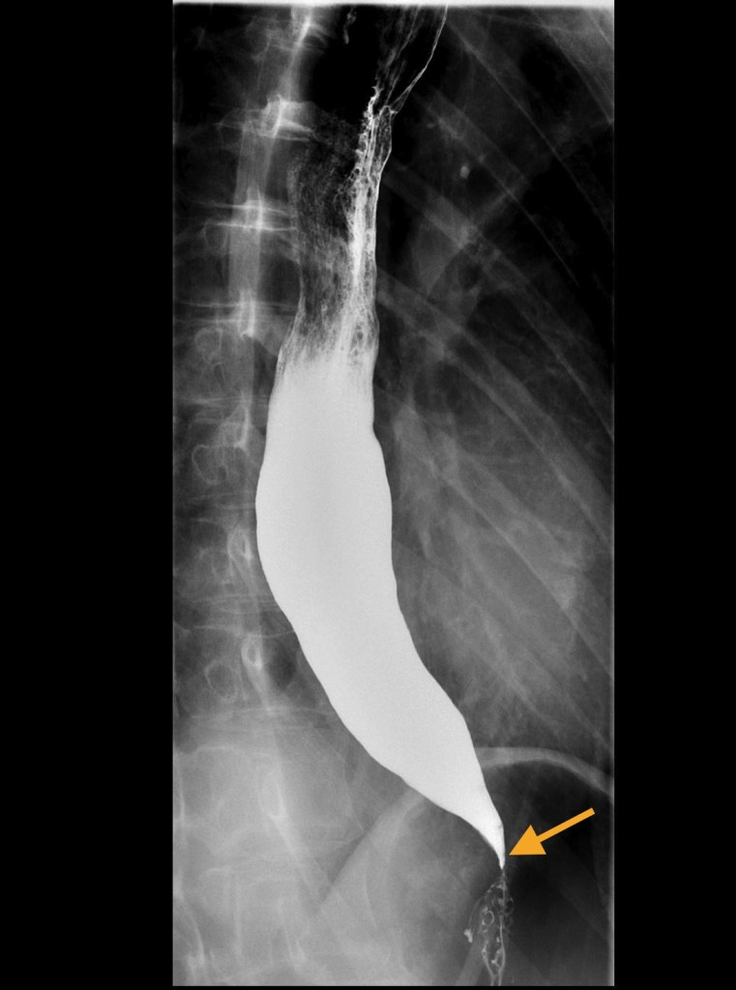
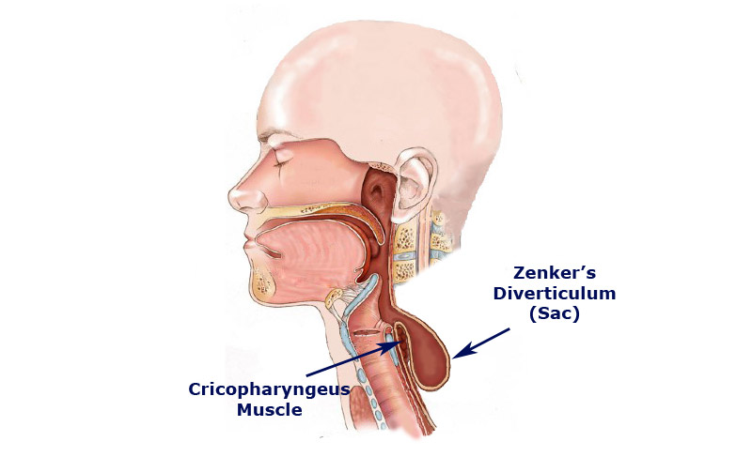

Slide 44
Nausea and vomiting
Frequency
amount
Relation to meals and timing
Associated symptoms
Content : Bile stained , Blood stained or faeculant
Wt loss
medications

Slide 45
Dyspepsia
Peptic ulcer
peritonitis
Gastric outlet
Small or large bowel obstruction
Notes:
Could be associated with pallor, sweating and hyperventilation.
Dyspepsia → nausea without vomiting
Gastric outlet obstruction → projectile vomiting of large volumes of gastric content without significant pain that is not bile-stained (green).
Obstruction distal to the pylorus → bile-stained vomit.

Slide 46
Non GI causes
Drugs
Pregnancy
DKA
Renal or Liver failure
Hypercalcemia
Addsion’s disease
Raised intracranial pressure
Vestibular disorder

Slide 47
Eating disorders
Anorexia nervosa.
Bulemia nervosa.

Slide 48
Wind and flatulence
Belching
It is due to air swallowing (aerophagy) and has no medical significance.
It may indicate anxiety, but sometimes occurs in an attempt to relieve abdominal pain or discomfort, and accompanies GERD.

Slide 49
Excessive flatus
Mixed gases from aerophagia and bacterial fermentation in colon
Normally 200–2000 ml of flatus is passed each day.
Excessive flatus occurs particularly in lactase deficiency and intestinal malabsorption

Slide 50
Borborygmi
audible bowel sounds
Loud borborygmi, particularly if associated with colicky discomfort, suggest small-bowel obstruction or dysmotility.

Slide 51
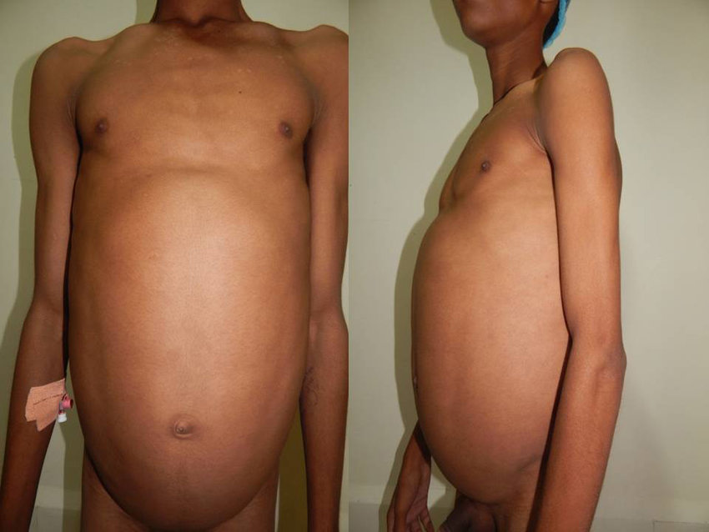
Abdominal distention
Notes:
Increased abdominal girth

Slide 54
Altered Bowel Habit

Slide 55
Diarrhea more than 3 times daily or frequent passage of loose stool
Clarify : frequency vs. consistency
Steatorrhea : fat 7g/day
Greasy, pale, bulky,
float, difficult to flush

Slide 56
Ask about:
Onset :
Acute, Chronic, intermittent
Stool:
frequency, volume, color, consistency (watery, unformed, semisolid),
Content (red blood,mucus,pus)
Associated features:
urgency, fecal incontinence, tenesmus, abdominal pain, vomiting, sleep disturbance.
Recent travel
Medications

Slide 57
High-volume diarrhea (>1 liter per day) occurs when stool water content is increased
Low-volume diarrhea is associated with the irritable bowel syndrome.

Slide 58
Secretory: due to intestinal inflammation, e.g. infection, or inflammatory bowel disease.
Osmotic: due to malabsorption, adverse drug effects or motility disorders.

Slide 59
Causes → high volume diarrhea
Infective gastroenteritis – most common , norovirus/ salmonella/ c.diff , if > 4 weeks → chronic ( giardia , amebic )
IBD → bloody
Colonic ischemia → bloody
Colon cancer → rt sided ca
Thyrotoxicosis → secretory
Celiac disease → steatorrhea
Chronic pancreatitis → steatorrhea
Cystic fibrosis → steatorrhea
Notes:
Norovirus is the most

Slide 60
Causes → low volume diarrhea
Irritable bowel syndrome → pain , dyspepsia , bloating → rome criteria of diagnosis of IBD ( not required )

Slide 61
Constipation Less than once in three days
Infrequent passage of hard stool
Onset: lifelong, recent
Stool frequency: How frequent, time spent straining
Shape of stool → Bristol classification ( not required )
Associated symptoms: pain, anal pain, rectal bleeding
Drugs

Slide 62
Obstipation:
Absolute constipation with no gas or bowel movements, suggests intestinal obstruction
Tenesmus: feeling of incomplete evacuation, suggests rectal inflammation or cancer(the sensation of needing to defecate although the rectum is empty)
Anesmus : difficulty to empty the rectum despite straining due to paradoxical contraction of puborectalis muscle

Slide 63
Causes
Lack of fibers
IBS
Intestinal obstruction (CA)
Drugs
Immobility
Metabolic\endocrine

Slide 64
Bleeding
Haematemesis
vomiting blood, which can be fresh and red, or when it is dark brown in colour and resembles coffee grounds.
Ask about :
Color → fresh , coffee ground
Amount
Onset
Previous hx
Alocohol , nsaid , steroids

Slide 65
Melaena
the passage of tarry, shiny black stools with a characteristic odor and results from upper gastrointestinal bleeding.
Distinguish this from the matt black stools associated with oral iron or bismuth therapy.

Slide 66
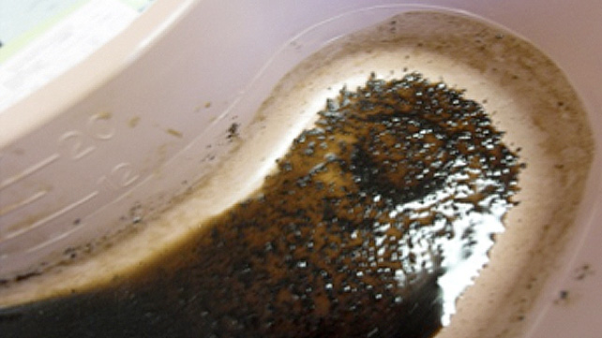
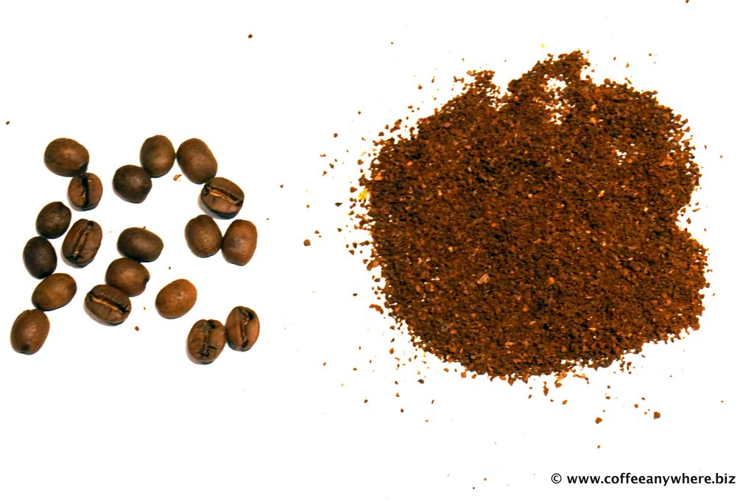
Melena: > 50 ml\day
Hemoccult: >20 ml\day

Slide 67
Fresh rectal bleeding (heamatocazia)
indicates a disorder in the anal canal, rectum or colon .
Blood may be mixed with stool, coat the surface of otherwise normal stool, or be seen on the toilet paper or in the pan.
During severe upper gastrointestinal bleeding, blood may pass through the intestine unaltered, causing fresh rectal bleeding.

Slide 68
Causes of rectal bleeding

Slide 69
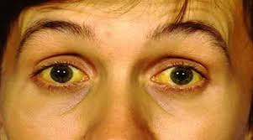
Jaundice
Jaundice is a yellowish discoloration of the skin, sclerae and mucous membranes due to hyperbilirubinaemia.
Most clinicians will recognize jaundice when bilirubin levels exceed 3 mg\dl

Slide 72
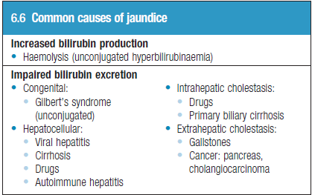

Slide 74
Prehepatic jaundice
Hepatic jaundice
Posthepatic / cholestatic jaundice

Slide 75
Direct VS. Indirect hyperbiliirubenemia
Indirect : <20 % of congugated(D) billrubin
Mixed : 20-50% of congugated(D) billrubin
Direct : >50% of congugated(D) billrubin

Slide 76
Groin swellings and lumps
Hernia
Lymph nodes
Skin and subcutaneous Lumps
Saphena varix
Hydroceele
Undescended testis
Femoral aneurysm
Psoas abscess

Slide 77
Past history
History of a similar problem may suggest the diagnosis: for example, bleeding peptic ulcer or inflammatory bowel disease.
Primary biliary cirrhosis and autoimmune hepatitis are associated with thyroid disease.
(NAFLD) is associated with diabetes and obesity.

Slide 78
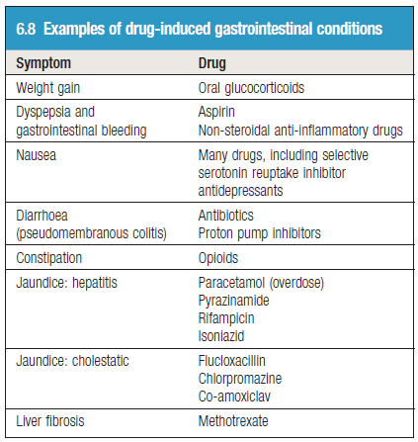
Drug history

Slide 79
Family history
Inflammatory bowel disease is more common in patients with a family history of either Crohn’s disease or ulcerative colitis.
Colorectal cancer in a first-degree relative increases the risk of colorectal cancer and polyps.
Peptic ulcer disease is familial but this may be due to environmental factors, e.g. transmission of Helicobacter pylori infection.

Slide 80
Gilbert’s syndrome is an autosomal dominant condition.
Haemochromatosis and Wilson’s disease are autosomal recessive disorders.
Autoimmune diseases, particularly thyroid disease, are common in relatives of those with primary biliary cirrhosis and autoimmune hepatitis.
A family history of diabetes is frequently seen in the context of NAFLD

Slide 81
Social history
Dietary history and food intolerance
alcohol consumption
Smoking
risk of oesophageal cancer, colorectal cancer, Crohn’s disease and peptic ulcer, while patients with ulcerative colitis are less likely to smoke.
stress
Irritable bowel syndrome and dyspepsia
Foreign travel

Slide 82
Risk factors for liver disease
IV drug abuse
Tattoos
Foreign travel
Blood transfusion
Homosexuality
Multiple sexual partners
History of hepatitis B or C

Slide 83
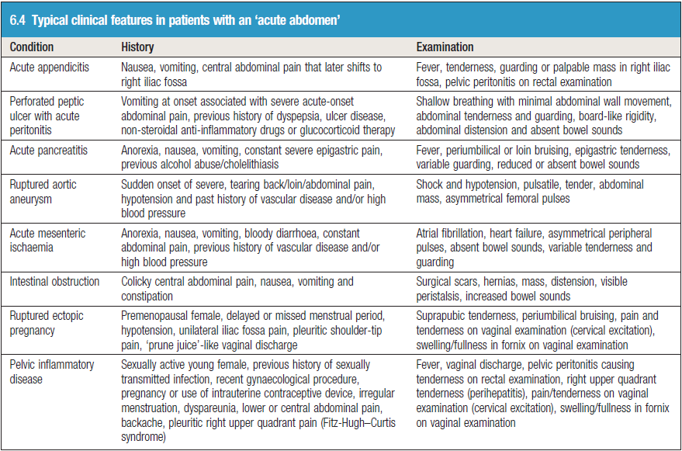
Acute abdomen

Slide 84
Thank you

