Slide 1
Cardiovascular system History and physical examination
Farah Abuazzam

Slide 2
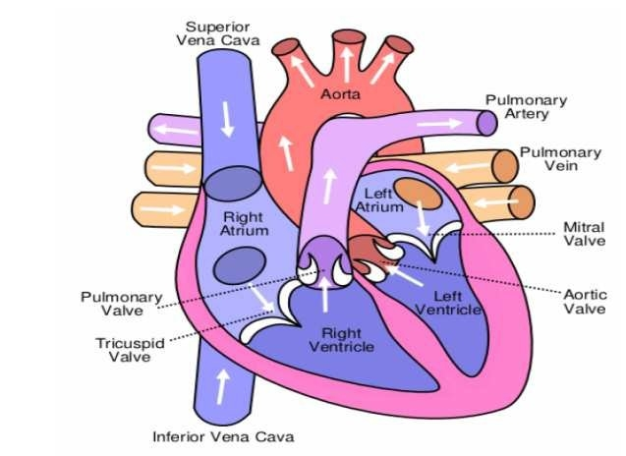
ANATOMY & PHYSIOLOGY

Slide 3
Normal resting pressure in the heart and great vessels

Slide 4
HISTORY
Common presenting symptoms:
Chest pain
Dyspnoea
Palpitation
Syncope and presyncope
Oedema

Slide 5
1. Chest pain

Slide 6
Chest pain
SOCRATES
Always ask about its relation to exertion and degree of limitation caused by symptoms
DDx:
Angina
Myocardial infarction
Aortic dissection
Pericarditis
Oesophageal Spasm
Pneumothorax
Musculoskeletal pain

Slide 7
Angina
Chest pain due to inadequate oxygen supply to the heart muscle
Causes:
Coronary atherosclerosis (Chronic fixed narrowing of the coronaries)
Aortic stenosis
Hypertrophic cardiomyopathy

Slide 8
Angina
Site | retrosternal
Onset | progressive, increase in intensity over 1-2 minutes
Character | Constricting, heavy
Radiation | Sometimes arm, neck, epigastrium
Associated features | Dyspnoea
Timing | Intermittent, with episode lasting 2-10 minutes
Exacerbating/relieving factors | Triggered by emotion, exertion, cold, large meal Relieved by rest, nitrates
Severity | Mild to moderate

Slide 9
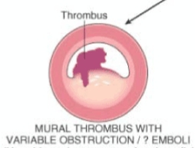
Stable vs. unstable angina
Unstable angina: atherosclerotic plaque rupture with non-occlusive thrombus
New onset chest pain < 6 weeks, or < 2 weeks post-MI
Worsening in severity, frequency, less responsive to nitrates
Occur with minimal exertion or at rest

Slide 10
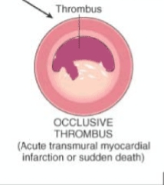
Myocardial infarction
Atherosclerotic plaque rupture with occlusive thrombus
The symptoms are move severe and prolonged than angina
+ve autonomic symptoms: nausea, vomiting, pallor, sweating
Angor animi: feeling of impending death

Slide 11
MI
Site | Retrosternal
Onset | Rapid over few minutes
Character | Constricting, heavy
Radiation | Arms, neck, jaw, epigastrium
Associated symptoms | Autonomic symptoms, angor animi, SOB
Timing | Acute presentation, prolonged duration >30 minutes
Exacerbating/relieving factors | Stress and exercise are rare triggers, usually spontaneous Not relieved by rest or nitrates
Severity | Usually severe

Slide 12
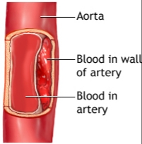
Aortic dissection
Tear in the intima of aorta
Associated with profound autonomic stimulation
If the tear involves the cranial or upper limb arteries, there may be associated syncope, stroke, or upper limb pulse asymmetry
Predisposing factors:
HTN
CTD (Marfan syndrome)

Slide 13
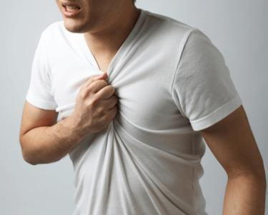
Aortic dissection
Site | Interscapular/retrosternal
Onset | Very sudden
Character | Tearing, ripping
Radiation | Back, interscapular
Associated features | Sweating, syncope, focal neurological deficit, signs of limb ischemia, mesenteric ischemia
Timing | Acute presentation, prolonged duration
Exacerbating/relieving factors | Spontaneous, no manoeuvres relieve pain
Severity | Very severe

Slide 14
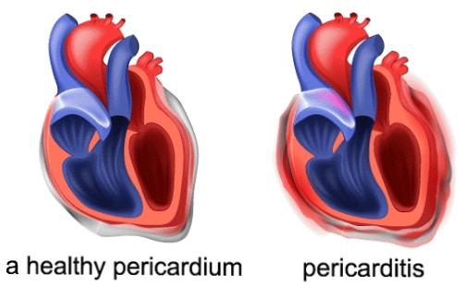
Pericarditis
Inflammation of the pericardium
Causes:
Viral infection
CTD
MI
After surgery, catheter ablation or radiotherapy

Slide 15
Pericarditis
Site | Retrosternal or left sided
Onset | Gradual, postural changes may suddenly aggravate
Character | Sharp, stabbing
Radiation | Left shoulder or back
Associated symptoms | Flu-like prodrome, SOB, fever
Timing | Acute presentation, variable duration
Exacerbating/relieving factors | Sitting up/lying down, inspiration worsen pain Relieved by NSAID, leaning forward
Severity | Can be severe

Slide 16
Oesophageal spasm
Site | Retrosternal or epigastric
Onset | Over 1-2 minutes, can be sudden (spasm)
Character | Gripping, tight or burning
Radiation | Often to back, sometimes to arms
Associated symptoms | Heartburn, acid reflux
Timing | Intermittent, often at night-time, variable duration
Exacerbating/relieving factors | Triggered by lying flat and some food Not relieved by rest Nitrates sometimes relieve
Severity | Usually mild but oesophageal spasm can mimic MI

Slide 17
2. Dyspnea

Slide 18
Dyspnoea (breathlessness)
Unpleasant awareness of breathing
Acute vs. Chronic
Causes of acute SOB:
Heart failure-most common cause (Acute or chronic)
Pulmonary embolism
Arrhythmias

Slide 19
Mechanisms of heart failure

Slide 20
Angina equivalent
SOB caused by MI
May be accompanied with chest pain
Elderly, DM
Identical precipitant to angina and relived with nitrate

Slide 21
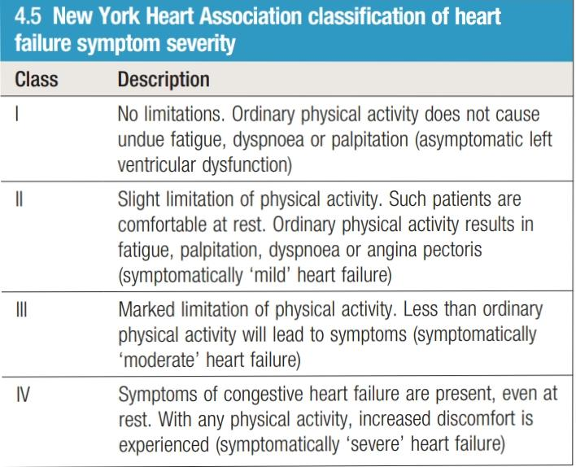
Exertional dyspnea, orthopnea, paroxysmal nocturnal dyspnea
Exertional dyspnea: the symptomatic hallmark of heart failure
NYHA grading system to assess the degree of symptomatic limitation caused by exertional SOB of heart failure

Slide 22
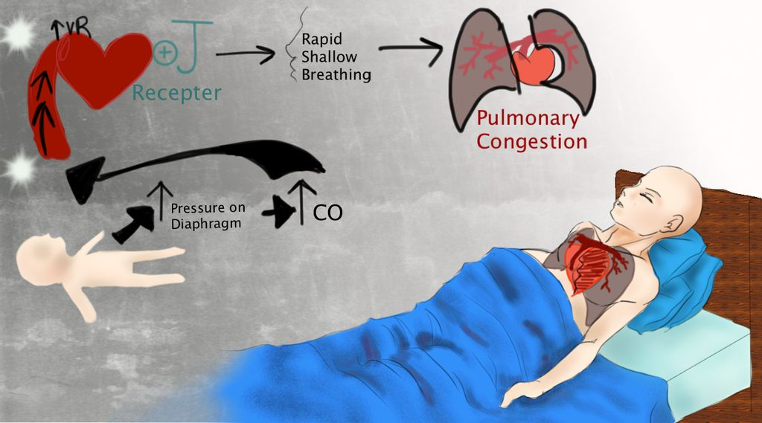
Orthopnea
Dyspnea on lying flat
Mechanism: increase venous return
Severity is assessed by the number of pillows used at night
The most severe form on dyspnea

Slide 23
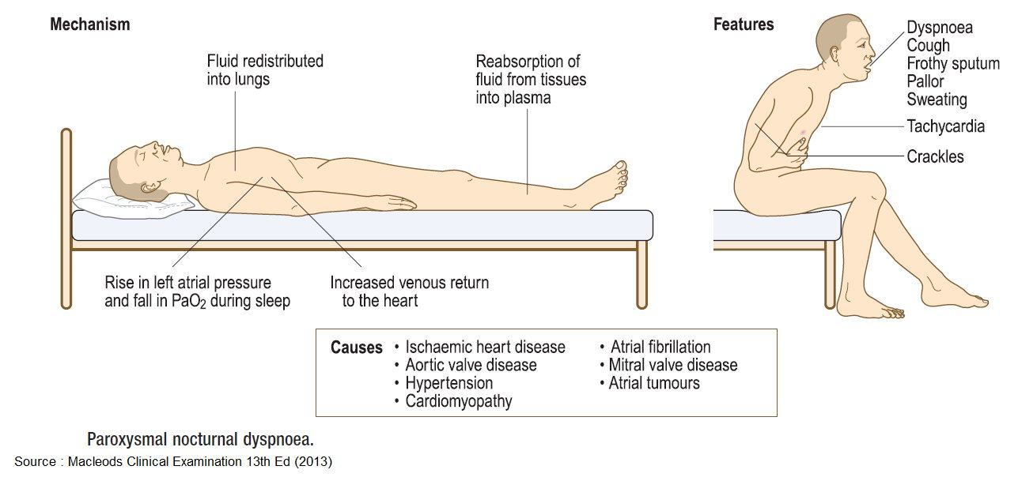
Paroxysmal nocturnal dyspnea (PND)
SOB awaken patient from sleep
Same mechanism and orthopnea
Pt describe episode of choking or gasping for air, relieved by sitting
VS. Asthma attack

Slide 24
Acute dyspnoea Chronic dyspnoea
Ask about:
duration of onset
Background symptoms of exertional dyspnoea and usual exercise tolerance
Associated symptoms: chest pain, syncope, palpitation or respiratory symptoms (cough, sputum, wheezes, haemoptysis)
Ask about:
Relationship between symptoms and exertion
degree of limitation caused by symptoms and their impact on everyday activities
effect of posture on symptoms and/or episodes of nocturnal breathlessness
associated symptoms: ankle swelling, cough, wheeze or sputum.

Slide 25
3. Palpitation

Slide 26
Palpitation
Unexpected or unpleasant awareness of the heart beating in the chest
Ask about:
Nature of palpitation (Heart beats rapid, forceful, irregular)
Timing of symptoms: speed on onset and offset, frequency and duration of episodes
Precipitants for symptoms or relieving factors
Associated symptoms: presyncope, syncope, chest pain
History of cardiac disease

Slide 27
In healthy people
More common in bed at night in slim people while lying on their left side
After exercise or in stressful situation will be aware of their heart beating with normal sinus rhythm

Slide 28
Benign, At rest
Abolished by exercise underfilling alternating with overfilling of left ventricle
Affects young
Regular, sudden paroxysms
Affects pts with underlying cradiomyopathy, or previous MI

Slide 29
High risk features for life-threatening arrhythmia
Previous MI or cardiac surgery
Associated syncope or severe chest pain
Family hx of sudden death
Wolff-Parkinson-white syndrome
Significant structural heart disease (HCM, AS)

Slide 30
4. Syncope/presyncope

Slide 31
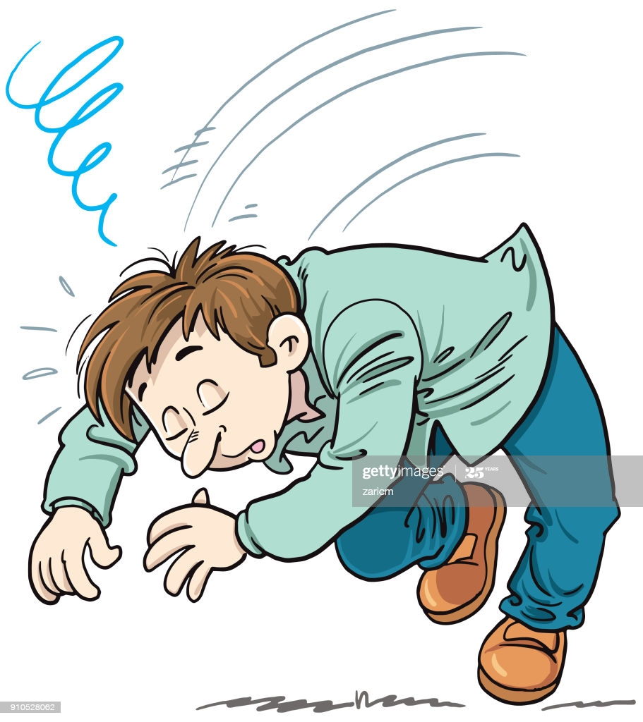
Syncope and presyncope
Syncope: Transient loss of consciousness due to transient cerebral hypoperfusion
Presyncope: sensation of lightheadedness and impending loss of consciousness without progressing to acute LOC

Slide 32
For SYNCOPE ask about:
Ask about witness
Circumstances of the event and any preceding symptoms (palpitation, chest pain, lightheadedness, nausea, tinnitus, sweating and visual disturbance)
Duration of LOC, appearance of the patient while unconscious and any injuries sustained.
Time to recovery to full consciousness and normal cognition
Current driving status, including occupational driving

Slide 33
For PRESYNCOPE ask about:
Exact nature of symptoms and associated features as palpitation
Precipitants for symptoms such as postural changes, prolonged standing, intense emotion or exertion
Frequency of episodes and impact on lifestyle
Possible contributing medications as antihypertensive meds

Slide 34
Causes of syncope/presyncope
Postural hypertension
Neurocardiogenic syncope
Hypersensitive carotid sinus syndrome (pressure over carotid sinus may lead to reflex bradycardia and syncope
Arrhythmia
Mechanical obstruction of cardiac output

Slide 35
Postural hypotension as a cause of syncope
A fall > 20 mmHg in systolic BP, > 10 mmHg in diastolic BP on standing with reflex tachycardia of 15-20 bpm increase in heart rate
Causes:
Hypovolemia
Drugs
Autonomic neuropathy
- Common in elderly, esp. above 65 years

Slide 36
Vasovagal syncope
Mechanism: abnormal autonomic reflexes produce a sudden bradycardia and/or vasodilatation
In healthy people forced to stand for a long time in warm environment or subject to painful or emotional stimuli such as sight of blood
VS. seizure
Prodrome of lightheadedness, tinnitus, nausea, sweating, facial pallor, darkening of vision from periphery
Slides to floor losing consciousness
Wakes up, flushing, and nausea, even vomiting
DON’T HOLD THE PATIENT UPRIGHT
This will worsen cerebral hypoperfusion, leading to delays recovery and possible progression into seizure

Slide 37
Arrhythmia as a cause of syncope
Most common cause is bradyarrhythmia
Stoke-Adams attacks: episodic LOC secondary to sinoatrial disease or AV block
Drugs
Ventricular tachycardia causes syncope more often than supraventricular tachycardia esp. in patient with impaired LV function

Slide 38
Mechanical obstruction to ventricle outflow as a cause of syncope
1. Left ventricular outflow obstruction (related to exertion)
Severe aortic stenosis
Hypertrophic cardiomyopathy
2. Right ventricular outflow obstruction
Pulmonary embolism
3. Atrial myxoma, thrombosis of prosthetic heart valves

Slide 39
5. Edema

Slide 40
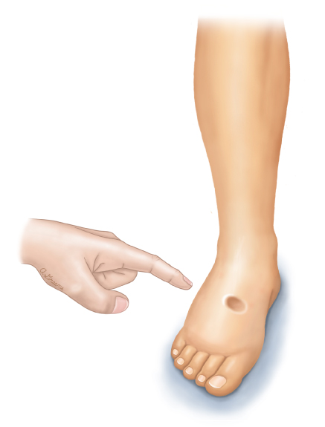
Edema
Excess fluid in the interstitial space
Usually gravity dependent
Where to look for?
Unilateral vs bilateral
If suggestive of cardiac cause of edema> check for JVP
Check for other symptoms of volume overload

Slide 41
Other symptoms of cardiac disease
Non-specific symptoms; weight loss, generalized weakness, fever, night sweats (infective endocarditis)
Symptoms of stroke, acute mesenteric ischemia, acute limb ischemia (patients with atria myxoma or infective vegetations)
Abdominal distension due to ascites, muscle wasting due to cardiac cachexia (advanced heart failure)

Slide 42
Past medical history
Ask about:
Detailed record for any previous cardiac disease, investigations, and interventions
Conditions associated with increased risk of vascular diseases
Rheumatic fever or heart murmur during childhood
Potential causes of bacteremia in patients with suspected infective endocarditis
Systemic disorders with cardiac manifestations

Slide 44
Premature CAD
In the patient
CAD < 55 years in female, < 45 years in male
In the family
First degree relative
CAD < 65 years in female, < 55 years in male

Slide 45
Drug history

Slide 46
Family history
Family history of premature coronary artery diseases (angina, interventions/surgery, sudden cardiac death)
First degree relative ( < 65 years in female, < 55 years in male)
Cardiac diseases with genetic components such as cardiomyopathies
Venous thrombosis due to inherited hemophilia's
Familial hypercholesterolemia

Slide 47
Social history
Smoking
Alcohol
Recreational drugs
Daily life activity and change of limitations
Eligibility for certain occupations

Slide 48
General examination

Slide 49
Ensure privacy, good light, explain what you are going to do and take permission
Wash hand, wear gloves
Exposure
Position

Slide 50
From right side of the patient
General:
Comment on patient position in bed
Level of consciousness
Looks well or ill
Breathless, cyanosed
Distressed, frightened

Slide 51
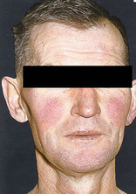
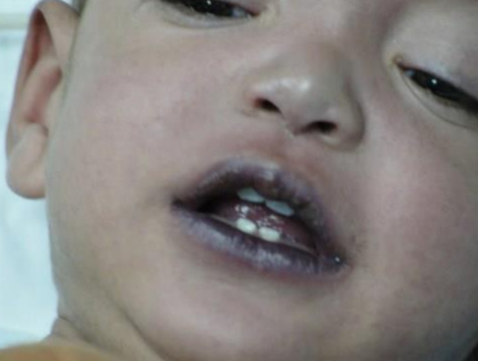
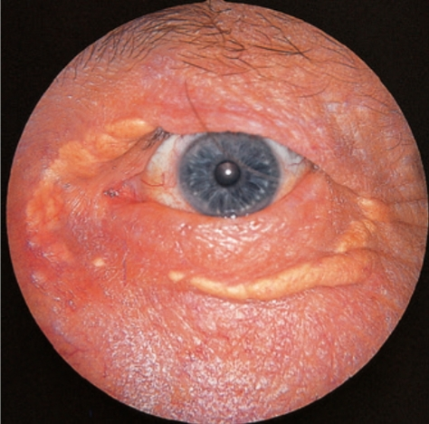
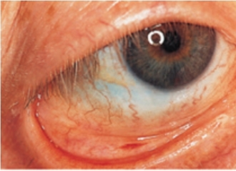
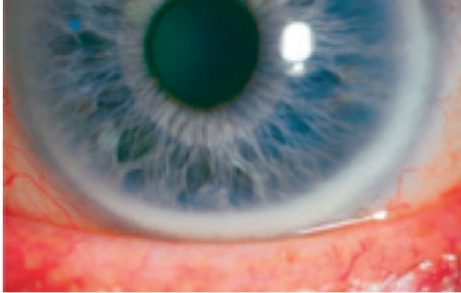
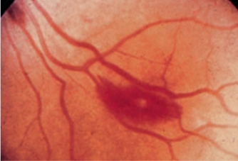
Face
Eyes
Xanthelasmata on eyelids
Conjunctival pallor and petechial hemorrhage
Corneal arcus on iris
Fundoscopy to view the fundus looking for DM or HTN changes, or Roth spots
Cheeks
Malar flush
Mouth
Cyanosis under the tongue or on the lips

Slide 52
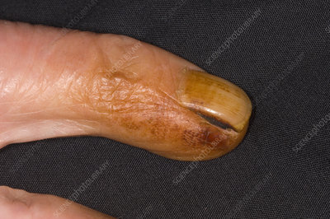
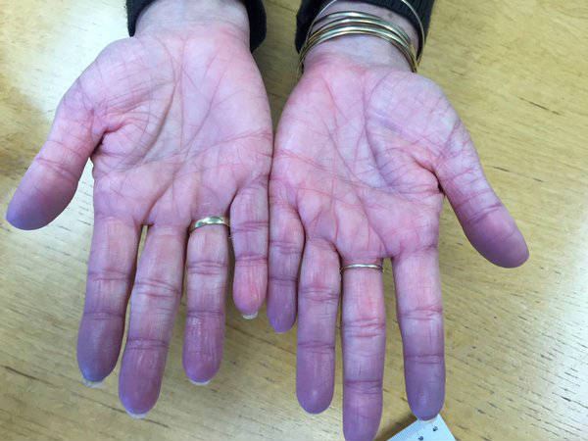
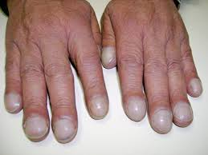
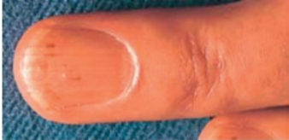
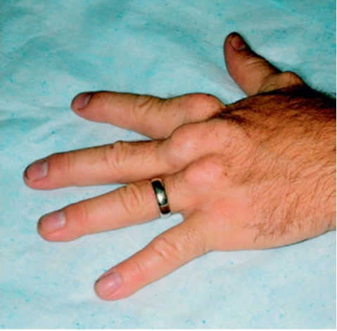
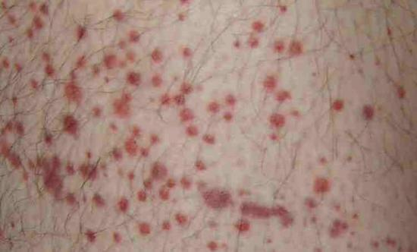
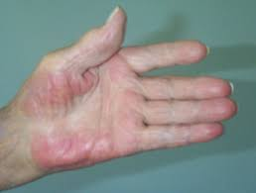
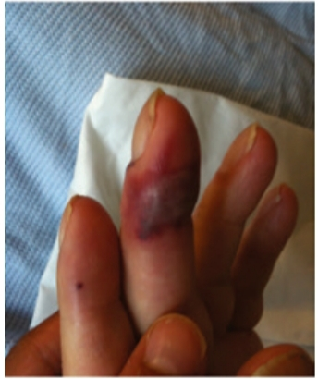
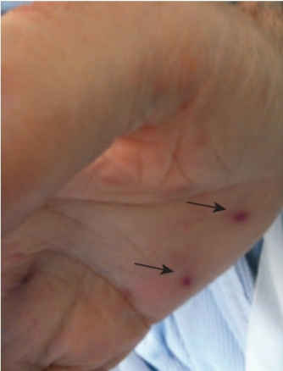
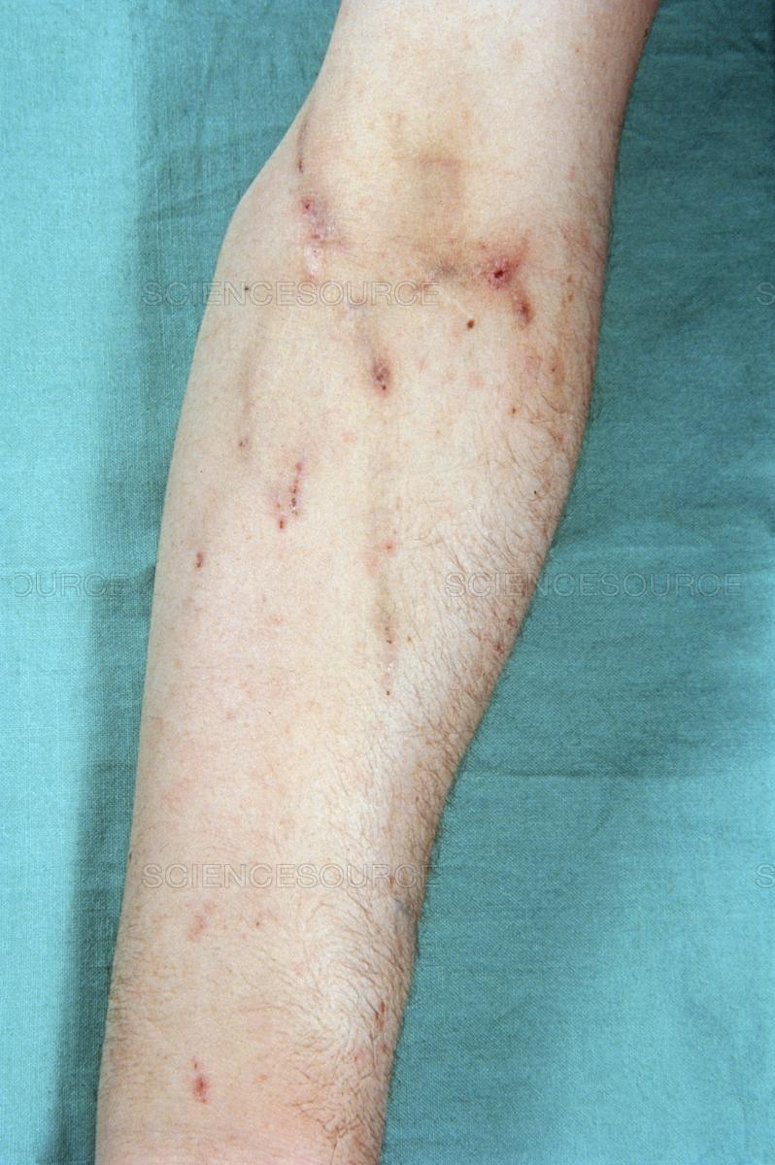
Hands
Inspection
- Nails: tobacco stain, cyanosis, clubbing, splinter hemorrhage
dorsum: tendon xanthoma, petechial rash
Palmar aspect: palmar erythema, Osler nodes, Janeway lesion
IV drug use site
Tremor

Slide 53
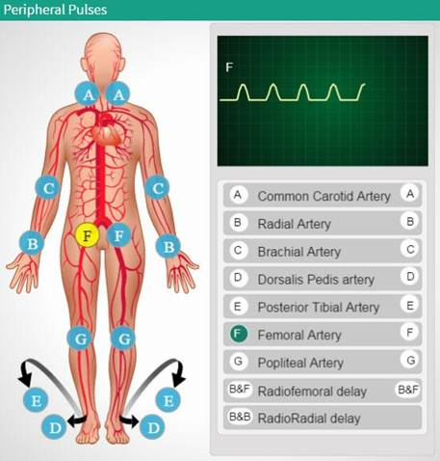
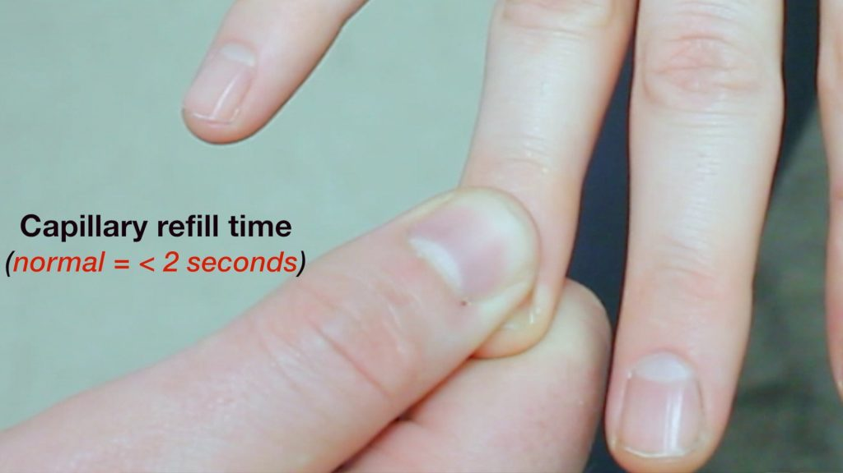
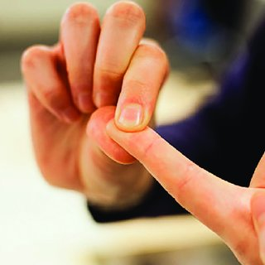
Palpation
Temperature
Wet/dry
Capillary refill
Pulses

Slide 54
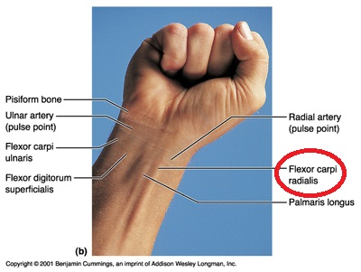
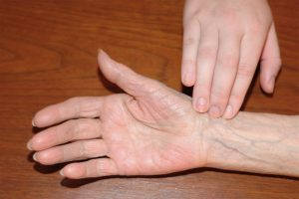
Arterial pulses
Radial pulse:
On the right wrist, locate flexor carpi radialis tendon
Feel just lateral to the tendon with the pads of 3 fingers
Count for 1 minute
Comment of rate, rhythm, volume character and compressibility
Feel both sides simultaneously for radio-radial delay
Feel radial artery and femoral artery simultaneously for radio-femoral delay
Check for collapsing pulse
Calculate pulse deficit

Slide 55
Collapsing pulse
Palpate the radial pulse
Ask the patient if he has shoulder or arm pain
Using base of the fingers, elevate the hand above the patient's head

Slide 56
Pulse deficit
Should have 2 examiners, one for palpation
and one for auscultation
If one examiner only; can palpate for 1 minute, auscultate for another 1 minute
Palpate the radial artery and calculate the rate over 1 minute
Auscultate over the heart apex and calculate the rate over 1 minute
The deficit between HR by auscultation and pulse rate by palpation should not exceed 10 bpm

Slide 57
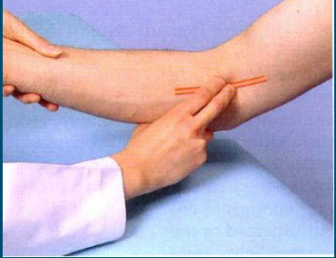
Brachial artery
Medial to biceps tendon in antecubital fossa by index and middle fingers
Comment of volume, character, and compressibility

Slide 58
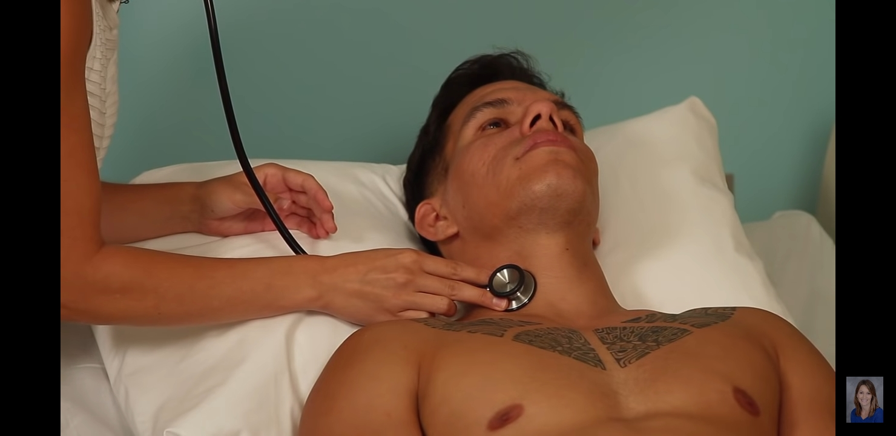
Carotid pulse
Explain what are you going to do.
Feel it between the larynx and anterior border of SCM muscle
Press gently by the thumb
DON’T FEEL BOTH SIDES SIMULTANOUSLY
AUSCULTATE FOR BRUIT ON BOTH SIDES WHILE HOLDING HIS BREATH

Slide 59
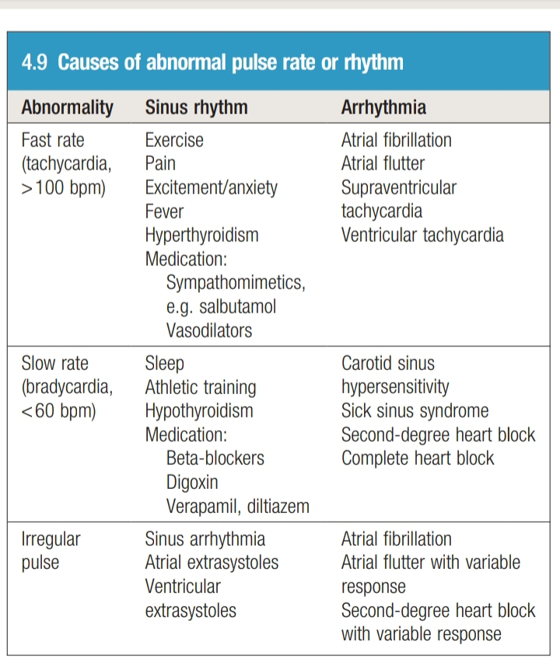
Rate
Normal heart rate 60-100 bpm
Tachycardia > 100 bpm
Bradycardia < 60 bpm

Slide 60
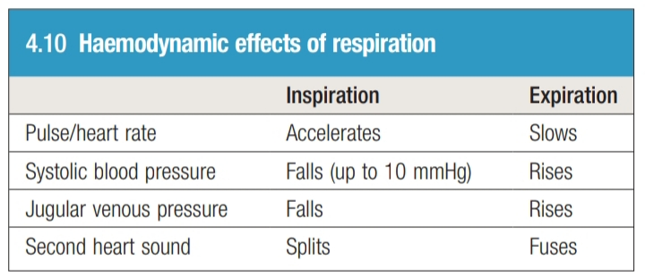
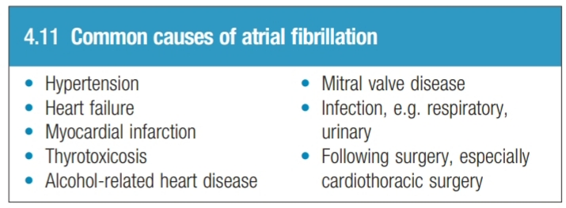
Rhythm
Normally should be regular with some physiological hemodynamic changes
Comment: regular, irregularly regular, irregularly irregular

Slide 61
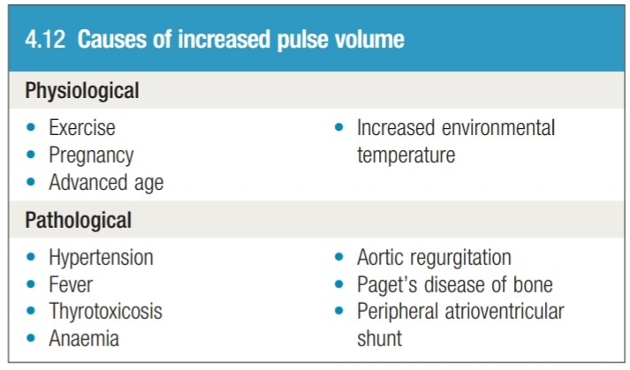
Volume
Stroke volume
Since ventricles fill during diastole, longer diastolic interval associated with increase stroke volume so increase in pulse volume on examination
Large pulse volume
Low pulse volume
Sever heart failure
Condition associated with inadequate ventricular filling (hypovolemia, cardiac tamponade, mitral stenosis)
Asymmetrical pulse volume
Peripheral artery disease
Aortic dissection
Coarctation of aorta

Slide 62
Character
Slow rising pulse
Collapsing pulse
Pulsus bisferiens
Pulsus alternans (volume rather than character)
Pulsus paradoxus

Slide 63
Slow rising pulse
Gradual upstroke with a reduced peak occurring late in systole
Severe aortic stenosis

Slide 64
Collapsing pulse
The peak of the pulse wave arrives early and is followed by rapid fall in pressure as blood flows back into LV, resulting in wide pulse pressure
Pulse pressure (systolic Bp- diastolic Bp > 80 mmHg)
Severe aortic regurgitation

Slide 65
Pulsus bisferiens
Increased pulse with a double systolic peak separated by distinct mid-systolic dip
Concomitant aortic stenosis and aortic regurgitation
HCOM

Slide 66
Pulsus alternans
Beat-to-beat variation in pulse volume with normal rhythm
Advanced heart failure

Slide 67
Pulsus paradoxus
Exaggeration of the normal variability of pulse volume with breathing
Pulse volume normally increase with expiration decreases during inspiration dur to intrathoracic pressure changes affecting venous return to the heart
This variability is exaggerated when ventricular diastolic filling is impeded by elevated intrapericardial pressure
cardiac tamponade, pericardial constriction, acute severe asthma

Slide 68
Blood pressure

Slide 69
Blood pressure is the measure of the pressure that the circulating blood exerts against arterial wall
Systolic pressure: maximal pressure that occur during systole
Diastolic pressure: the lowest value of pressure during diastolic filling, which is maintained at a lower level by elasticity and compliance of the vessel wall
Is measured by sphygmomanometer or invasively by intra-arterial catheter in ICU setting
Record the reading as systolic pressure/diastolic pressure with mmHg as the measurement unit, note of where and how it was recorded
e.g. 120/85 mmHg, left arm, sitting

Slide 70
Hypertension
Abnormal elevation of blood pressure from normal range
Many guidelines
SILENT KILLER
Essential hypertension: most cases, without identifiable cause
Secondary hypertension: rare
Whit coat Hypertension: elevated BP in healthcare setting, while normal away, use ambulatory measurement to diagnose it

Slide 72
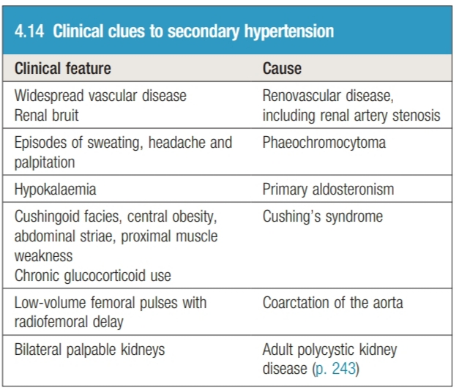
Approach to hypertension
Assess symptoms
Assess for potential cause
Assess for end-organ damage
Cardiac
Renal
Eye

Slide 73
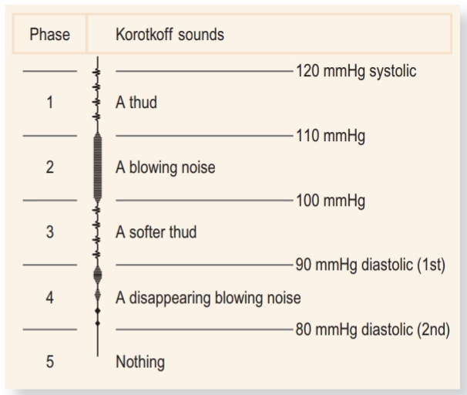
Korotkoff sounds
Snapping sound that is produced when the cuff pressure is between systolic and diastolic because the artery collapses completely and reopen with each heartbeat
First sound appearance (phase 1) indicate systole
When the sounds muffle and then disappear (phase 5) indicate diastole

Slide 74
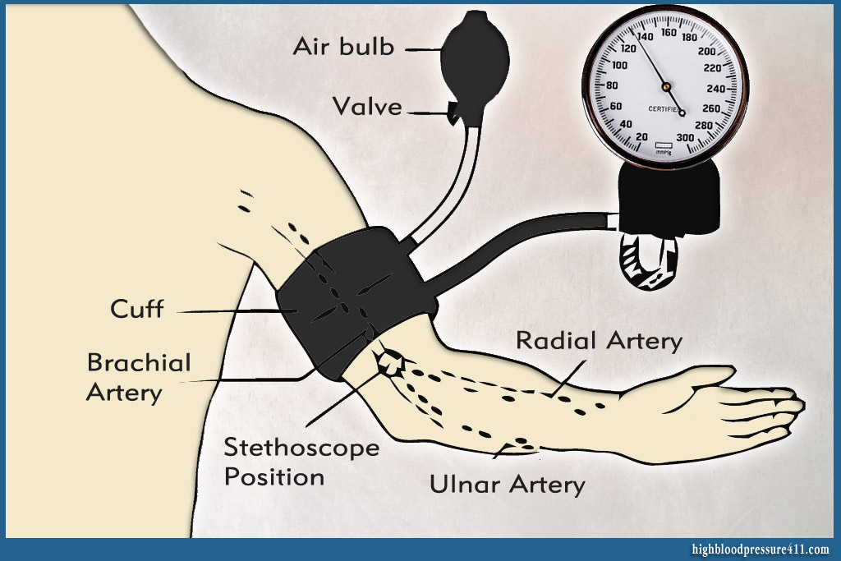
How to measure blood pressure?
Rest for 5 minutes
No tight clothing
Support the arm at the heart level
Proper cuff size
Apply the cuff to the upper arm, with the center of bladder over brachial artery
Palpate brachial artery
Inflate cuff until the pulse is impalpable around 30 mmHg above, put the diaphragm of stethoscope on brachial artery and deflate slowly
Measure in both arms

Slide 75
First sound to hear is systolic pressure
When the sounds completely disappear this is diastolic pressure
If the muffled sounds persist (phase 4) and do not disappear, use the point of muffling as diastolic pressure

Slide 76
Common BP measurement problems
Difference > 10 mmHg in each arm (suggest aortic or subclavian artery disease)
Wrong cuff size: the bladder should be 80% of the length and 40% of the width of upper arm
Auscultatory gap: 20% of elderly hypertensive patients, when Korotkoff sounds appear at systolic BP and disappear for an interval between systolic and diastolic pr. Avoid by palpating the systolic BP
Pt’s arm at the wrong level: elbow should be at the level of the heart
Postural change: check for postural hypotension
Atrial fibrillation: take average value

Slide 77
Jugular venous pressure

Slide 78
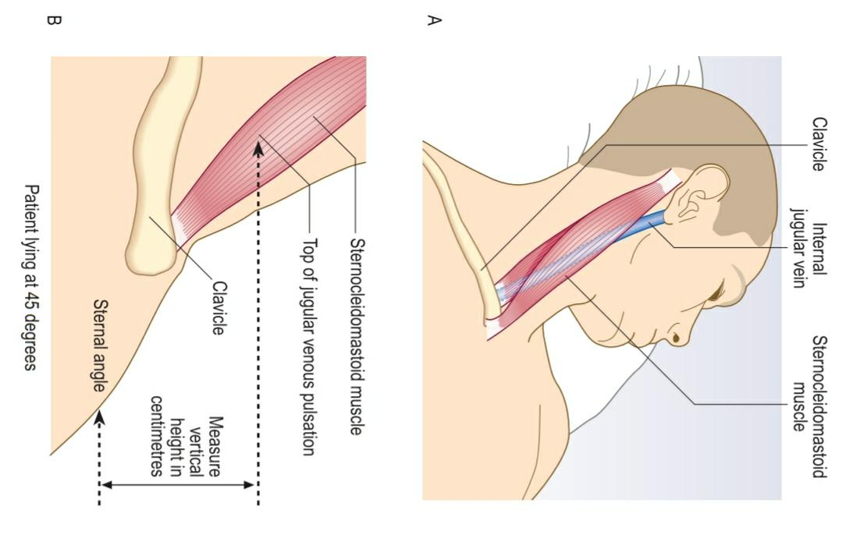
Jugular venous pressure and waveform
What does the JVP reflect?
Normally measures < 7 mmHg/ 9 cmH2O when the patient lies at 45 degrees
Internal jugular vein vs. External jugular vein?
How to differentiate between jugular and venous pulsation?

Slide 80
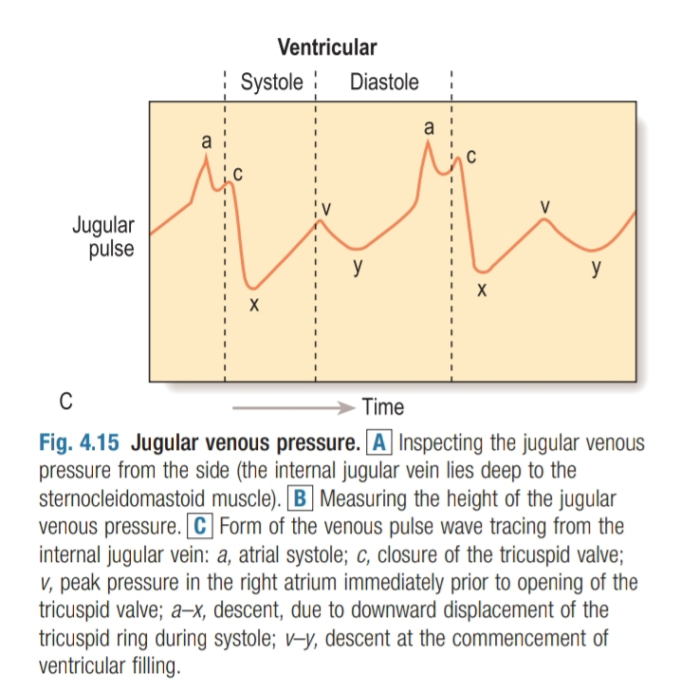

Slide 81
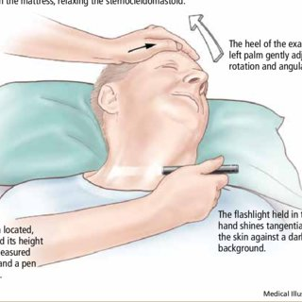
Jugular venous pressure examination
Be on the right side of the patient
Position the patient supine, reclined on 45 degrees, with pillow below the head and slightly turned to the left with adequate exposure
Use the light
Identify Jugular venous pulsation

Slide 82
1. Inspection
Diffuse inward movement
Two waves per pulse
2. Palpation
Impalpable
Compress at the root of the neck it will disappear with pressure

Slide 83
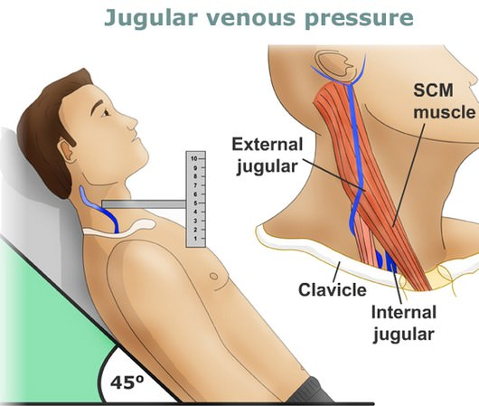
3. Special maneuvers
Varies with respiration (decreases with inspiration)
Ask patient to lie flat (increase with lying flat)
Abdominojugular reflux
4. Measure JVP height
Between tip of visible pulsation and the sternal angle
Unit: cmH2O

Slide 84
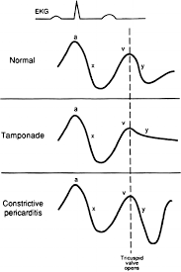
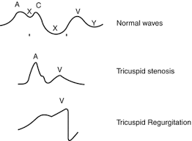

Slide 85
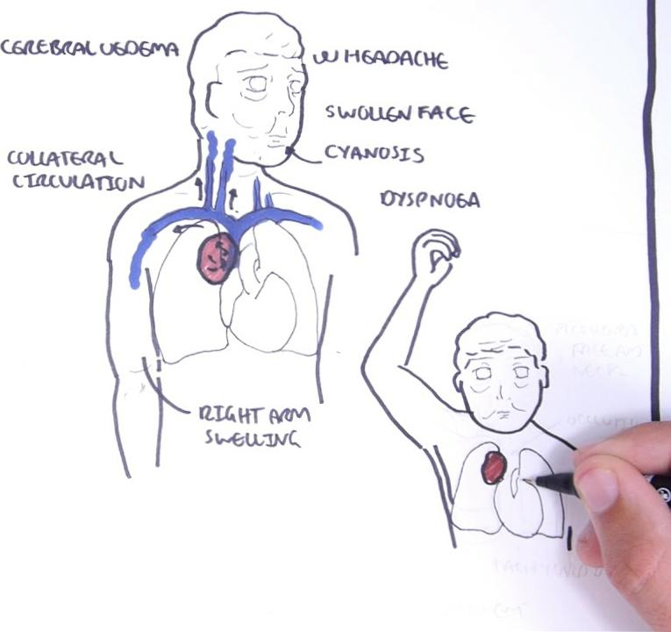
Superior vena cava obstruction
Non-pulsatile JVP elevation
Negative abdominojugular reflux
DOESN’T reflect right atrial pressure

Slide 86
Kussmaul’s sign
Paradoxical elevation of JVP with inspiration
Differential diagnosis:
Pericardial constriction
Severe right ventricular failure
Restrictive cardiomyopathy

